Slide 2
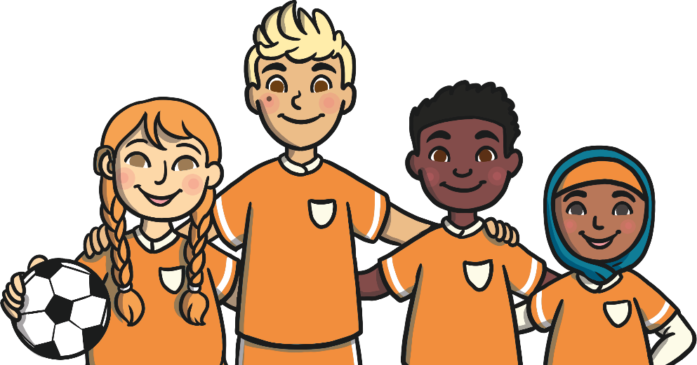
Introduction
Girls, women, boys and men are not always treated the same.
Sometimes they were seen as being less important than boys and men.
Although the lives of many women have improved, some girls and women are still treated unfairly.
International Women’s Day is a day to think about how we can make the world a fairer place for all people.

Slide 3
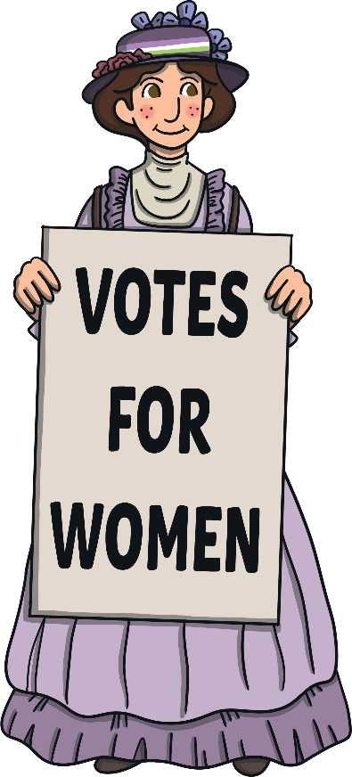
In the Past
In the past, women were not always allowed to:
choose whether to get married or not;
have a job or be paid fairly for it;
vote in elections;
go to school or university;
choose to not have children;
make important decisions about their lives or their families.

Slide 4
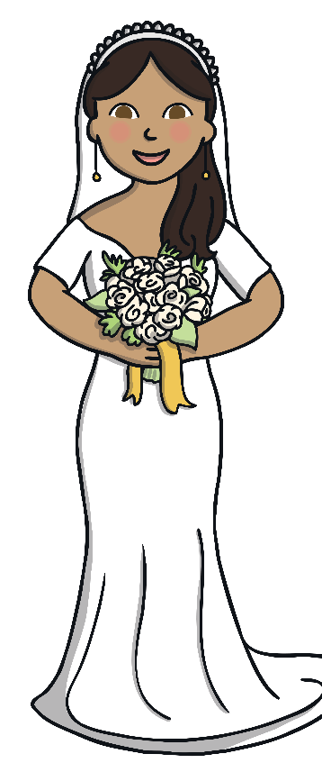
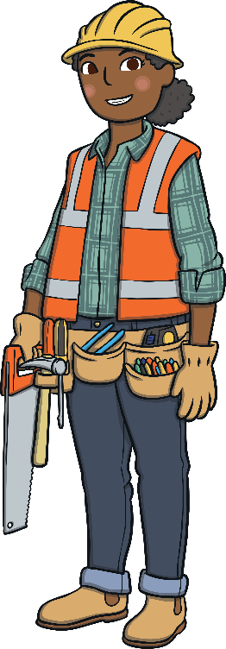
In the Past
Women were not able to work in certain jobs because they were seen as ‘men’s jobs’.
Many women were expected to get married at a young age and start a family.
Some cultures thought that girls were not as clever as boys.
Boys were seen as more valued than girls.

Slide 5
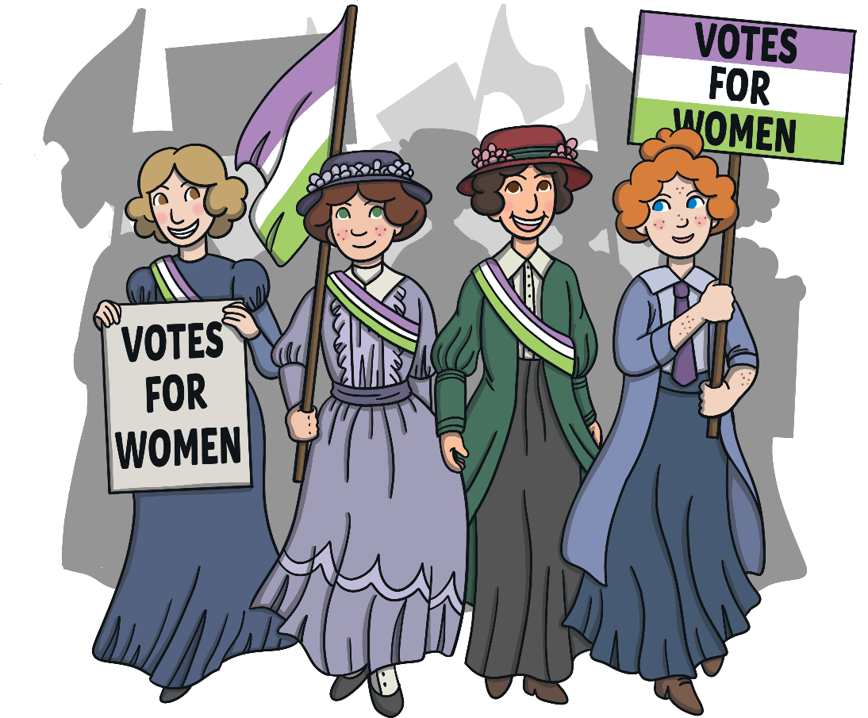
What Has Changed?
Many people have worked, or are still working, to make things better for women across the world.
During the Victorian era, the Suffragettes campaigned for women to have the right to vote in elections. As a result, in the UK in 1928, all women over age 21 were finally allowed to have a say in who governed their country.
Current role models for women’s equality include Alexandria Ocasio-Cortez and Malala Yousafzai.

Slide 6
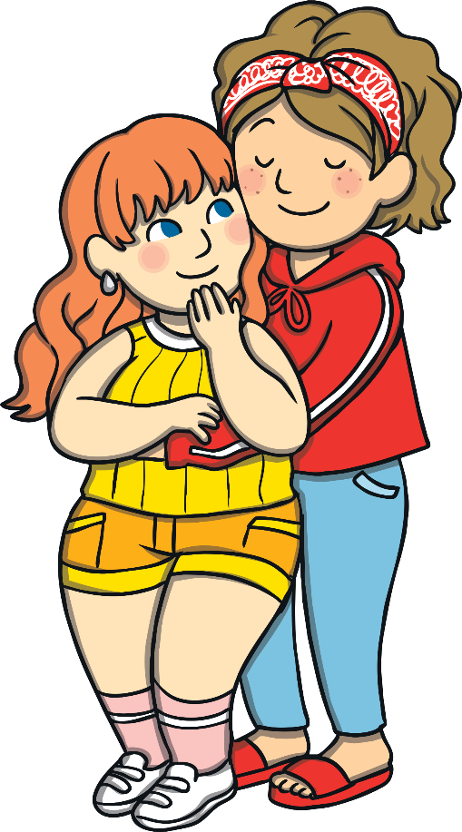
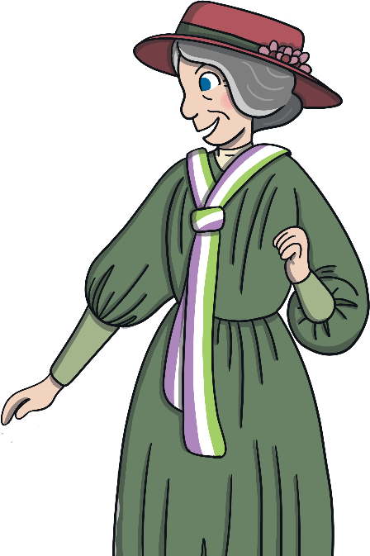
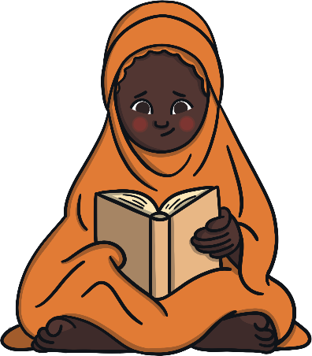
What Has Changed?
Women have the right to make their own decisions about their lives and family.
Women have the right to be educated.
Women work in every kind of job.
Women vote in elections.

Slide 7
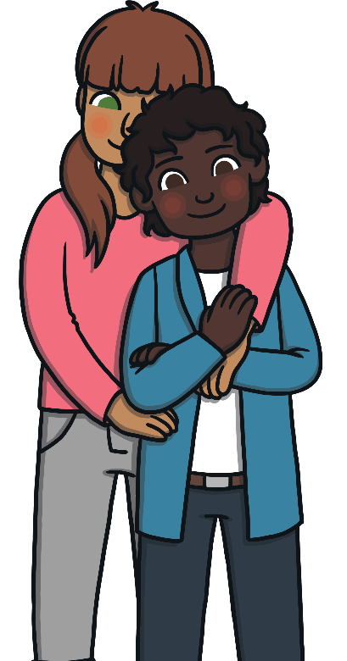
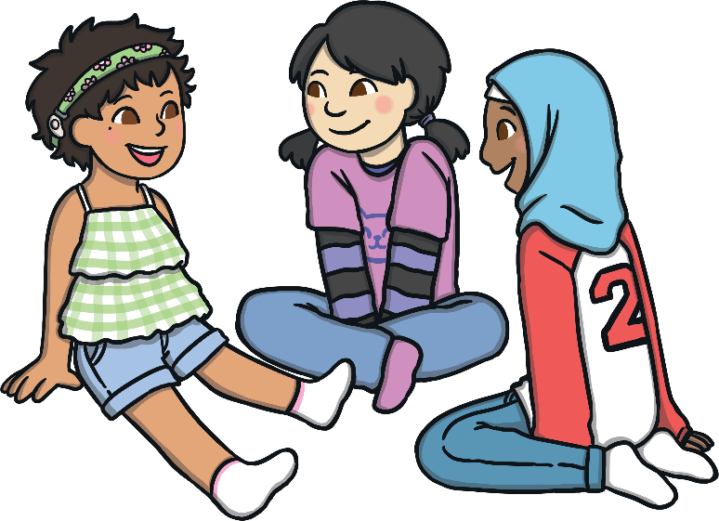
International Women’s Day
International Women’s Day is held every year on the 8th of March.
We remember those who have done or are doing incredible things to make life fairer for women.
Some women still need to fight for their opinions to be heard or to do what they want to do with their lives.
What could you do to make the world a more equal place for all people?

Slide 8
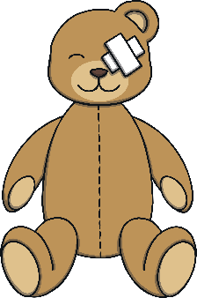
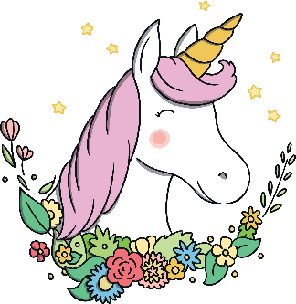
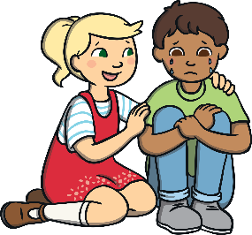
What Can We Do Now?
How can we make the world a fairer place?
Share your answers to these questions.
Does it matter if toys say ‘for boys’ or ‘for girls’?
Does it matter if girls like football or boys like unicorns?
Is it OK for boys to cry when they’re sad?
Is it OK for girls to carry chairs or books around school?

Slide 9
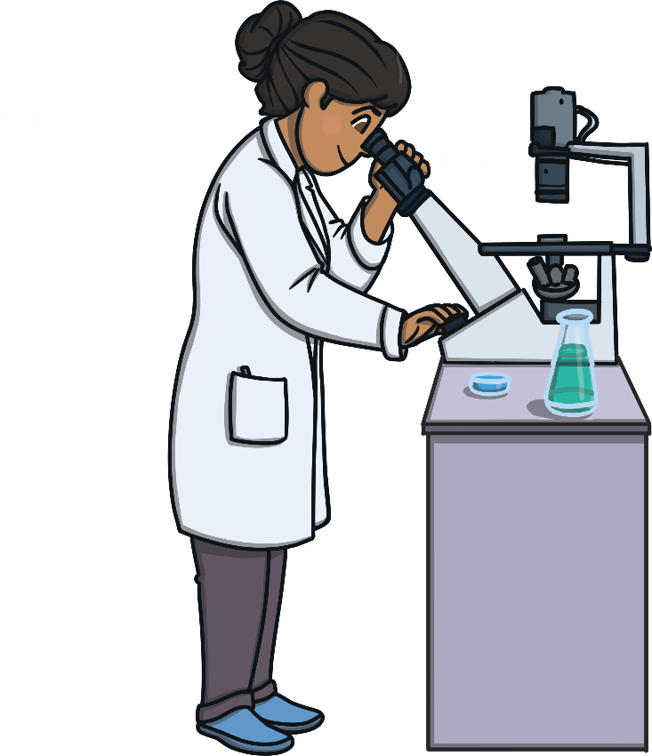
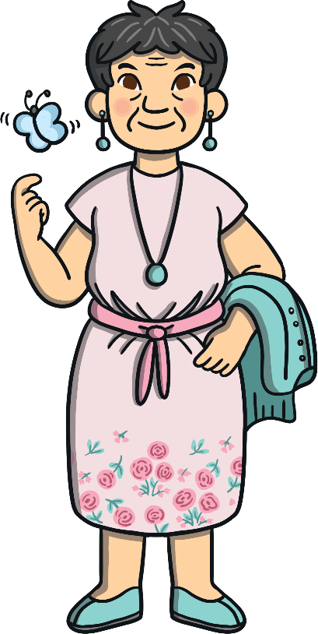
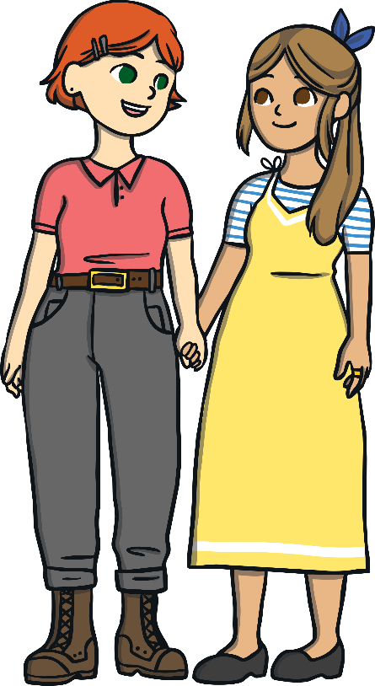
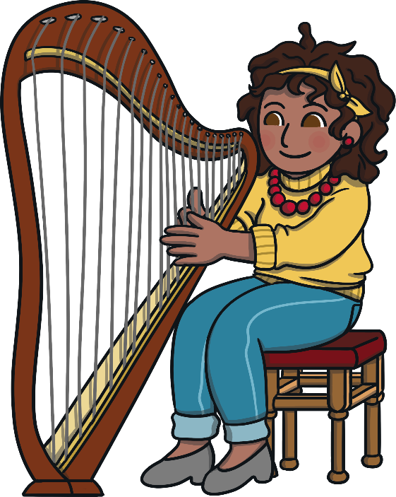
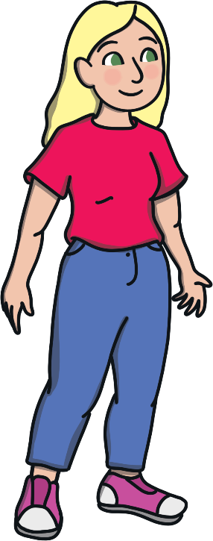
Finally…
All of us can work together to create a world where everyone is equal.
On 8th March, we celebrate women’s achievements and we challenge unfairness and inequality.

