Slide 1
Christmas Card Competition
2023
Thank you to all who entered. The Liturgical Leaders vote for the winning designs – here are the winning entries.

Slide 2
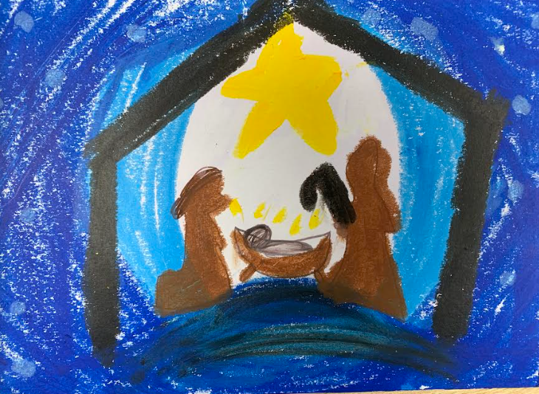
EYFS Winner
Hettie Nursery

Slide 3
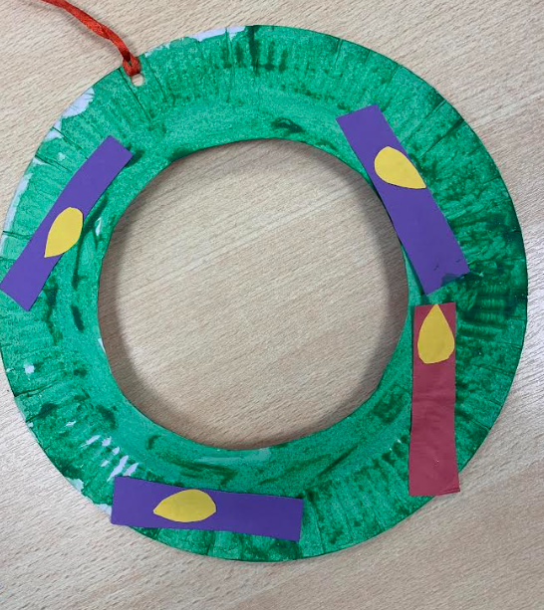
EYFS runner up
Ethan Nursery

Slide 4
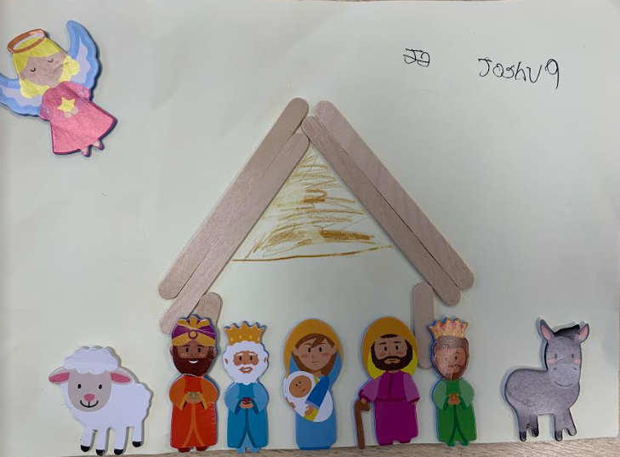
KS1 Winner
Josh G

Slide 5
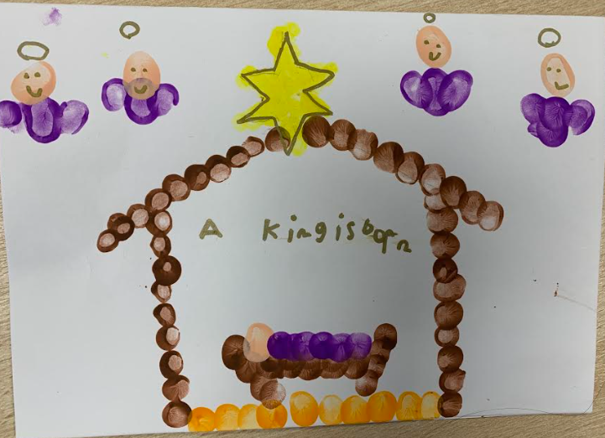
KS1 Runner up
Bibi-Rose

Slide 6
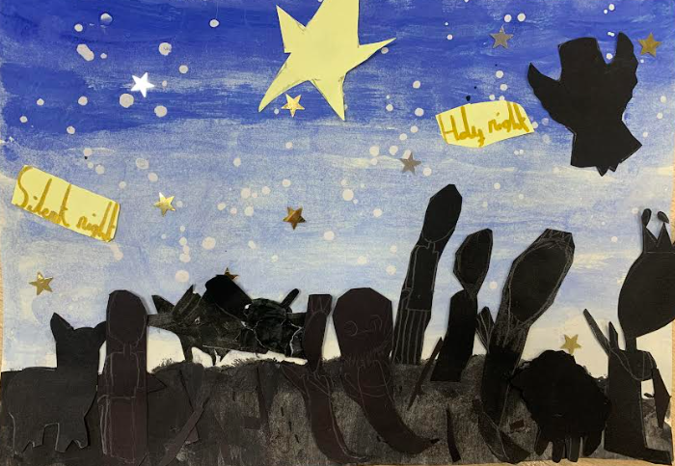
LKS2 Winner
Keira

Slide 7
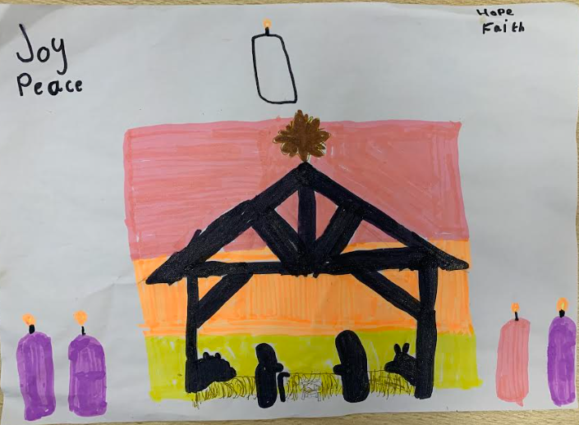
LKS2 runner up
Isla

Slide 8
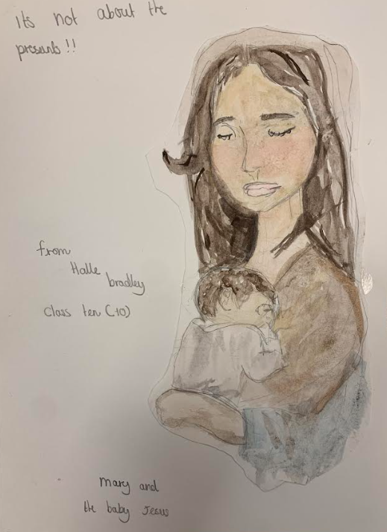
Overall winner to be made into school card
UKS2 Winner
Halle

Slide 9
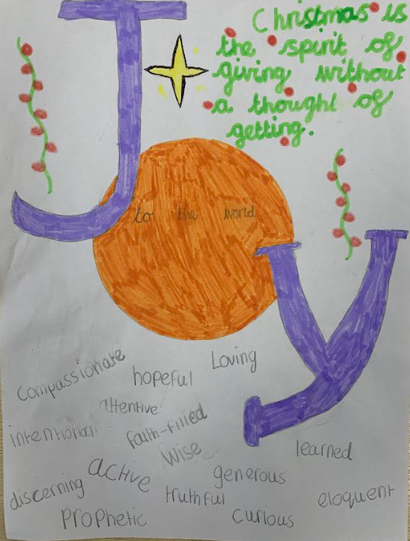
UKS2 Runner up
UNKNOWN

