Slide 2
Notes:
Introduce the assembly marking 100 years of Remembrance.
Ask children whether they know of any traditions linked to Remembrance such as:
Wearing a poppy
Attending a Remembrance service
Visiting a war memorial or cenotaph

Slide 3
Notes:
We remember the sacrifice of the Armed Forces from Britain and the Commonwealth, serving across the world. We pay tribute to the emergency services who also continue to put service before themselves and make sacrifices to ensure the safety of civilians. We acknowledge civilians who have lost their lives in conflict and acts of terrorism.

Slide 5
Notes:
These are three ways that people choose to mark Remembrance and there are lots of other ways too. Some people prefer to mark Remembrance on their own and others attend services or marches to be with other people.

Slide 6
Notes:
Why do you think this memorial is important?
Can you think of other examples of monuments or special places where people mark Remembrance? Have you been to any of these monuments?
For more examples of acts of Remembrance visit https://www.britishlegion.org.uk/about-us/our-centenary/telling-our-story/100-years-of-Remembrance

Slide 8
Notes:
Remembrance can be marked through ceremonies or events that take place on special days. These photos show:
In Australia and New Zealand Remembrance is marked on both Anzac Day - 25th April - and Remembrance Day on the 11th November.
In Barbados Remembrance is marked on the 11th November with special ceremonies (this is the same as the UK).
In the UK the Festival of Remembrance takes place in November with musical performances and stories of service and sacrifice.

Slide 9
Notes:
The red poppy is a sign of both Remembrance and hope for a peaceful future. Poppies are specifically a symbol of new life after conflict, as they were the first flowers to bloom in the battle-scarred fields of the Western Front of the First World War.
Whilst the red poppy is the UK’s only recognised and universal symbol of Remembrance, some people choose to use other symbols or poppies.
In India and Pakistan, the marigold is worn as an act of Remembrance, and in France, the cornflower (Bleuet de France) is a symbol of Remembrance.

Slide 10
Notes:
The National Memorial Arboretum in Staffordshire is a year-round space including almost 400 memorials dedicated to lives lived, and commemorating lives lost. Of the memorials pictured above, three are located at the NMA:
The Naval Service Memorial commemorates those who have served, serve today and will serve tomorrow regardless of rank, trade or fighting arm. The colours used represent the five oceans, and the shadow cast by the glass panels creates the shape of a ship.
The Association of Jewish Ex-Servicemen and Women Memorial is dedicated to all members of the Jewish community who have served and sacrificed.
The Football Remembers Memorial commemorates the temporary truce between forces along some parts of the Western Front during the First World War. Designed by 10 year old competition winner Spencer Turner, the memorial depicts the truce on Christmas Day 1914, when German and British forces laid down their weapons to play a game of football. You can find out more about Spencer and the memorial here: Prince William hails 'lasting memorial' to WW1 Christmas truce - BBC News
The cenotaph is a monument erected in honour of soldiers who could not return home. There are cenotaphs in towns and cities all across the UK.
Question: can pupils think of examples of local monuments of Remembrance?

Slide 11
Notes:
Question: What would you hear if you were in the places where these pictures were taken?
For example:
A bugle played at the Festival of Remembrance
Boots stamping in this military parade in Barbados
The Two Minute Silence

Slide 12
We now spend 2 minutes in silence…
Notes:
Ask children how they will mark Remembrance. It might be through one of the ways described in this assembly:
Attending a Remembrance service or event.
Wearing a poppy.
Visiting a special monument or memorial.
Singing a song or observing the Two Minute Silence.
Encourage children to think of ways to mark Remembrance that are special to them. For example, lighting a candle, planting a tree, writing a poem, talking to someone who has served in the military etc.

Slide 13
Then play…
https://www.youtube.com/watch?v=pv_ub7Be7oA

Slide 15
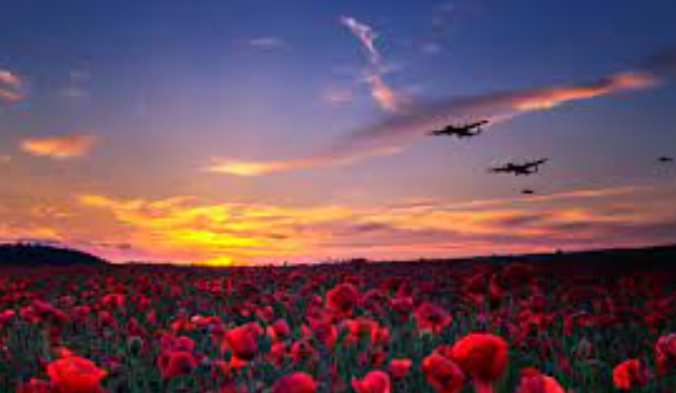
We say together:
Eternal rest,
Grant unto them O Lord. And let perpetual light shine upon them.
May they rest in peace, Amen.

