Slide 2
Notes:
Ask children if they can think of any symbols or traditions of Remembrance. Answers might include:
Cenotaph
Cenotaph march-past
The service for the Unknown Warrior
Wreaths
Two Minute Silence
Poppy
Crosses/war cemetery
Many of these symbols and traditions have remained the same over the last 100 years but new symbols and new ways of marking Remembrance continue to develop.
Define Remembrance as an opportunity to pause, reflect and remember those who have served others and made sacrifices for their country. In every act of Remembrance, we honour the memory of the fallen and pledge to care for the living. Although we have these well-known symbols and ceremonies, the act of Remembrance can look different for different people.

Slide 3
Notes:
We remember the sacrifice of the Armed Forces from Britain and the Commonwealth, serving across the world. We pay tribute to the emergency services who also continue to put service before themselves and make sacrifices to ensure the safety of civilians. We acknowledge civilians who have lost their lives in conflict and acts of terrorism.

Slide 5
Notes:
Answer: all of them!
The next slides feature case studies of each of these Remembrance acts. Some are public, some are private; some take place in the UK and some are in Commonwealth and other allied countries – we suggest you and your pupils choose two acts of Remembrance to look at in more detail.
Extension/challenge question: what are the similarities between these acts of Remembrance? What are the differences? For example, pupils might notice that some acts are public and some are more private; some take place throughout the year and some mark a special day.

Slide 6
Notes:
How has the British Sikh community’s attitude to war memorials changed? Why do you think this is?
Why do you think this memorial is important?
Can you think of other examples of monuments or special places where people mark Remembrance?
For more examples of acts of Remembrance visit https://www.britishlegion.org.uk/about-us/our-centenary/telling-our-story/100-years-of-Remembrance

Slide 7
Notes:
How has the British Sikh community’s attitude to war memorials changed? Why do you think this is?
Why do you think this memorial is important?
Can you think of other examples of monuments or special places where people mark Remembrance?
For more examples of acts of Remembrance visit https://www.britishlegion.org.uk/about-us/our-centenary/telling-our-story/100-years-of-Remembrance

Slide 8
Notes:
Read and listen to Laura’s poem on the Children’s Poetry Archive: https://childrens.poetryarchive.org/poem/we-remember/
You can also watch this video which explores Laura’s process of writing a poem of Remembrance: https://vimeo.com/465716963
Can the children think of any other examples of poems of Remembrance? Is Laura’s poem similar or different?
For more examples of acts of Remembrance visit https://www.britishlegion.org.uk/about-us/our-centenary/telling-our-story/100-years-of-Remembrance

Slide 9
https://childrens.poetryarchive.org/poem/we-remember/
Notes:
Read and listen to Laura’s poem on the Children’s Poetry Archive: https://childrens.poetryarchive.org/poem/we-remember/
You can also watch this video which explores Laura’s process of writing a poem of Remembrance: https://vimeo.com/465716963
Can the children think of any other examples of poems of Remembrance? Is Laura’s poem similar or different?
For more examples of acts of Remembrance visit https://www.britishlegion.org.uk/about-us/our-centenary/telling-our-story/100-years-of-Remembrance

Slide 10
Notes:
What was Bill’s act of Remembrance?
Why was it important to him?
How did his act of Remembrance change in 2020?
Extension/challenge question: what are the similarities between these acts of Remembrance? What are the differences? For example, pupils might notice that some acts are public and some are more private; some take place throughout the year and some mark a special day.
For more examples of acts of Remembrance visit https://www.britishlegion.org.uk/about-us/our-centenary/telling-our-story/100-years-of-Remembrance

Slide 11
Notes:
What was Bill’s act of Remembrance?
Why was it important to him?
How did his act of Remembrance change in 2020?
Extension/challenge question: what are the similarities between these acts of Remembrance? What are the differences? For example, pupils might notice that some acts are public and some are more private; some take place throughout the year and some mark a special day.
For more examples of acts of Remembrance visit https://www.britishlegion.org.uk/about-us/our-centenary/telling-our-story/100-years-of-Remembrance

Slide 12
Notes:
Question: Do you think these sounds are the same or different in countries around the world? Why do you think this?

Slide 13
Notes:
Watch the video produced by the Royal British Legion to promote the two-minute silence on 11th November.
Link: https://www.youtube.com/watch?v=HJIulcbrR0U
Questions:
What does the speaker mean by pause? What would ‘pausing’ look like for us?
What emotions is the speaker trying to share with the audience? What language is used to suggest this?
What does ‘empathise’ mean? Who does the speaker want us to empathise with? How can we empathise with people we might never have met?
How can reflecting on the sacrifice of others help us to remember?

Slide 14
Notes:
Explore with pupils these examples of informal Remembrance.
Questions:
What does the rainbow image symbolise and why do you think this is? – hope, possibility, positivity; bright, rain and sun mixing, only occasionally seen.
Can you remember what the poppy symbolises?
In Germany, people were encouraged to light a candle as an act of Remembrance. What can a candle symbolise?

Slide 15
Let us pray
As we enter our two minutes silence, we think of all those who have lost their lives in war, from past to present.
We thank them for their bravery.
We pray that they are at peace with God.
Please bow your heads and stand still for the 2 minutes silence. (Then play last post – get this ready so that adverts are missed)
The Last Post

Slide 16
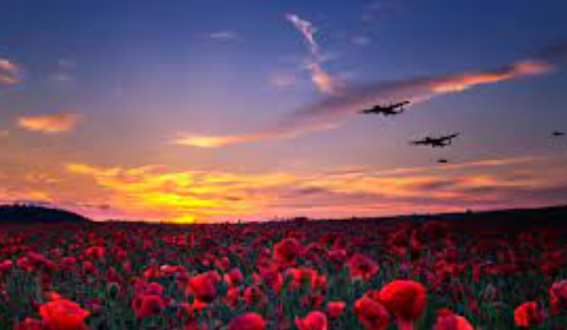
We say together:
Eternal rest,
Grant unto them O Lord. And let perpetual light shine upon them.
May they rest in peace, Amen.

