Slide 1
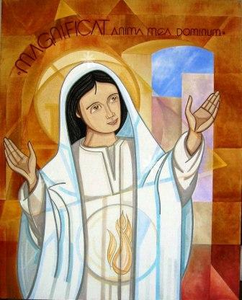
The Magnificat
My soul glorifies the Lord,
My spirit rejoices in God, my Saviour.
He looks on his servant in her loneliness;
henceforth all ages will call me blessed.
The Almighty works marvels for me.
Holy his name!
His mercy is from age to age,
on those who fear him.

Slide 2
He puts forth his arm in strength
and scatters the proud-hearted.
He casts the mighty from their thrones
and raises the lowly.
He fills the starving with good things,
sends the rich away empty.
He protects Israel, his servant,
remembering his mercy,
the mercy promised to our fathers,
to Abraham and his sons for ever. Amen.

