Slide 1
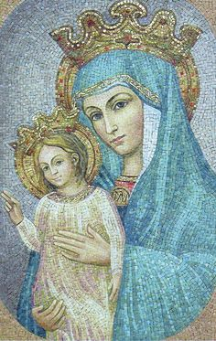
Regina Caeli
Queen of Heaven, rejoice. Alleluia!
For he whom you were made worthy to bear. Alleluia!
Has risen as he said. Alleluia!
Pray for us to our God. Alleluia!
Rejoice and be glad, O Virgin Mary. Alleluia!
For the Lord has risen indeed. Alleluia!
Let us pray;
God, who through the resurrection of your Son, our Lord Jesus Christ,
has made glad the whole world, grant us, we pray,
that through the intercession of the Virgin Mary, his mother,
we may attain the joys of everlasting life.
Through the same Christ our Lord.
Amen.

