Slide 1
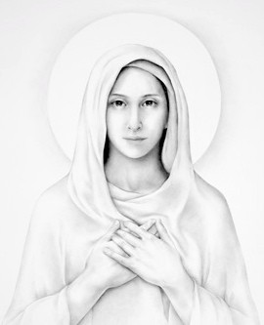
The Memorare
Remember, O most gracious Virgin Mary,
that never was it known
that anyone who fled to your protection,
implored your help or sought your intercession,
was left unaided.
Inspired with this confidence, I fly unto you,
O Virgin of virgins, my Mother.
To you I come, before you I stand,
sinful and sorrowful;
O Mother of the Word Incarnate,
despise not my petitions, but in your mercy
hear and answer me.
Amen.

