Slide 1
The Angelus
Prayed together on
The Solemnity of the Annunciation of the Lord
for the
Act of Consecration to the Immaculate Heart of Mary
Friday 25 March 2022

Slide 2
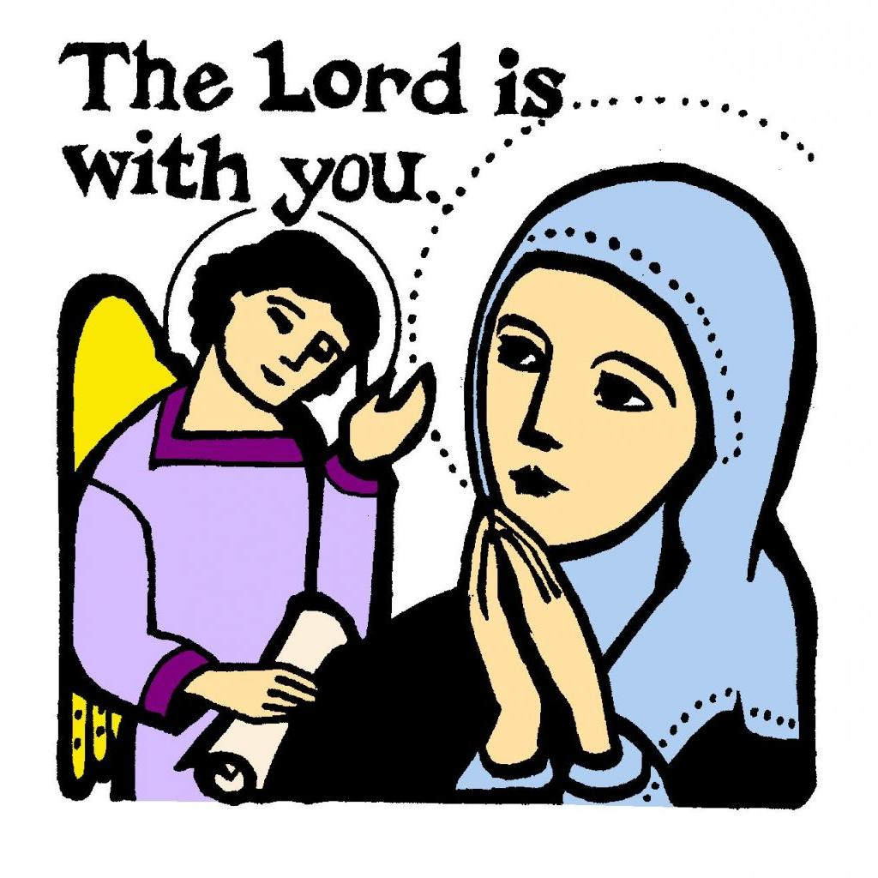
The Angelus
The Angel of the Lord declared to Mary: and she conceived of the Holy Spirit.
Hail Mary… Holy Mary…
Behold the handmaid of the Lord: be it done to me according to your word.
Hail Mary… Holy Mary…
And the Word was made flesh: and dwelt among us
Hail Mary… Holy Mary…
Pray for us, O holy Mother of God that we may be made worthy of the promises of Christ.

Slide 3
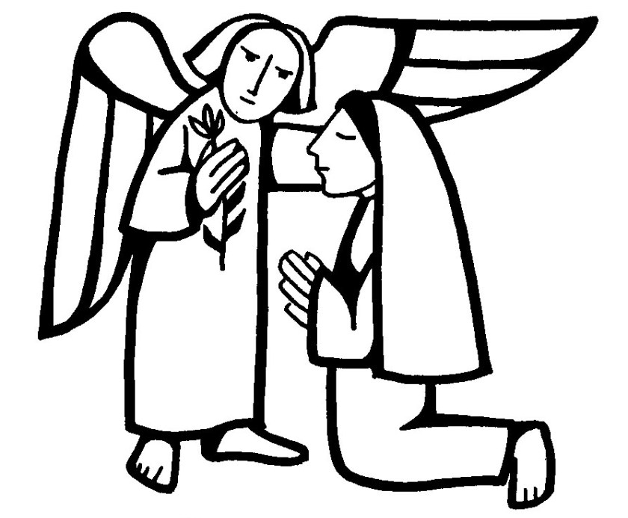
Let us pray:
Pour forth, we beseech you, O Lord,
your grace into our hearts,
that we to whom the incarnation of Christ, your Son,
was made known by the message of an angel,
may be brought by his passion and cross
to the glory of his resurrection,
through Christ our Lord. Amen.

