Slide 1
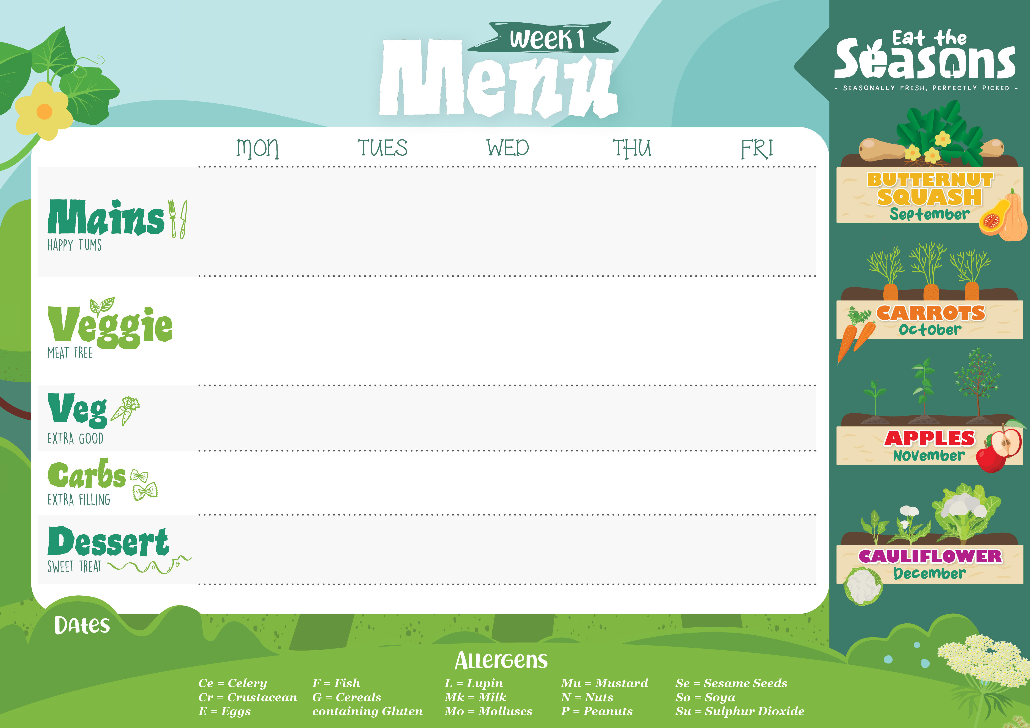
Gluten Free Sausage with Gravy | Gluten Free Beef Bolognaise | Roast Gammon served with Gravy | Gluten Free and Dairy Free Cheese and Tomato Pizza | Gluten Free Jumbo Fish Finger
Steamed Broccoli Carrots | Mixed Summer Salad | Tender baby Carrots Green Beans | Sweetcorn | Garden Peas Baked Beans
Creamy Mashed Potato |  | Roast New Potatoes | Crispy Potato Wedges | Oven Baked Chips
Free from Chocolate Mousse | Free from Chocolate Cake | Jelly | Free from Vanilla Cookie | Free from Crumble and Cream
Jacket Potatoes, salad bar, cold desserts and fresh fruit available daily.
Insert dates here

Slide 2

Sweet and Sour Chicken | Beef chilli with Vegetables | Gluten Free Baked Sausages with Gravy | Gluten Free Pasta Bake | Beetroot and Chick Pea Falafel
Broccoli | Spring Greens | Roasted Carrots Green Beans | Chef’s Salad | Garden Peas Baked Beans
Rice Noodles | White Rice | Mashed Potatoes |  | Oven Baked Chips
Free from Chocolate Cookie | Free from Lemon Cake | Jelly | Free from Pineapple Cake | Free from Strawberry Mousse
Jacket Potatoes, salad bar, cold desserts and fresh fruit available daily.
Insert dates here

Slide 3

Gluten Free Sausage Roll with Gravy | Chicken and Tomato Bake | Roast Pork with Gravy | Free from Carbonara | Gluten Free Fish Fingers
Steamed Green Beans Parsley Carrots | Mixed Salad | Steamed Carrots Savoy Cabbage with Leeks | Steamed Broccoli Summer Salad | Garden Peas Baked Beans
Mash Potato | Baked Potato Wedges | Roasted Potatoes |  | Oven Baked Chips
Free From Lemon Drizzle Cake | Gluten Free Vanilla Cake | Jelly | Free from Chocolate Mousse | Free from Ice Cream
Jacket Potatoes, salad bar, cold desserts and fresh fruit available daily.
Insert dates here

Slide 4

Chicken baked in a homemade BBQ Sauce | Free From Slow Cooked Beef Lasagne | Roast Turkey Breast with Gravy | Mild Chicken Curry with Peppers and Spinach | Gluten Free Fish Fingers with Lemon Wedges
Sweetcorn Carrots | Chef’s Salad Green Beans | Green Beans Roast Parsnips | Sauteed Courgette Steamed Carrots | Garden Peas Baked Beans
Potato Wedges |  | Roasted New Potatoes | White Rice | Oven Baked Chips
Free from Vanilla and Apple Cake | Free from Apple Crumble with Cream | Jelly | Free from Chocolate Mousse | Free from Chocolate Cookie
Jacket Potatoes, salad bar, cold desserts and fresh fruit available daily.
Insert dates here

