Slide 1
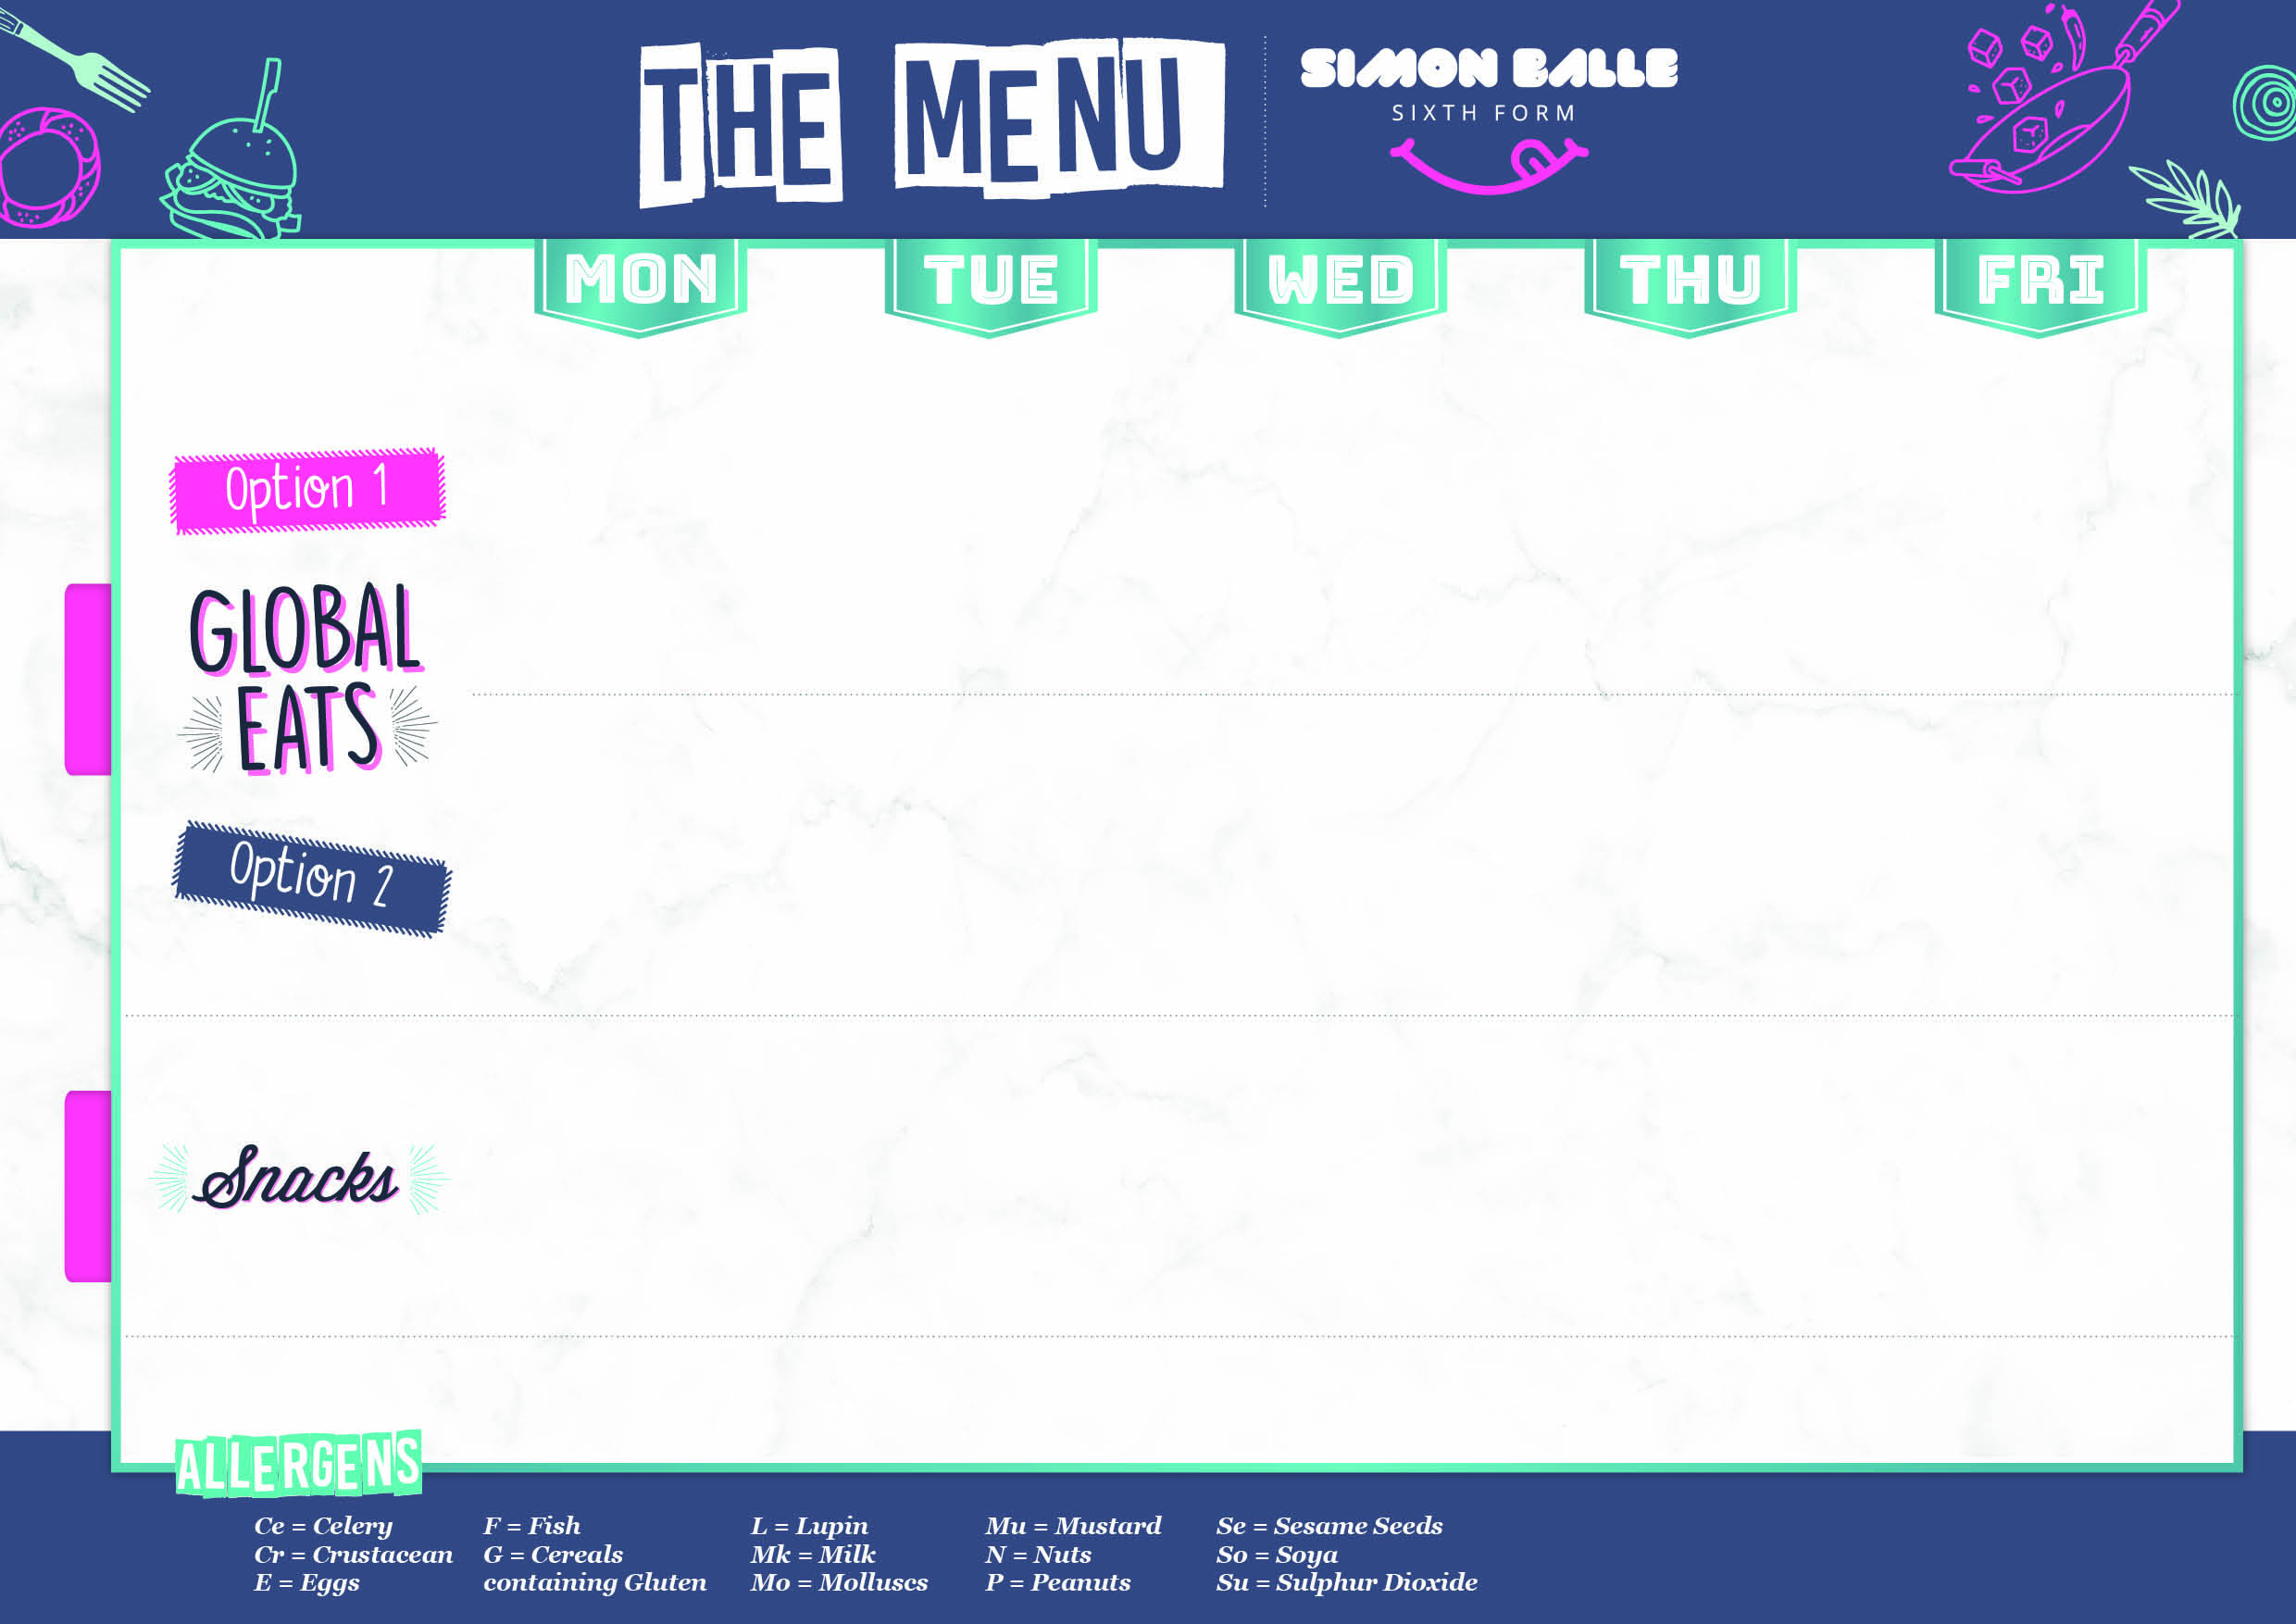
Kung Pao Chicken with Stir Fry Vegetables and Noodles £3.40 | Quarter Pounder Cheese Burger with Coleslaw £3.40 | Chicken Curry Pocket with Indian Rice, Slaw and Mango Chutney £3.40 | Giant Yorkshire Pork sausage, Roast Potatoes, Peas and Gravy £3.65 | Flamin Fish Burger £3.40
Vegetable Spring rolls with Stir Fry Vegetables and Noodles £3.40 | Spicy Bean Burger with Coleslaw £3.40 | Vegetable Curry Pocket with Indian Rice, Slaw and Mango Chutney £3.40 | Giant Yorkshire Veggie sausage, Roast Potatoes, Peas and Gravy £3.65 | Falafel Wrap £3.40
Jacket Potato with Baked Beans and Cheese £2.50 | Macaroni Cheese Pot £2.65 | Nacho’s Basket With Salsa, Sour Cream, Cheese and Jalapeno’s £2.50 | Tomato and Basil Pasta Pot with Garlic Bread £2.65 | Dirty Fries Cheese and Bacon or BBQ sauce and Garlic Mayo £2.25
^{from £3.00}
^{from £2.00}

Slide 2
Chinese Chicken with Noodles £3.40 | Jerk Chicken with Mexican Rice and Slaw £3.55 | Buttermilk Chicken Burger £3.40 | Pizza Pot 6” Pizza, wings and Potato Wedges £3.65 | Beef Chilli Con Carne with Rice and Nacho’s with Salsa £3.40
Vegetable Gyoza with Stir Fry Noodles £3.40 | Cauliflower Curry with Rice and naan Bread £3.40 | Spicy Bean Burger £3.40 | Pizza Pot 6” Pizza, wings and Potato Wedges £3.65 | Vegetable Chilli with Rice and Nacho’s with Salsa £3.40
Cut ‘n’ Crush Cheese and Spring Onion Stuffed jacket potato £2.50 | Nacho’s Basket with Cheese, Salsa, Sour Cream and Jalapeno £2.55 | Macaroni Cheese Pot With Garlic bread £2.65 | Jacket Potato with Baked Beans and Cheese £2.50 | Tomato and Basil Pasta Pot with Garlic Bread £2.65
^{from £3.00}
^{from £2.00}

Slide 3
Katsu Chicken Curry with Egg fried Rice £3.40 | Mediterranean Chicken Pocket with Greek Salad £3.40 | Chicken Tikka Skewer in Folded Naan with Rice and Yoghurt and Mint Sauce £3.40 | Green Thai Chicken with Noodles and Prawn Crackers £3.40 | BBQ Pulled Pork Bap with Salad £3.40
Vegetable Spring Roll with Egg Fried Rice and Sweet Chilli Sauce £3.40 | Falafel with Hummus and Greek Salad Pocket £3.40 | Onion Bhajis Folded Naan with Rice and Yoghurt and Mint Sauce £3.40 | Vegetable Gyoza with Noodles and Prawn Crackers £3.40 | Macaroni Cheese Bake with Garlic Bread £2.65
Jacket Potato with Baked beans and Cheese £2.50 | Nacho’s Basket with Sour Cream, Salsa, Jalapeno and Grated Cheese £2.50 | Vegetable Burrito Wrap £2.50 | Tomato and Pesto Pasta Pot with Garlic Bread £2.65 | Dirty Fries With Cheese and bacon or Spicy Mayo and Sweet Chilli Sauce £2.25
^{from £3.00}
^{from £2.00}

Slide 4
Chipotle Chicken Soft Taco £3.40 | Pizza Box 6” Pizza, wings and Potato Wedges £3.75 | Moroccan Chicken with Cous Cous, Moroccan Salad and a Yoghurt and Mint Sauce £3.40 | Giant Yorkshire With Roast gammon, Roast Potatoes, Peas and Gravy £3.65 | Cheese Beef Quarter Pounder Burger with BBQ Sauce and Coleslaw £3.40
Roasted Tomato Gnocchi with Garlic Bread £3.40 | Pizza Box 6” Pizza, wings and Potato Wedges £3.75 | Falafel with Cous Cous with Moroccan Salad and a Yoghurt and Mint Sauce £3.40 | BBQ Veggie Sausages with Roast Potatoes, Peas and Gravy £3.40 | Vegetable Burger with Coleslaw £3.40
Jacket Potato with Baked beans and Cheese £2.50 | Nacho’s Basket with Sour Cream, Cheese, Salsa and Jalapeno £2.50 | Cut ‘n’ Crush Cheese and Spring Onion Stuffed jacket Potatoes £2.50 | Tomato and Basil Pasta Pot with Garlic Bread £2.65 | Dirty Fries Cheese and Bacon or BBQ sauce and Garlic Mayo £2.25
^{from £3.00}
^{from £2.00}

