Slide 1
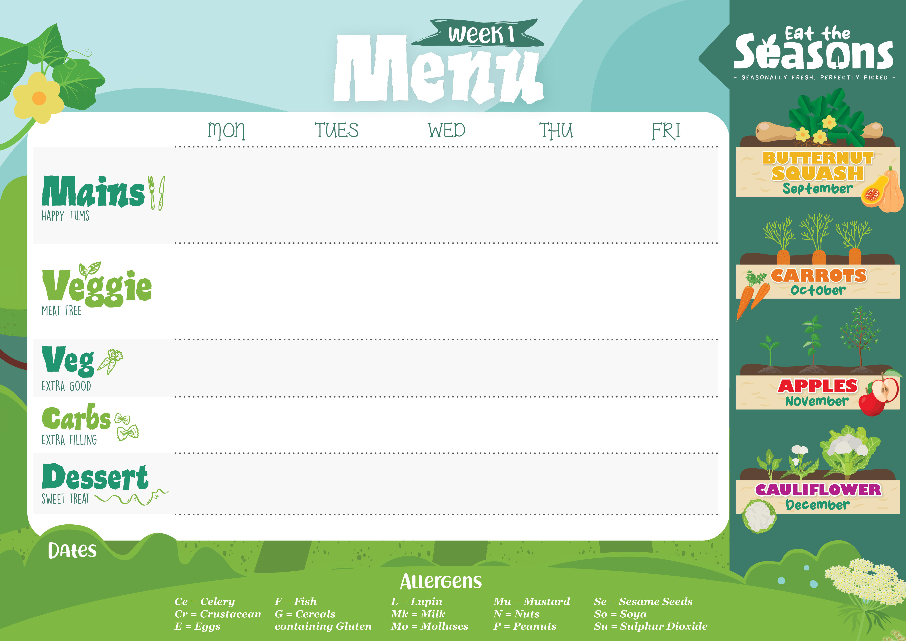
Cumberland Sausage with Gravy (G,Su) | Penne Beef Bolognaise (G) | Roast Gammon served with Gravy | Pepperoni Focaccia Pizza (G,E,Mk) | Battered Pollock with Tartar Sauce (G,F,Su,E)
Vegetarian Sausage with Gravy (G,Ce) | Veggie Mince Spaghetti Bolognaise (G,So) | Vegetarian Wellington served with Gravy (G,E) | Focaccia Pizza with Mozzarella and Basil (G,E,Mk) | Veggie Burger in a soft Bun (G,Se,E)
Steamed Broccoli Carrots | Mixed Summer Salad | Tender baby Carrots Green Beans | Sweetcorn | Garden Peas Baked Beans
Creamy Mashed Potato |  | Roast New Potatoes | Crispy Potato Wedges | Oven Baked Chips
Eve’s Pudding with Custard (G,E,Mk,So) | Choc Chip Oat Cookie (G,E,Mk,So) | Fruity Vegetarian Jelly | Ginger Cake (E,G) | Ice Cream with Strawberry Jam Sauce (Mk)
Jacket Potatoes, salad bar, cold desserts and fresh fruit available daily.
Insert dates here

Slide 2

Sweet and Sour Chicken Stir Fry (G,So) | Savoury Beef Chilli with Vegetables (Ce) | Baked Sausages with Gravy | Chicken and Macaroni Pasta Bake topped with Mozzarella (G,So,Mk) | Baked Fish Fingers with Lemon Wedges (G,F)
Sweet and Sour Veggie Stir Fry (G,So) | Veggie Mince Casserole with Root Vegetables (So,Ce) | Vegetarian Sausage with Gravy (G,So,E) | Courgette, Spinach and Cheddar Pasta Bake (G,Mk) | Vegetable Finger (G)
Broccoli | Spring Greens | Roasted Carrots Green Beans | Chef’s Salad | Garden Peas Baked Beans
Egg Noodles (G,E) | White Rice | Mashed Potatoes |  | Oven Baked Chips
Raspberry Jam Sponge pudding with Custard (Mk,E,G,So) | Raisin and Banana Cookie (G,E) | Fruity Vegetarian Jelly | Italian Pineapple Sponge Cake (G,E,Mk) | Lemon and Blueberry Blondie (G,E,Mk,So)
Jacket Potatoes, salad bar, cold desserts and fresh fruit available daily.
Insert dates here

Slide 3

Signature Sausage Roll with Gravy (G,E,Su) | Chicken Enchilada with a Tomato Sauce (G,Mu,Mk) | Roast Pork with Gravy | Penne Carbonara (G,Mk) | Battered Pollock, Lemons & Tartare Sauce (G,Su,F,E)
Vegetable Sausage with Gravy (G,Ce) | Vegetable Enchilada with Tomato and Cheese (G,Mu,Mk) | Roast Vegetable and Bean Crumble (G,Mk,Mu) | Penne Mushroom Carbonara (G,Mk) | Mixed Bean and Vegetable Burrito (G,Mk,Mu)
Steamed Green Beans Parsley Carrots | Coleslaw (E) | Steamed Carrots Savoy Cabbage with Leeks | Steamed Broccoli Summer Salad | Garden Peas Baked Beans
Mash Potato | Baked Potato Wedges | Roasted Potatoes |  | Oven Baked Chips
Lemon Drizzle Cake (G,E) | Cornflake Cake (G,Mk) | Fruity Vegetarian Jelly | Chocolate Chip Banana Tea Bread (G,E,Mk,So) | Ice Cream (Mk)
Jacket Potatoes, salad bar, cold desserts and fresh fruit available daily.
Insert dates here

Slide 4

Chicken baked in a homemade BBQ Sauce (Ce,G,Su,So) | Slow Cooked Beef Lasagne (G,Mk,E) | Roast Turkey Breast with Gravy and Cranberry Sauce | Mild Chicken Curry with Peppers and Spinach | Baked Fish Fingers with Lemon Wedges (G,F)
BBQ Quorn and Vegetable Wrap (G,E,Mk,Mu) | Veggie Mince Lasagne (So,G,Mk,E) | Butternut Squash, Leek and Onion Wellington (G,E,Mk) | Mild Vegetable Curry | Vegetable Finger (G)
Sweetcorn Carrots | Chef’s Salad Green Beans | Green Beans Roast Parsnips | Sauteed Courgette Steamed Carrots | Garden Peas Baked Beans
Potato Wedges |  | Roasted New Potatoes | White Rice | Oven Baked Chips
Strawberry Fool (Mk) | Oaty Apple Crumble with Custard (G,Mk,So,E) | Fruity Vegetarian Jelly | Flapjack (G) | Chocolate Brownie (G,E)
Jacket Potatoes, salad bar, cold desserts and fresh fruit available daily.
Insert dates here

