Slide 1
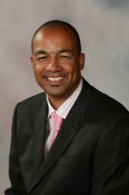
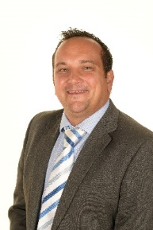
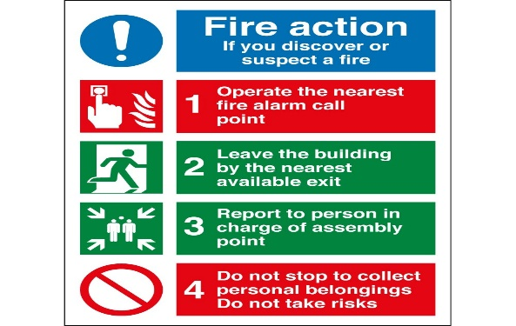
OUR COMMITMENT TO SAFEGUARDING
REPORTING CONTACT DETAILS
At Simon Balle All-through the safety and wellbeing of our students is paramount.
All adults visiting Simon Balle All-through have a part to play in keeping our students safe.
It is also important that visitors keep themselves safe.
At Simon Balle All-through we promote safe working practices for everyone in the school community, whatever their role or reason to be here.
Do
Sign in at school Reception on arrival.
Wear your visitor badge at all times.
Be aware that verbal interaction with students could be interpreted as inappropriate even if it was not your intention.
Be aware that contact with Simon Balle All-through students outside school ground may be considered inappropriate.
Report ANY occasion when a student instigates communication via social media or in person.
Report any unacceptable behaviour to a member of staff as soon as possible.
Do Not
Initiate any verbal or physical contact with a student unless it is appropriate and part of an agreed reason for your visit.
Give any personal information or details to any student e.g. your name, address, telephone number, email or any social media account details.
Accept or respond to students attempting to share personal details with you.
Put yourself in a situation of vulnerability i.e. unsupervised one-one with a student unless it is agreed as necessary to your visit.
Instigate or respond to communication with students using any form of social media.
Use any recording device (including mobile phones) to take images within school except with the express prior permission from the Designated Safeguarding Lead.
Respond to verbal or physical contact from students. If this occurs or you have any other concerns about student behaviour, report it immediately to the member of staff responsible for your visit.
Designated Safeguarding
Lead
Leon Brown
Director of Care
and Wellbeing
Deputy Designated Safeguarding
Lead
James Pooley
Assistant Head
Deputy Designated Safeguarding
Lead
Lucy Owen
Assistant Head
Deputy Designated Safeguarding
Lead
Rachel Kirk
Vice Principal
If you suspect a young person is at risk of serious harm
Call 0300 123 4048
Child Protection
At Simon Balle All-through we believe all students have the right to be SAFE from HARM and EXPLOITATION.
Adults working with or around children and young people must be aware of the risk of abuse from adults and other young people.
If you have any concerns about a young person safety during the course of your visit to our school:
Immediately inform the Designated Safeguarding Lead or Deputy
Write factual notes about what you heard, witnessed or been told. Sign and date all notes
If you suspect abuse or if a young person confides in you or if a complaint is made about you or any adult, it is your duty to report the concern to a member of staff
IN THE EVENT OF A FIRE ALARM SOUNDING
Please follow the schools evacuation procedures, do not re-enter the building until authorised by the person in charge

