Slide 1



Year 4 Multiplication Tables Check (MTC)

Slide 2
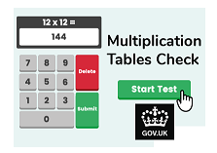
Year 4 Multiplication Tables Check
Purpose
Explain the Year 4 Multiplication Check (MTC)
What we are doing to help your child learn their multiplication facts
Provide tips, ideas and resources to help at home

Slide 3
Year 4 Multiplication Tables Check
Purpose: To determine whether children can recall all their times table facts fluently
June 2025 – All Year 4 children will undertake the MTC
Online timed assessment – 25 randomly assigned questions (3 practice ones before)
6 seconds per question: Read… Solve… Type (3 second break in between)
Importance of quick mental recall
High emphasis on ‘Year 4’ tables e.g. 6x, 7x, 8x, 9x and 12x
Will take no more than 10 minutes to complete
Child and teacher won’t be shown score immediately – but will receive them
No pass mark – National average score
Schools are required to report results to parents – end of year report

Slide 4
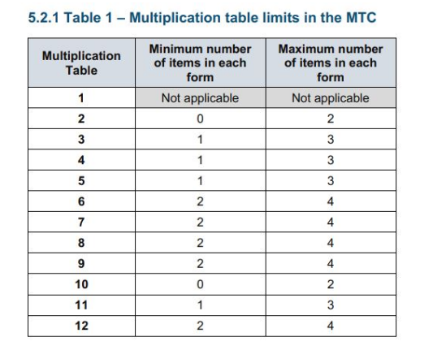
Year 4 Multiplication Tables Check

Slide 5
Year 4 Multiplication Tables Check
This is what the MTC looks like…

Slide 6
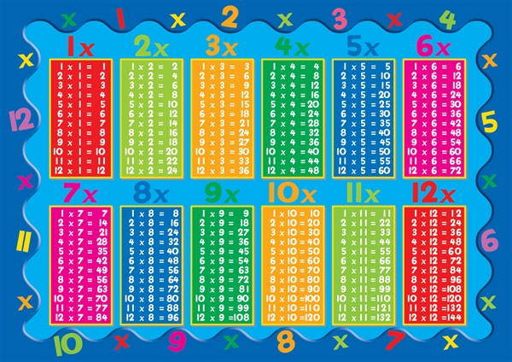
Year 4 Multiplication Tables Check
But don’t panic…

Slide 7
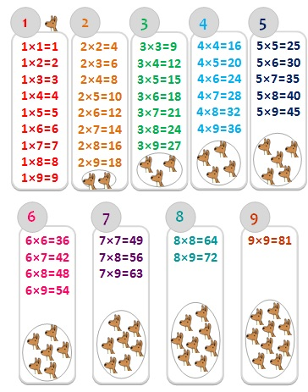
Year 4 Multiplication Tables Check
Multiplication is
commutative!

Slide 8
Year 4 Multiplication Tables Check
How are we best preparing your child?
We don’t wait until Year 4 to focus on this. Teaching of multiplication begins as early as EYFS
Resilience
Leapfrog – weekly multiplication test
Termly Assessments in Year’s 2 and 3 and half termly in Year 4 (online).
High focus on learning tables which are relevant to their year group within maths lessons
Regular chanting, online games and morning activities
TT Rockstars – to improve speed
Teaching children strategies and techniques to improve speed and mental recall
March 2025 – Government release ‘try it out’ area

Slide 9

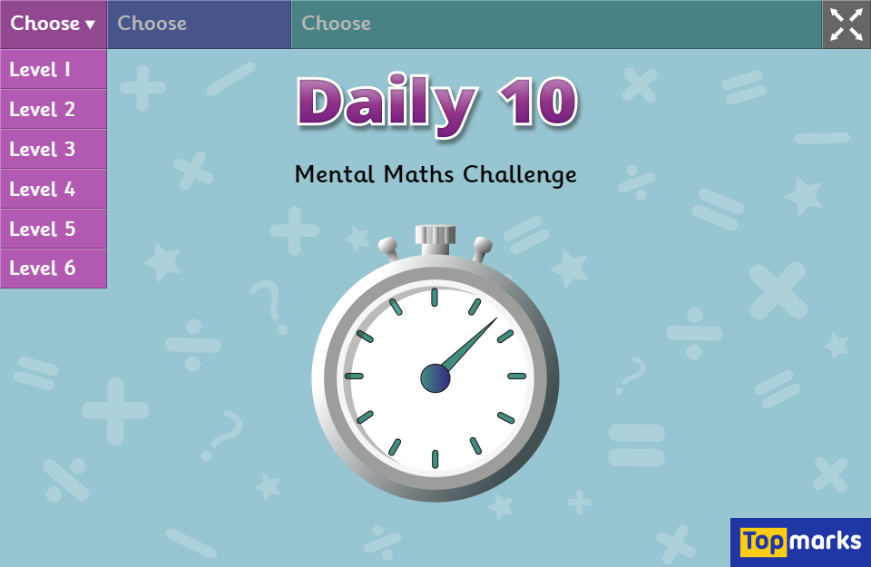
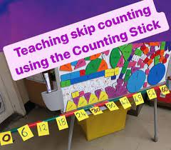
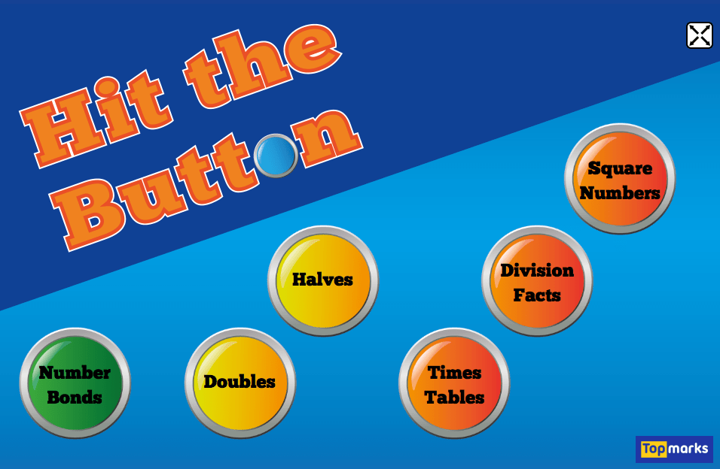
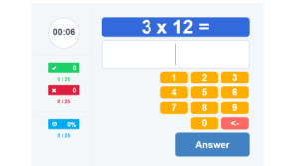
Top Tips / Ideas
Repetition is key – chanting (break up the table)
Number cards (post-it notes) / counting sticks
Use soundcheck on TT Rockstars
Games = Daily 10, Hit the Button
Songs – YouTube
Switch number sentence around
12x anything…. Start at 11x!
9x anything…. 10x take away one lot
Use doubles E.g. 7x6 = 7 x 3 x 2
Have favourites

Slide 10
Website Links
https://www.topmarks.co.uk/maths-games/hit-the-button
https://www.topmarks.co.uk/maths-games/daily10
https://www.timestables.co.uk/
Interactive counting stick – BossMaths.com

Slide 11
