Slide 1
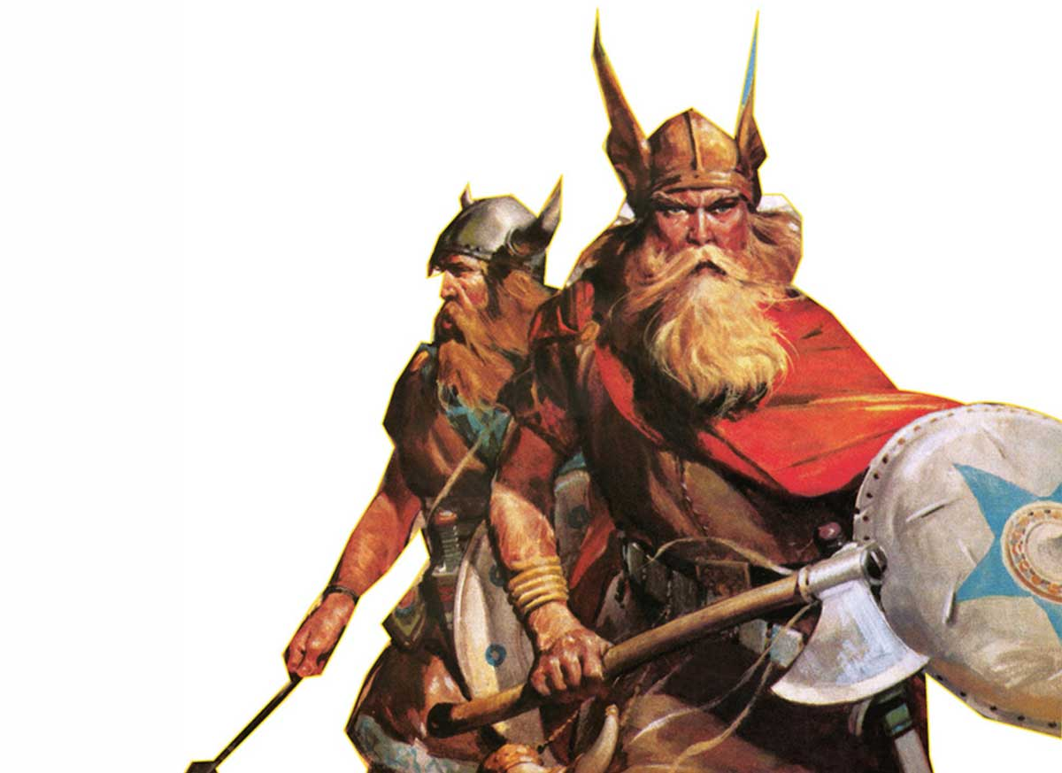

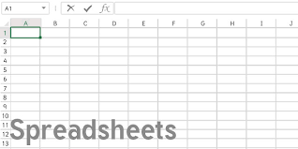
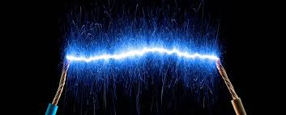
Science
The Vikings
What happened when the Vikings invaded Britain?
What were the features of Viking culture in Britain?
What can we learn from primary sources?
What do historians say about how the Vikings changed Britain?
Discuss historical viewpoints - How did the Vikings change Britain?
A report - How did the Vikings change Britain?
English
History
Styles of writing to be covered
Narrative description
Balanced discussion
Non-narrative recount
Grammar
Use punctuation for speech correctly.
Use subordinate clauses for additional detail.
Develop punctuation use for effect (hyphens and semicolons/colons).
Understand and write in the active and passive voice.
We are reading:
Electricity
Understand an electrical circuit.
Investigate the components and how they function ( Practical investigation).
Understand and use scientific symbols to represent an electrical circuit
Investigate the components and how they function (Investigation write up).
Investigate what materials insulate against electricity.
Design and make an electrical game.
Computing
Introduction to Spreadsheets
Understand what a spreadsheet does
Identify key elements of a spreadsheet (cells, columns, rows and formulas)
Know how to manipulate rows and columns
Knowing how to create a graph from a prepared spreadsheet data
Know how to format a graph
Maths
Shape
Identify the nets of 3D shapes
Identify the features of a circle
Statistics
Calculating the mean
Interpreting line graphs
Drawing line graphs
Interpreting pie charts
Constructing pie charts
Proportion
Proportion and ratio problems

Slide 2

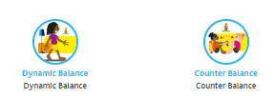
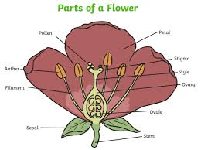


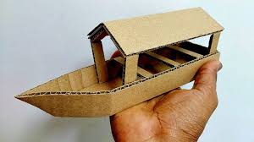
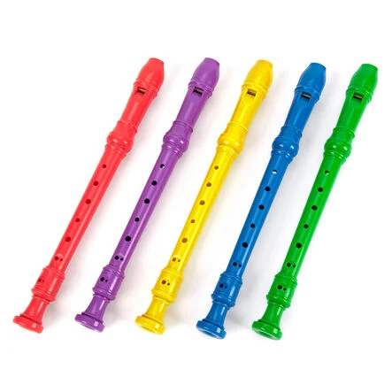
Bikeability
Gardening Workshop: Plant classification and how different plants reproduce.
Physical Education (PE)
This term your PE will be on:
Fundamental Focus |  | Dynamic balance Counter balance
Sport Specific Focus |  | Football
Whole child focus | PE award for: | Leading others
 | Learning in class about: | Identifying ways to lead others
Religious Education
What happened on the first Easter Sunday?
Explore different ways people understand and interpret the Easter story.
How artists represent Jesus’ death and resurrection through paintings and other visual art.
Discuss other stories that share similar themes, such as hope, sacrifice, and new beginnings.
Children will think about whether Easter is the end of the story and what it means for Christian beliefs today.
Curriculum Enrichment
DT
Music
In PSHE year 6 will be learning about healthy lifestyles:
Taking responsibility for their health
Making choices that will benefit their health well-being
Thinking about decisions that may put them in a vulnerable position.
Understand mental health and what it means to be emotionally well.
This term, we will be
turning to recorder to
solidify our flutephone
playing. We will be:
-reading music
-observing note lengths
-playing musically with the piano
PSHE
In DT this half term Year 6 will be constructing a toy boat inspired by the Viking longships.
They will research historic and contemporary boat design and be introduced to the principles of how forces including aerodynamics act on a sailing boat.
Children will experiment with and test materials and structures, create design drawings before developing a final design.
Click here to go back to the main page

