Slide 1
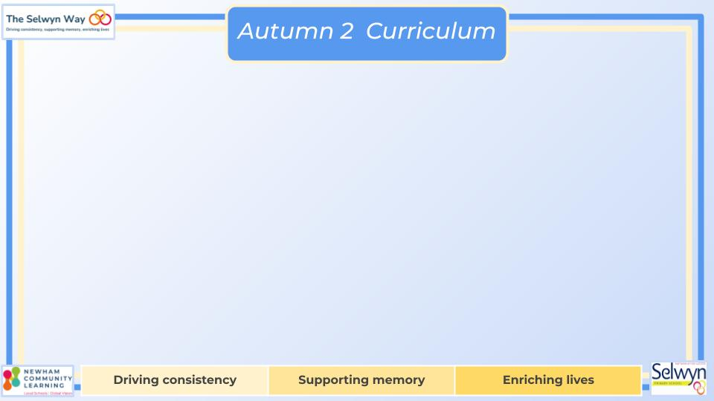
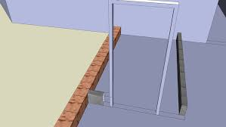


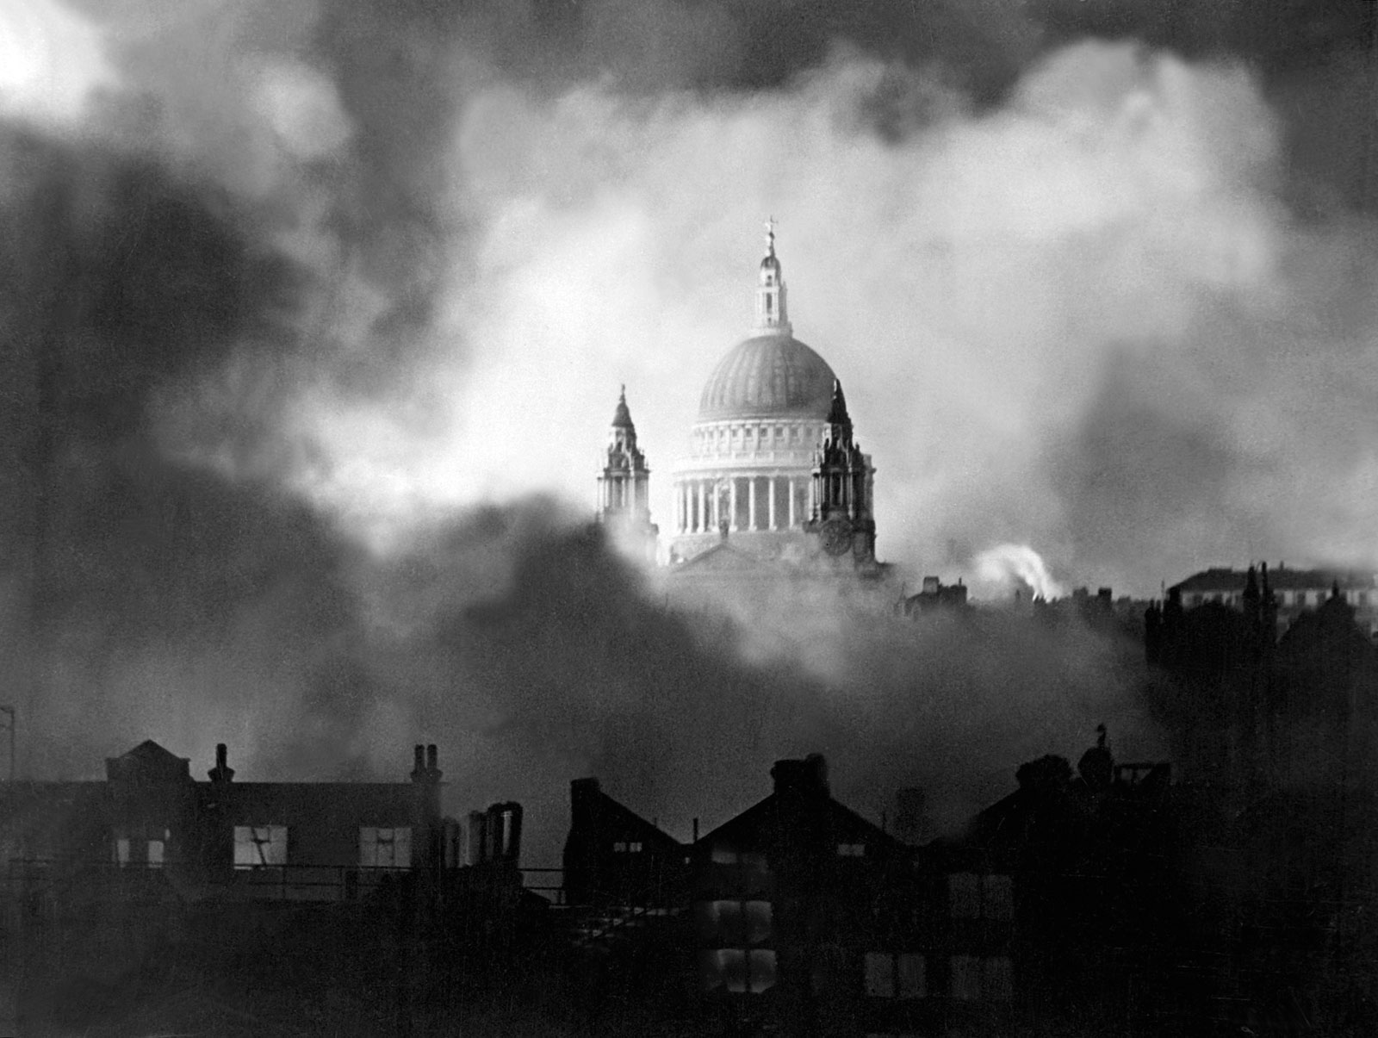
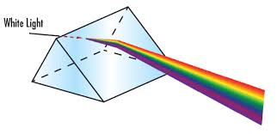
Year 6
English
Computing
Science
Communication and collaboration
Online Safety: Password Safety
Internet addresses
Data packets
Working together
Shared working
Communicating responsibly
We are reading:
Light
Learn how we see things
Recognise that light appears to travel in straight lines
To know that objects are seen because they give out or reflect light into the eye
To know that shadows have the same shape as the objects that cast them because light travels in straight lines
Explore the way that light behaves, including light sources, reflection and shadows.
Styles of writing to be covered
-Description
-Persuasive letter
-Character viewpoints
-Balanced discussion
Grammar
-Begin to use passive verbs effectively in sentences
-Be able to indicate degrees of possibility using adverbs (perhaps, surely)
-Vary sentence structure for impact and effect
-Use commas for clarity
History
WW2: The Homefront
- What happened during WW2?
- What happened on the Home Front?
- What do historians say about the impact of WW2 on the East End?
- Debate contested viewpoints - What were the consequences of WW2 for East London?
- A report - What were the consequences of WW2 for East London?
Calculation Problems
- Understand the use of brackets
- Use knowledge of the order of operations to carry out calculations
Express missing number problems algebraically
- Solve equations with unknown values
Fractions
- Deepen understanding of equivalence
- Order, simplify and compare fractions
- Find decimal quotients using short division
- Add and subtract fractions
Maths

Slide 2





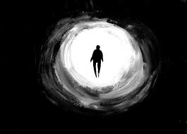
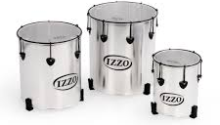

Year 6
Y6 Blitz Detective Workshop at West Ham Park.
Physical Education (PE)
This term your PE will be on: Thursday
Fundamental Focus |  | Static Balance Seated Static Balance Floor Work
Sport Specific Focus |  | Gymnastics
Whole child focus | PE award for: | Managing Emotional Wellbeing
 | Learning in class about: | Managing Emotions Under Pressure
Religious Education
What do people believe about life after death?
Discover what Hindu individuals think happens after they die, including ideas like being reborn or reaching spiritual freedom.
Explore the beliefs of Christians regarding what happens after they die, such as going to heaven or facing judgment.
Investigate the beliefs of Muslims about life after death, including the Day of Judgment and the afterlife in Islam.
Curriculum Enrichment
DT
Music
PSHE
Nutritious Seasonal Salads
Focus on designing, making, developing and testing nutritionally balanced dishes using a range of ingredients and preparation methods. Children create original salad recipes inspired by traditional dishes.
It’s Year 6’s turn to return to samba lessons this term. They will learn to:
● play rhythms accurately along with a piece of recorded music
● use their voice to help play rhythms
● follow 10 hand signals
● play a steady rhythm within the group and lead a groove
● play a 5 part groove
Dream and Goals
In PSHE this half term, we will be learning about our strengths and how we can set challenging but realistic goals. We will be thinking about how we can motivate ourselves to help us accomplish our goals. We will also be thinking about ways we can work with other to help achieve shared goals and to make the world a better place.
Click here to go back to the main page

