Slide 1
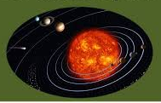
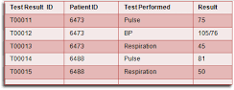

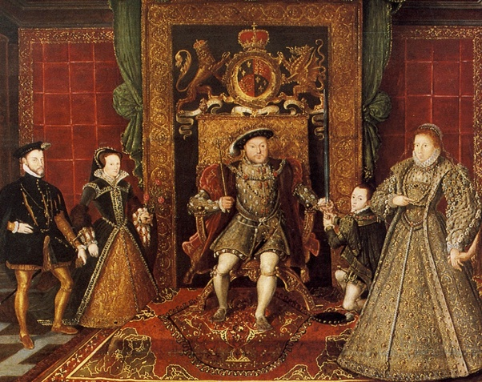
English
Computing
Science
Flat-file databases
Look at how flat-file databases can be used to organise data
Use tools within a database to answer questions about data
Create graphs and charts from their data to help solve problems
Use a real life database to answer a question and present their work to others
Non-narrative: Balanced discussion text
Should Lucy go for tea at the Faun’s house? - children to provide both sides of the argument
Non-narrative: Recount
Children to compose two diary extracts - one in the role of Mr.Tumnus and the other Lucy - recount the events of Lucy’s visit to Narnia
Narrative: Description / persuasion
Write an entry for a holiday brochure: persuade people to visit the wintery scenes of Narnia
We are reading:
Earth and space
How we’ve come to understand our solar system
What are the planets in our solar system?
Comparing the planets in the solar system
Investigate day and night
How time can be measured using the sun
What defines a moon
History
The Tudors
What happened during the reigns of Henry VII and Henry VIII?
What happened during the reign of Elizabeth I?
What can we learn from primary sources?
What do historians say about the significance of the Tudors?
Discuss historical contrasts - What was the significance of the Tudors?
A report - What was the significance of the Tudors?
Fractions
Compare and order fractions whose denominators are all multiples of the same number
Identify, name and write equivalent fractions of a given fraction, represented visually, including tenths and hundredths
Recognise mixed numbers and improper fractions
Add and subtract fractions with the same denominator and denominators that are multiples of the same number
Multiply proper fractions and mixed numbers by whole numbers, supported by materials and diagrams
Maths

Slide 2
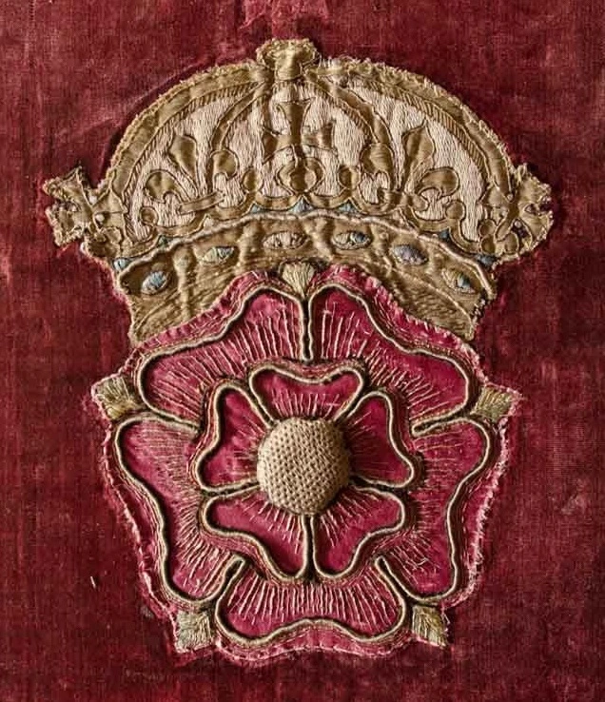
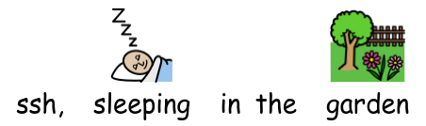
-World Book Week event at Rokeby Secondary School
-DT workshop at Rokeby Secondary School
-Girls of the World Day at Eastlea Secondary School
-Swimming lessons at Atherton Leisure Centre
Physical Education (PE)
This term your PE will be on: Creative Development
Fundamental Focus |  | Sending and receiving / Ball chasing
Sport Specific Focus |  | Association Football
Whole child focus | PE award for: | Improving others
 | Learning in class about: | Identifying ways to improve others
Religious Education
How do Christians try to follow Jesus’ example?
Who sets us an example?
What can we learn from the story about Jesus selling possessions and overturning tables?
What did Jesus teach about giving?
How did Jesus set an example for others to follow?
How can we summarise Jesus’ example of the right way to live?
Curriculum Enrichment
Music
PSHE
DT
This half term, we will be looking at abstract music through the lends of French composer Messian.
We will be composing and performing our own piece in class set in a peaceful garden.
Healthy Me
To know the health risks of smoking
To know some of the risks with misusing alcohol, including anti-social behaviour, and how it affects the liver and heart
To understand how the media, social media and celebrity culture promotes certain body types
To describe the different roles food can play in people’s lives
To know what makes a healthy lifestyle
Embroidered cushions
Analyse fabric design
Experiment with stitching
Create emblem designs
Evaluate a design
Develop a cushion design
Click here to go back to the main page

