Slide 1



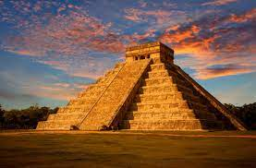

English
Computing
Science
Sound:
Identify how sounds are made.
Understand how to change the pitch of a sound
Know how volume is affected by vibration
Understand the relationship between distance and volume
Investigate sound insulation
Repetition in shapes
Write programs to move a screen avatar
Use sequence, selection and repetition in a program
Using loops to create shapes
Styles of writing to be covered
-Narrative description
-Recount
-Explanation text: How to make a dream
-Information text
-Persuasion
Grammar
-To include subordinate clauses within sentences
-To use similes as a sentence starter and to develop ‘ed’ starters.
-To ensure tense and person are accurate and consistent with noun-verb agreement
We are reading:
History
The Mayan Civilization
Who are the Maya?
Why was the Maya civilisation significant?
What can we learn from primary sources?
What do historians say about the causes of maya decline?
Debate contested interpretations- what caused the decline of Mayan civilisation
Decimals:
Comparing and ordering decimal amounts
Rounding decimals to the nearest whole number
Multiplying and dividing decimals by 10 and 100
Area and perimeter
Perimeter in metres, centimetres and millimetres.
Perimeters of composite shapes in centimetres and millimetres.
Areas of rectangles
Area in square centimetres and meters.
Maths

Slide 2
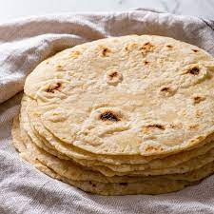
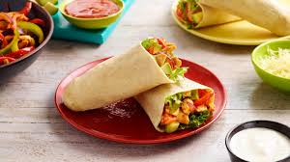
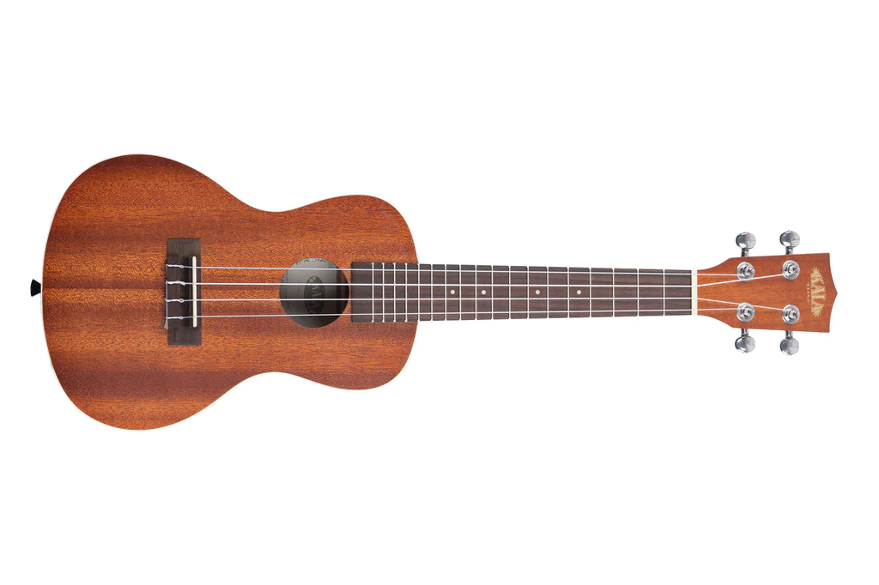
Physical Education (PE)
This term your PE will be on: Creative Development
Fundamental Focus |  | One leg balance Footwork
Sport Specific Focus |  | Football
Whole child focus | PE award for: | Working well with others
 | Learning in class about: | Developing social skills to work in a team
Religious Education
Gardening
Why is Easter important to Christians?
-Define Easter and explain its significance in the Christian faith.
-Identify symbols associated with Easter and interpret their representation of new life.
-Describe Palm Sunday and its significance within the Christian calendar.
-Summarise the events of the Last Supper and analyse the continued use of its symbols in Christian practices.
Curriculum Enrichment
Music
PSHE
DT
We will be returning to ukulele to solidify our strumming.
We’ll be revising C, A minor chords and introducing the F chord.
We will work on our strumming techniques too.
Healthy Me
To recognise how different friendship
groups are formed
To understand there are people who take
on the roles of leaders or followers in
a group
To recognise when people are putting
me under pressure and can explain ways to resist this when I want
To know myself well enough to have
a clear picture of what I believe is
right and wrong
Tortillas:
Analyse tortillas
Explore ingredients
Design tortilla dishes
Create tortilla dishes
Test and evaluate recipes
Click here to go back to the main page

