Slide 1

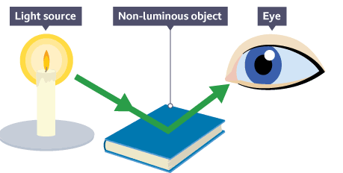


English
Computing
Science
News Report (continued)
How do I record a video?
How do I write a script?
How to perform in a video
How to edit a video
Grammar and punctuation focus:
Embedded clauses
Relative pronouns
Commas for clauses
Writing outcomes:
Setting description
Non-narrative recount
We are reading:
Physics: Light
Explore how light helps us see the world around us.
Learn how light’s properties allow us to see objects.
Find out how shadows are made.
Investigate how shadows change in size and shape.
Discover why our shadows move throughout the day.
Understand why the length of day and night changes.
History
Bronze Age to Iron Age
How significant was the discovery of bronze?
What made iron superior to bronze?
What were hill forts and where were they built?
What was life like at Maiden Castle?
How did Britain change from the Bronze age to the Iron age?
Maths
Calculating with Multiplication and Division
Recognise patterns in the 8 times table and link them to the 2s and 4s.
Multiply and divide numbers by 10 using place value knowledge.
Multiply 2-digit numbers using partitioning and visual methods.
Understand division through sharing and grouping.
Solve real-world problems using multiplication and division.

Slide 2



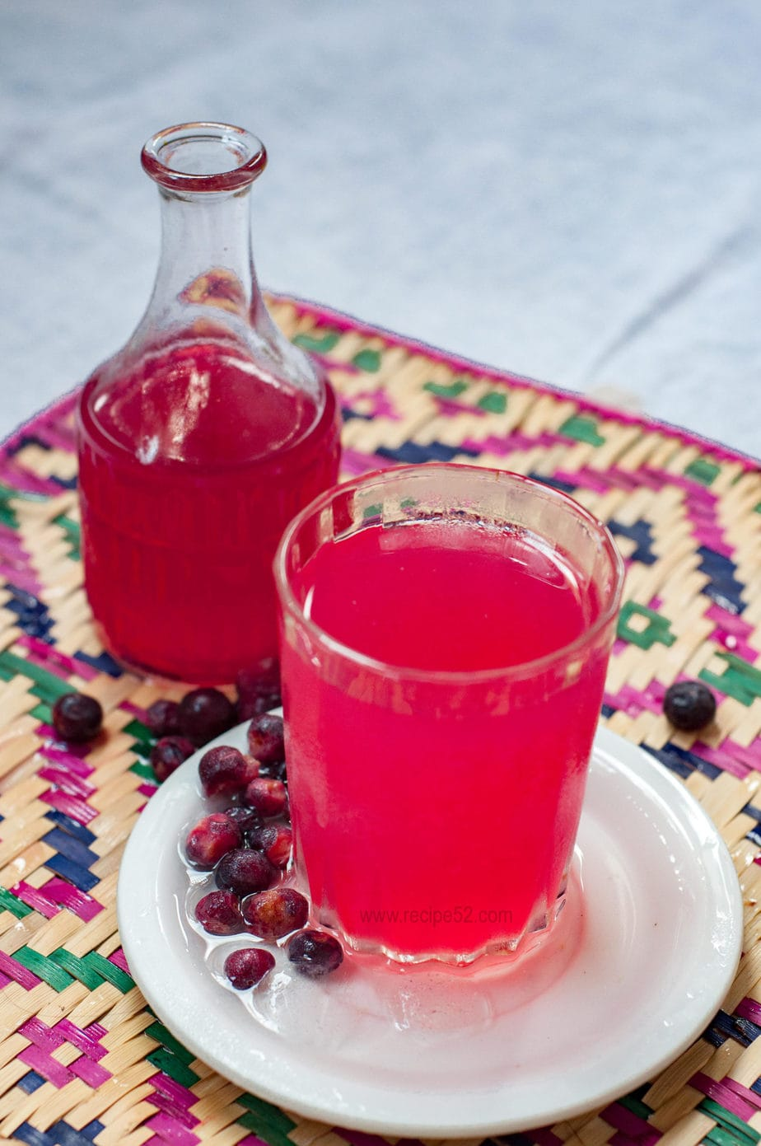
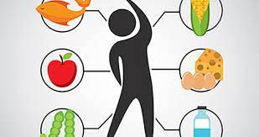
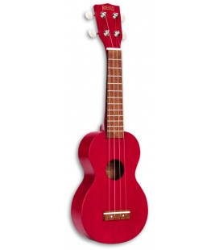
British Museum
Physical Education (PE)
This term your PE will be on:
Fundamental Focus
Sport Specific Focus |  | Football
Whole child focus | PE award for: | Working well with others
 | Learning in class about: | Developing social skills to work in a team
Religious Education
How and why do Hindus celebrate Holi?
Explore how stories show ‘good’ and ‘bad’ characters and what makes someone a hero or a villain.
Learn about the customs and traditions of Holi, the Hindu festival of colours.
Discover the different stories linked to Holi and why they are important.
Understand how Holi’s celebrations connect to Hindu beliefs about gods and good overcoming evil.
Curriculum Enrichment
Music
Design and Technology
Year 3 will continue learning how to
play the ukulele until the end of the
year.
They will be plucking the strings to
create songs and rhythm patterns.
Just wait until the summer term so
you can see them performing!
PSHE
Healthy Me
To understand how exercise affects my body.
To know that the amount of calories, fat and sugar I put into my body will affect my health.
To identify when something feels safe or unsafe.
To understand how complex my body is and how important it is to take care of it.
To tell you how to keep my teeth clean and healthy.
Soft drinks
Analyse soft drinks
Explore ingredients
Design soft drinks
Create soft drinks
Test and evaluate recipes
Click here to go back to the main page

