Slide 1

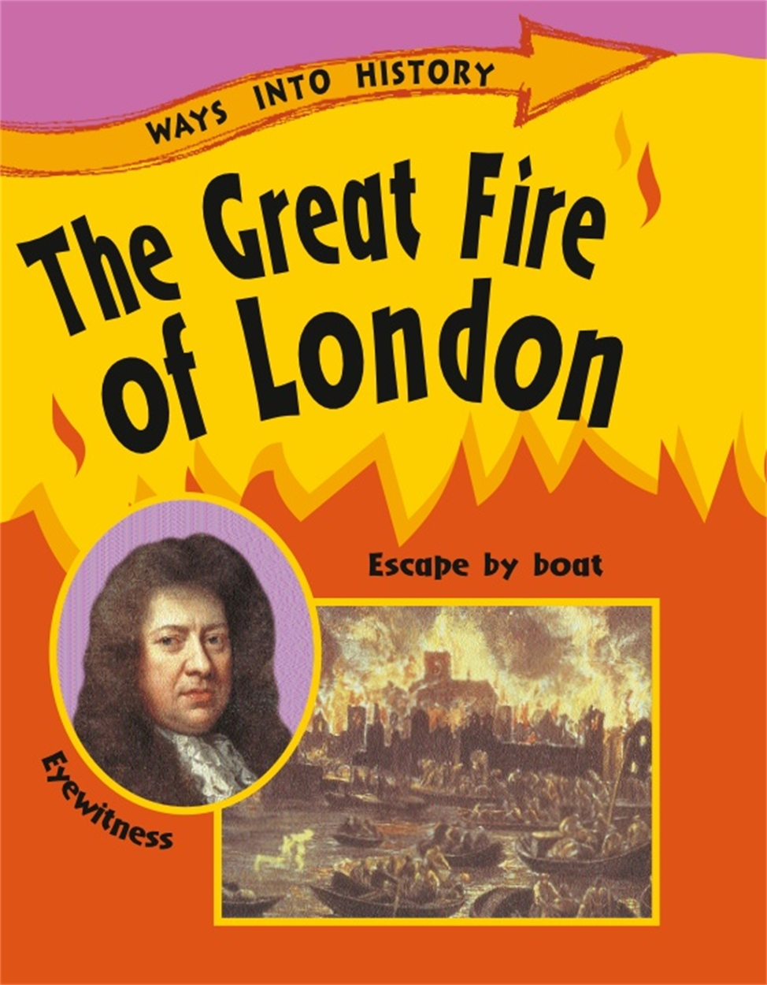
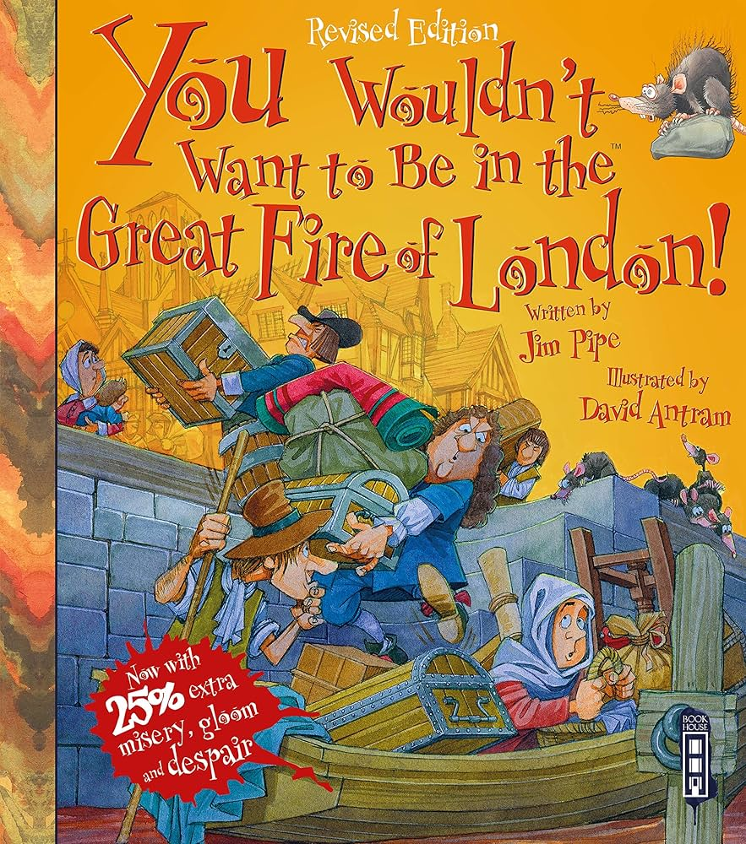
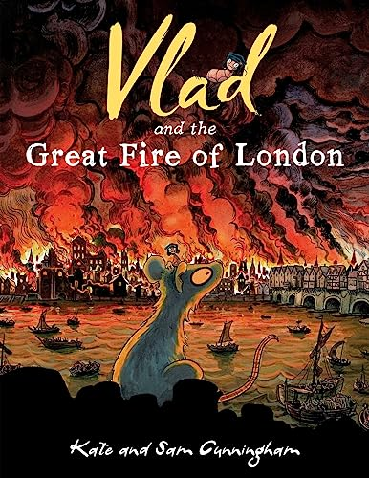
English
Computing
Science
Chrome Music Lab
The children will be exploring
pitch and rhythm patterns
using Google Music Lab.
We are reading:
Year Two will be learning all about Materials. Some of the aspects their learning will cover are:
Identifying and classifying different materials
Comparing the use of different materials
Explain why we use certain materials and why they may not work for specific purposes
The different outcomes the children will produce this half term:
-Information text
-Recount
-Description
-They will continue to use expanded noun phrases to describe the Great Fire of London
-We will consolidate coordinating conjunctions into sentences and using past tense with regular and irregular verbs in our writing.
History
In History children will be learning about a historical event; ‘The Great Fire of London’.
They will be investigating primary and secondary resources such as pictures, newspaper articles and diary entries to help them understand how a loaf of bread nearly destroyed our capital city. They’ll investigate:
-How did the great fire of London start?
-How the fire changed our city?
-What can we learn from primary sources?
-What was the chronology of the great fire of London?
We will have a trip to the London Archive for 2G (23rd March) and 2GT (25th March).
Maths
This half term children’s learning will focus on measurement (money), Faces, shapes and patterns; lines and turns.

Slide 2
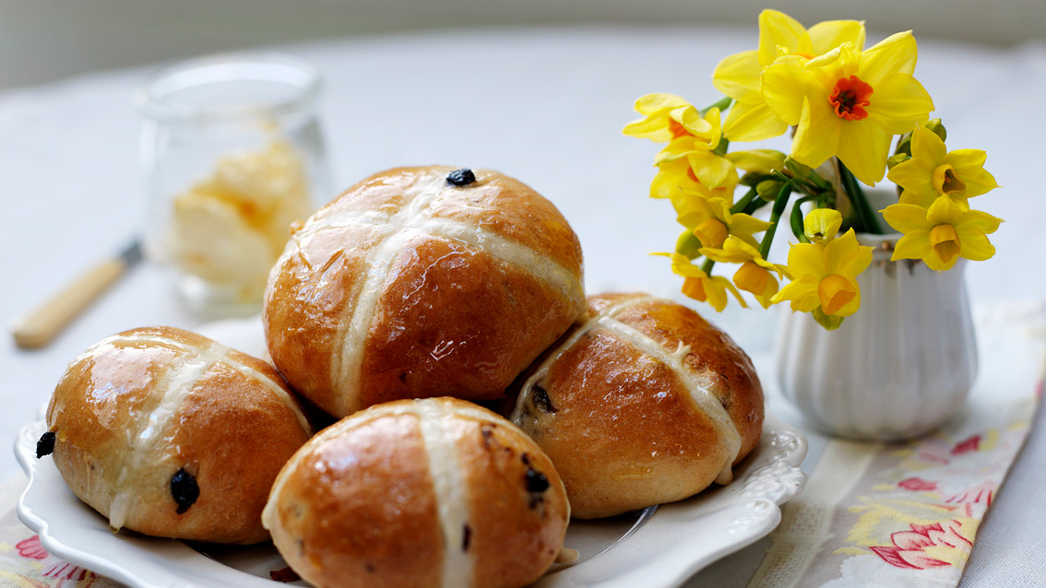
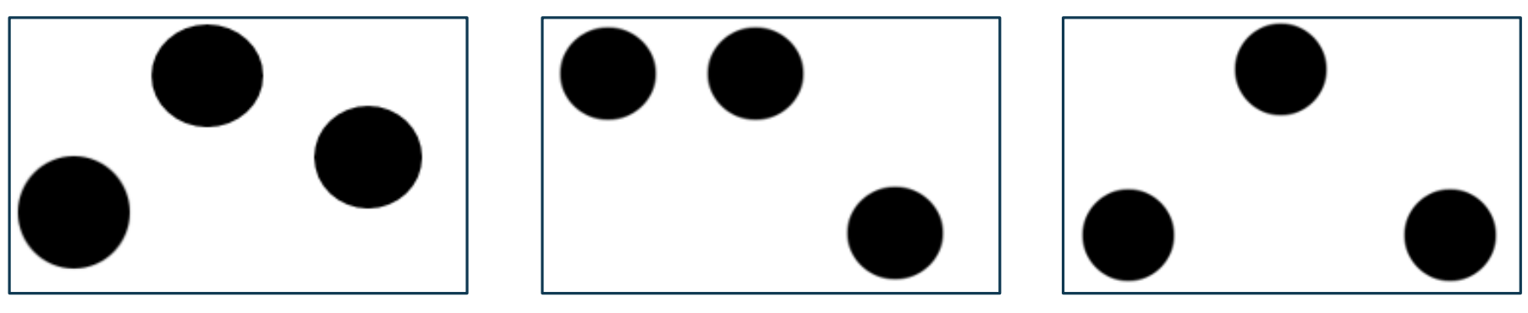


Physical Education (PE)
This term your PE will be on: Wednesday
Fundamental Focus |  | 1. Coordination - ball skills 2. Counter Balance in pairs
Sport Specific Focus |  | Games - Attack vs Defence
Whole child focus | PE award for: | Compare and develop
 | Learning in class about: | Causes of illness and disease
Religious Education
Linked to our learning about the Great Fire of London, Year 2 will be baking spiced buns this term.
Why is Easter important to Christian people?
Understand why Easter is important to Christians.
Learn the key events of the Easter story.
Know that Ash Wednesday begins Lent.
Learn about the Last Supper and Communion.
Recognise Easter symbols and their meanings.
Curriculum Enrichment
Art
Music
PSHE
In DT this half term, the children will design and make an original spiced bun.
They will:
-Analyse spiced buns
-Explore ingredients
-Design and create spiced buns
-Test and evaluate recipes
This half term in Music we will be listening to Gamelan music.
We will be exploring pitch and playing pitch patterns on chime bars (low and high notes, as seen below).
This half term the children will learn about how to stay healthy.
-To know what I need to keep my body healthy
-To show or tell you what relaxed means; to know some things that make me feel relaxed
and some that make me feel stressed
-To understand how medicines work in my body and how important it is to use them safely
-To sort foods into the correct food groups and know which foods my body needs every day
to keep me healthy
-To make some healthy snacks and explain why they are good for my body
-To decide which foods to eat to give my body energy
Click here to go back to the main page

