Slide 1




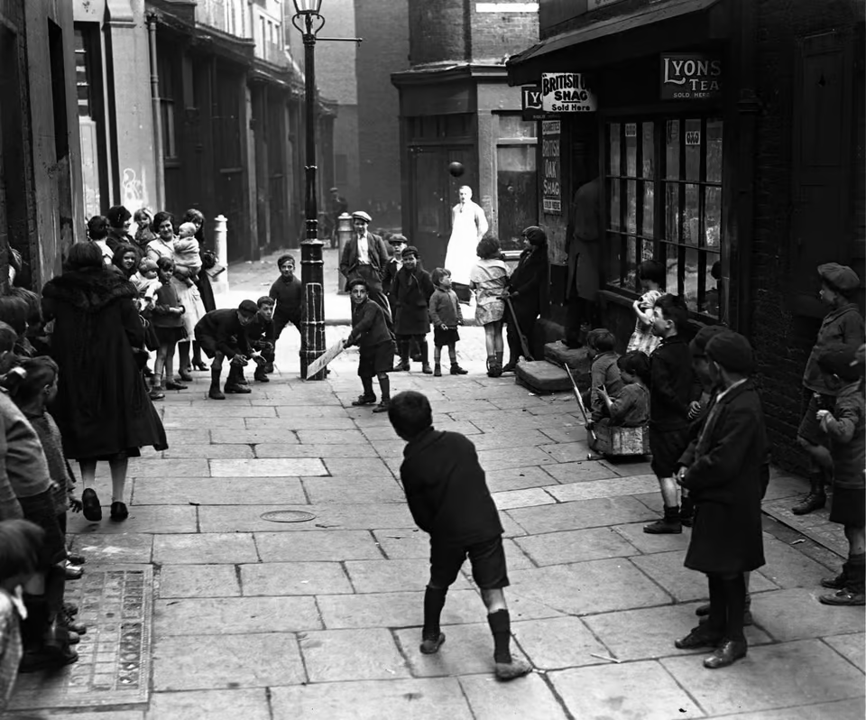

Year 1
English
We are reading:
Science
Computing
Digital Writing:
Exploring the keyboard
Adding and removing text
Exploring the toolbar
Making changes to text
Explaining my choices
Pencil or keyboard?
We are focussing on chemistry and learning all about materials by:
Classifying objects
Investigating elasticity
Finding out which type of ball bounces the most
Observing how a material changes over time
Answering the question: What are the properties of tin foil?
Grammar:
Subordinating conjunctions
Capital letters for days of the week
Exclamation and question marks
Adjectives
Styles of writing covered:
recount
explanation (warning poster)
short story
poem
non-chronological report
History
We will investigate:
What toys have been played with since ancient times?
What toys did children play with 100 years ago?
What can we learn from primary sources?
What would a day in the life of a Stratford child look like in the 19020’s?
How was a Stratford child’s life different 100 years ago?
Maths
Fractions
Understanding one half and one quarter
Using turns
Length and mass:
Comparing lengths
Measuring length and mass
Doubling and halving lengths
Numbers to 50 and 100 and beyond:
Identifying and representing numbers to 100
Find ten more or fewer
Comparing numbers within 100

Slide 2
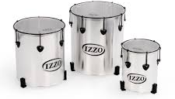

As part of their writing lessons, year 1 will be taking part in a ‘We’re going on a bear hunt’ workshop in West Ham Park.
We will also take a trip to the Young V&A museum as part of our history learning.
Physical Education (PE)
This term your PE will be on: Thursday
Fundamental Focus |  | 1. STATIC BALANCE- ONE LEG BALANCE 2. COORDINATION- FOOTWORK
Sport Specific Focus |  | Games - Kicking
Whole child focus | Learning to: | HELP AND ENCOURAGE OTHERS
 | Learning about: | USING SOCIAL SKILLS TO HELP OTHERS
Religious Education
What does it mean to belong to Christianity?
I can explain what it means to belong
What is a baptism service?
What is a dedication service?
Explain why the cross, the water and the candle are used in a baptism service
What is special about God to a Christian person?
Curriculum Enrichment
Music
PSHE
DT
Samba music drums
Year 1 will learn Samba Music this half term.
They will learn:
-what Samba is and where it is from
-how to hold drum sticks
-use my voice to create rhythms
-how to follow hand signals from the leader
-how to play in time and play a pulse
-the names of the Samba instruments
-how to play rhythms in different sections
Healthy me:
To understand the difference between being healthy and unhealthy
To know how to make healthy lifestyle choices
To know how to keep myself clean and healthy, and understand how germs cause disease/illness
To understand that medicines can help me if I feel poorly and I know how to use them safely
To know how to keep safe when crossing the road, and about people who can help me to stay safe
To tell you why I think my body is amazing and can identify some ways to keep it safe and healthy
Textiles: :
Analyse fabric design
Experiment from printing
Create relief prints
Develop a printed fabric

Slide 3
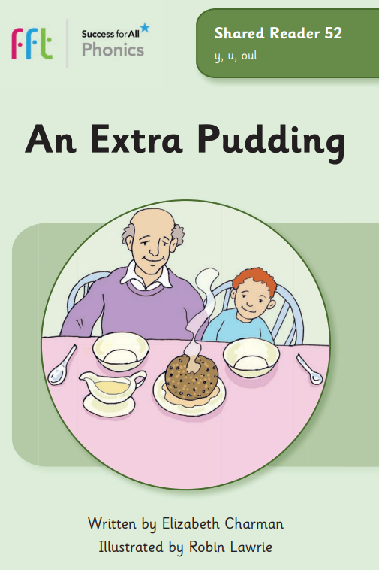
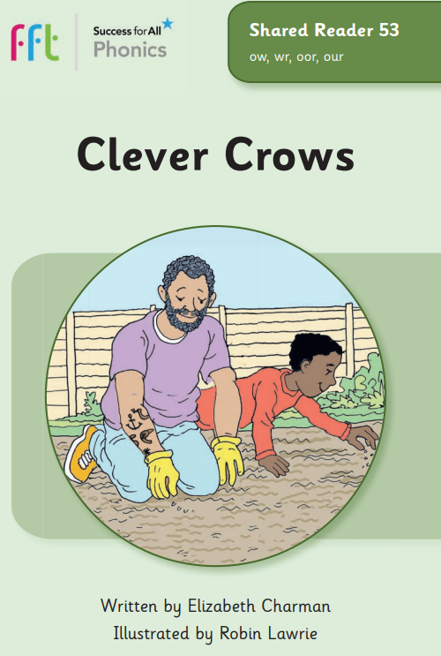
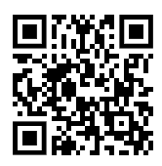






Phonics and reading to practise at home with your Year 1 child
Spring 2
Phonics GPCs
Red words
y (happy)
y (fly)
ow (snow)
soft c (ice)
soft g (gem)
busy
pretty
half
parents
everybody
Click here or scan the QR code to see how to pronounce these split digraphs.
sugar
improve
Watch out for your weekly phonics email with a link to our phonics books.
Can your child apply their phonics to decode and read these words?
Click here to go back to the main page

