Slide 1
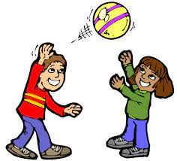
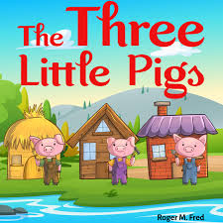
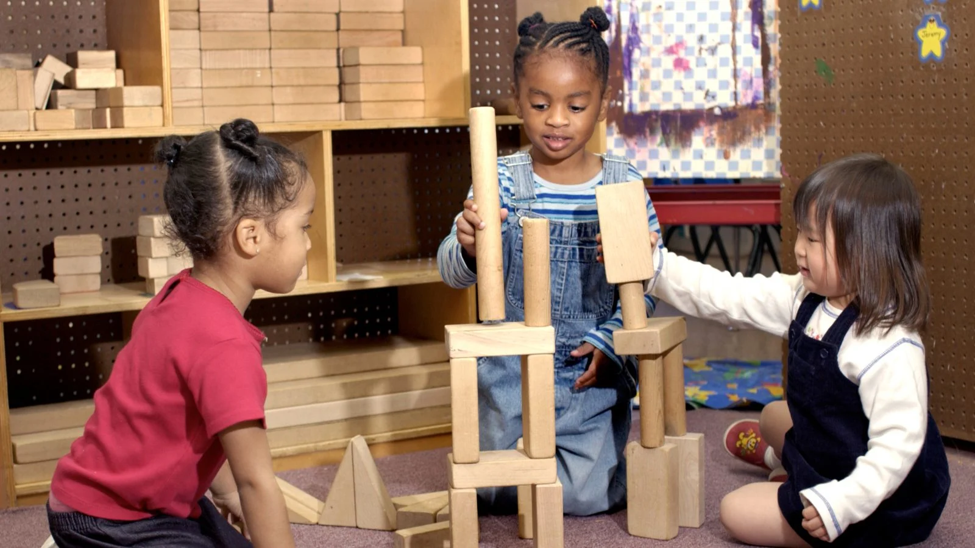
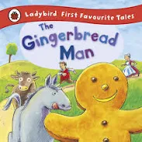

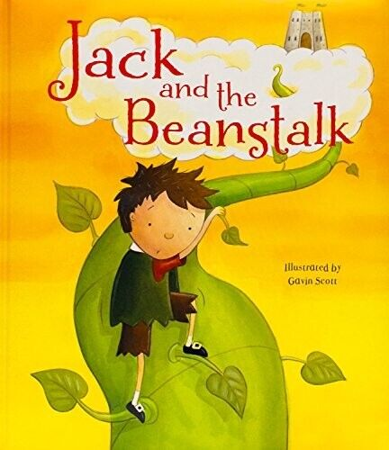
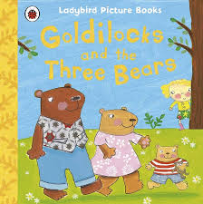
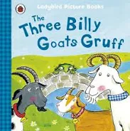
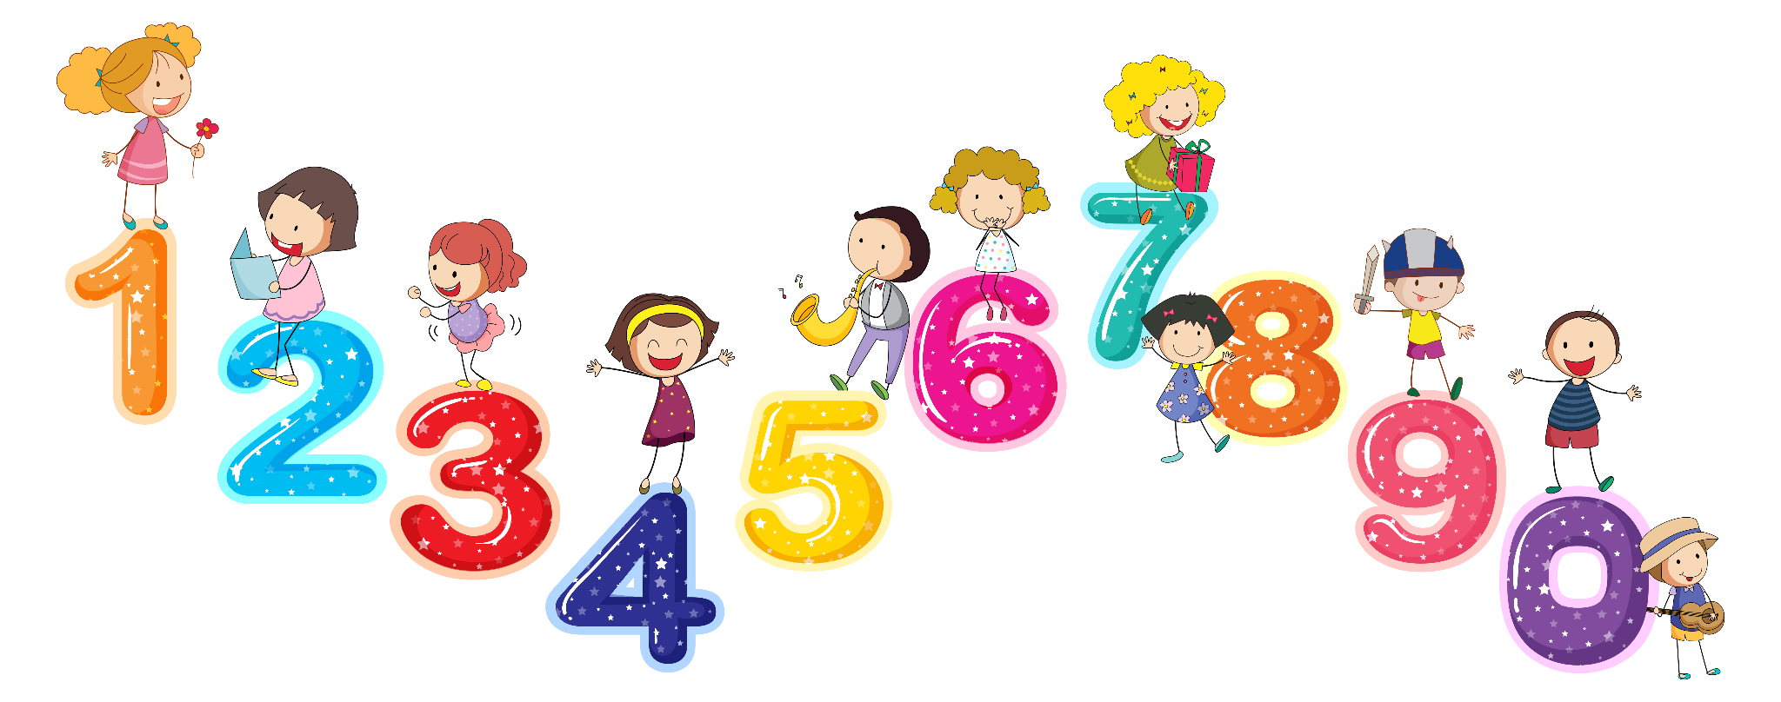
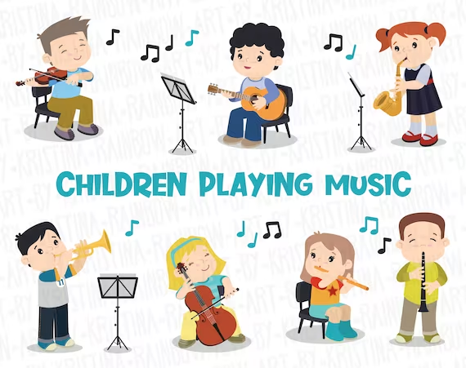
Nursery
Literacy, communication and language
Understanding of the world
Physical development
In free play indoor and outdoor we will:
Move in a variety of ways such as jumping, crawling and hopping.
Throw, catch and kick balls of different sizes.
Run with the ability to negotiate space, changing speed and direction.
Use a pencil with control and cutting using scissors.
PSED
We will be exploring the world around us by:
Finding out about what makes us the same and different to others.
Observing changes such as the changes in the weather and the appearance of trees and plants.
Talking about why things happen and how things work.
Discussing staying safe for example, was it ok for Goldilocks to go into the bears house?
We will be looking at maps and attempting to draw maps to show routes for example how to get to the other side of the bridge in the Three billy goats gruff.
We are reading:
The three pigs
The Gingerbread Man
Jack and the beanstalk
The Three Billy Goats Gruff
Goldilocks and the three bears
Through a range of different activities, children will learn to:
Involve other children in their play activities, sharing, turn taking.
Collaborative activities
Play with one or more other children, extending and elaborating play ideas.
Understanding how to stay healthy and what it entails.
We will be looking at the importance of exercise, sleep, eating healthy food and why we need to do this.
How to stay safe when we are outside.
Reading traditional tales, we will learn to:
Listen to and retell stories
Ask and answer a range of questions about a story.
Write some recognisable letters and words.
Write a range of text types including letters, invitations and posters, cards
Expressive art and design
Draw with increasing complexity and detail
Sing songs and rhymes.
Role play characters and events from the story
Listen with increased attention to sounds during Music sessions.
Make characters from stories using a range of materials
Mathematics
Recite numbers to 10.
Link numerals and amounts: for example, showing the right number of objects to match the numeral, up to 5 and 10
Know that the last number reached when counting a small set of objects tells you how many there are in total
Looking at a range of ways to measure for example long/ short, light/heavy

