Slide 1
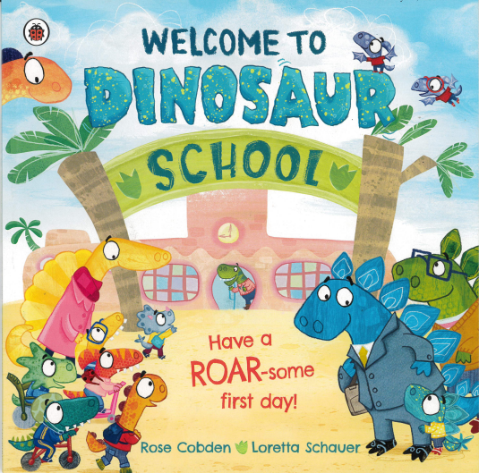
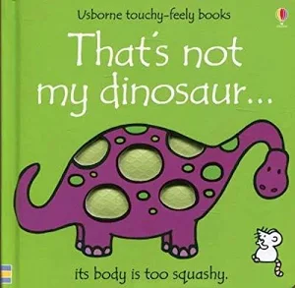
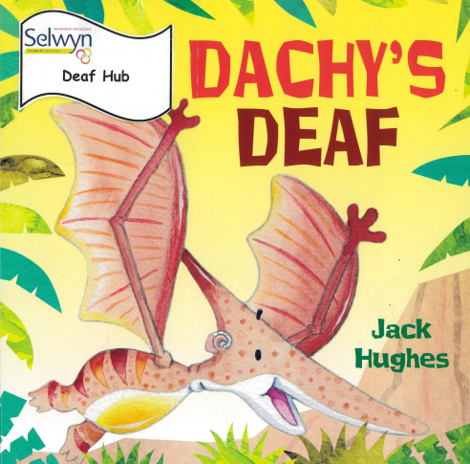
Butterfly, bumblebee and ladybird
Maths
Reading and Writing
We are reading:
Butterfly
This term, Butterfly class will be producing a variety of writing based on the books we are reading. The children will focus on writing an account and writing a description. They will also develop their grammar skills, including the correct use of full stops, capital letters, exclamation marks, question marks, and similes.
Butterfly
As part of their basic maths skills, Butterfly class will be developing their understanding of fractions. They will also be consolidating their knowledge of times tables to support their confidence and accuracy in multiplication.
Bumblebee
This term Bumblebee will be exploring their stories through forms of role play and practical activities, they will be encouraged to enjoy a story independently. In writing they will develop their sentence structure using Colourful Semantics and begin to extend their sentences.
Bumblebee
As part of their basic maths skills, Bumblebee will be continuing to develop their understanding of time.
They will be consolidating their understanding of o’clock and half past. They will be developing their learning by looking at quarter to and quarter past and five minute intervals.
Ladybird
Ladybird class will explore their stories through multi-sensory resources, looking at illustrations and linking them to colourful semantic keywords. They will use colourful semantics to explore the ‘who’ and ‘what doing’ in the books. In writing, the Ladybirds will develop their fine motor skills and strengthen their grip using a range of writing tools to support mark-making and early writing
Ladybird
In Ladybird, children will be focusing on developing their understanding of number in sequence.
Children will be learning this through various number rhymes. For example, ‘One, Two, Three, Four, five once I caught a fish alive ’.

Slide 2
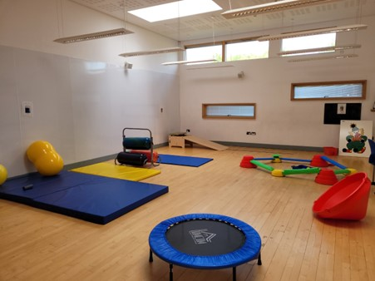
Butterfly, bumblebee and ladybird
Communication
Understanding of the world
Physical development
PSED
Topic: Where is the Amazon Rainforest?
Geography
The Amazon Rainforest
Amazon Rainforest Climate
Plants and Animals
People of the Amazon
Why is the Amazon important
Science
The zoo
The Rainforest
The Jungle
All the children will be participating in bespoke sensory circuits.
Building relationships:
- Use talk to resolve disagreements
- Pays attention to, and takes account of others views
- Shows an interest in other people's ideas
Managing self:
- Knows some behaviour is unacceptable
- Expresses needs and feelings in appropriate ways
- Demonstrates an awareness that not everyone thinks like they do
Self-regulation:
- Likes to make own decisions
- Has emerging self confidence to speak to others about wants and interests
Listening, attention and understanding:
- Remains quiet whilst a member of staff gives instruction
- Expresses their own opinion
- Expresses their feelings through creative means
Speaking:
- States a preference, giving their reason
- Takes part in a simple staff led discussion in which they can express their views
- Use their facial expressions to enhance meaning
Expressive art and design
Art and Design
- Creates work from observation
- Creates work from memory
Knows a variety of songs
Is able to do a range of dances
Taps out simple repeated rhymes
Music
Click here to go back to the main page

