Slide 1
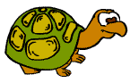
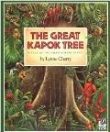

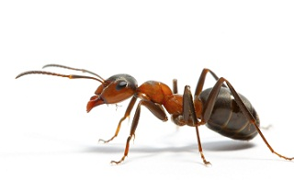
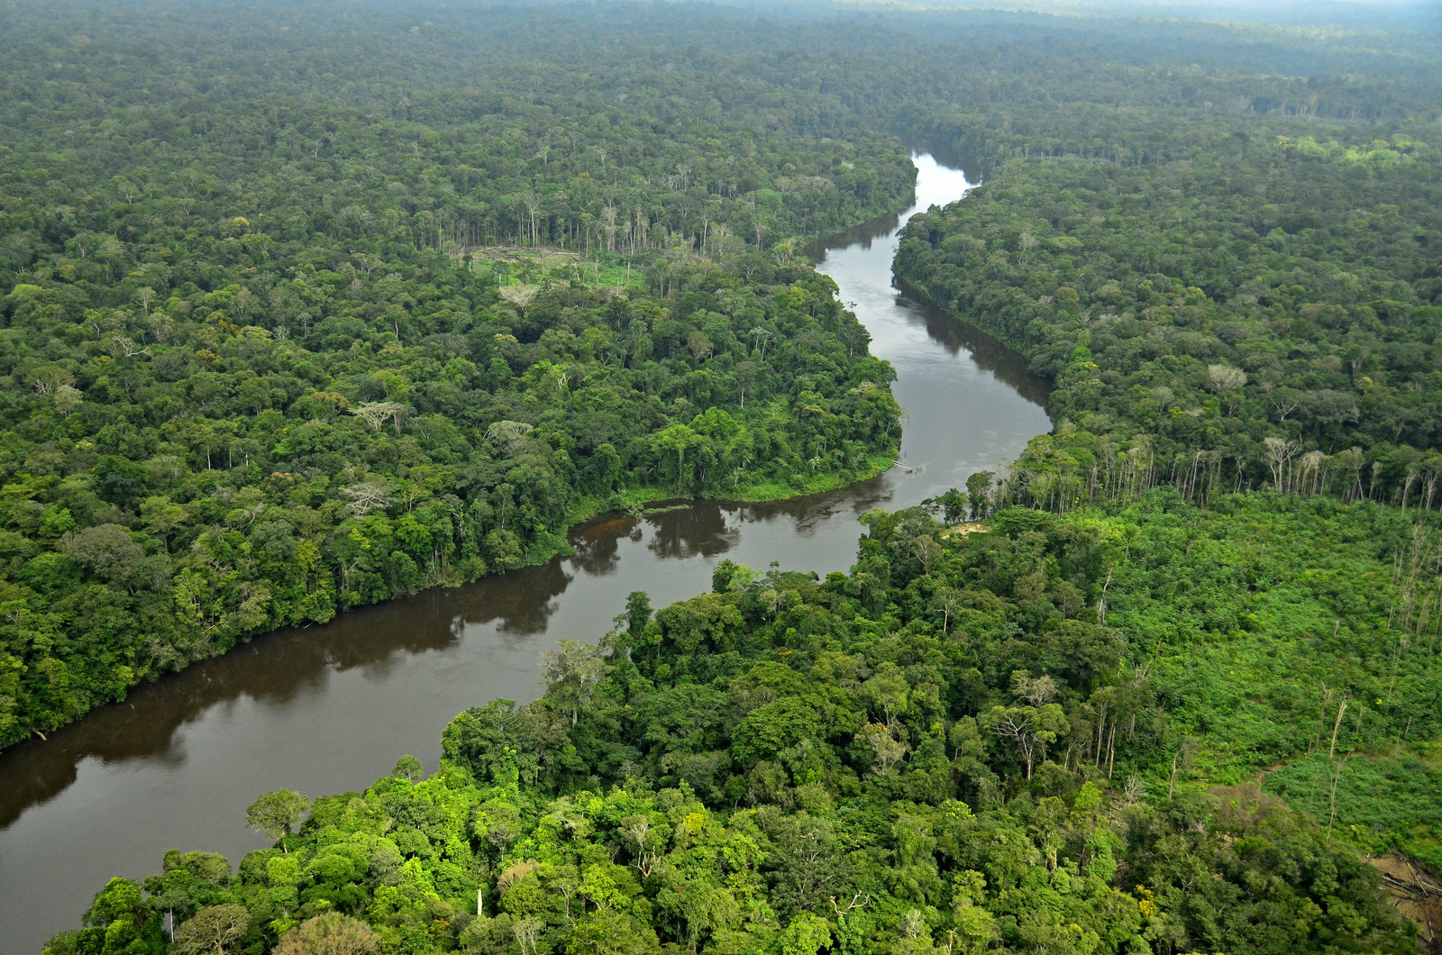
Year 4
English
Computing
Science
Repetition in shapes
Write programs to move a screen avatar
Use sequence, selection and repetition in a program
Using loops to create shapes
Style of writing to be covered:
Persuasive letter
Non-narrative explanation / letter
Diary entry
Grammar:
Relative pronouns
Relative clauses
Parenthesis
Use subordinate clauses to add relevant detail accurately
Living things and their habitats
Classify invertebrates
Use a classification key to identify living things
Understand a micro-habitat
Classifying flowering plants and non-flowering plants.
Investigate how humans impact positively on the environment
Make a guide for a local living thing
We are reading:
Geography
We are reading:
The Amazon: What makes the Amazon Rainforest different and unique?
Where is the Amazon Basin?
What are the physical features of the Amazon Basin?
What are human features of the Amazon Basin?
What makes the Amazon different and unique?
How is the Amazon similar and different to British forests?
Multiplication and Division
Dividing a 2 and 3 digit number by a 1-digit number using the short method for division.
Fractions
recognise and show, using diagrams, families of common equivalent fractions
count up and down in hundredths; recognise that hundredths arise when dividing an object by one hundred and dividing tenths by ten.
Maths

Slide 2





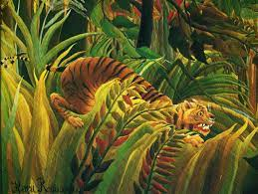
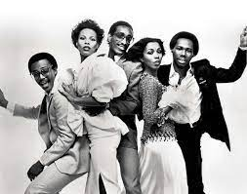
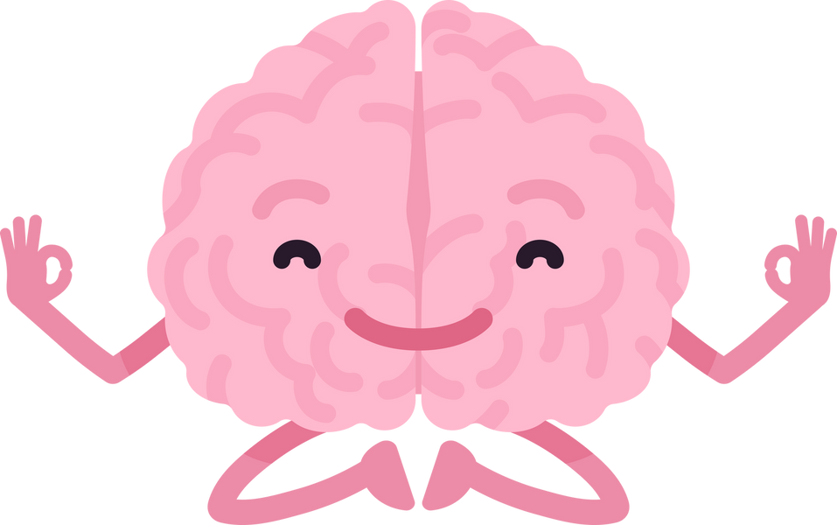
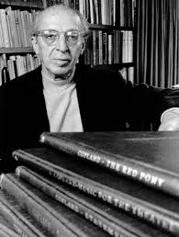
Physical Education (PE)
This term your PE will be on: Thursdays
Fundamental Focus
Sport Specific Focus |  | Netball
Whole child focus | PE award for: | Explain how others could like after their body
 | Learning in class about: | Identify elements of a healthy lifestyle
Religious Education
-Visit to London Zoo
- Celebrate Safer Internet Day
-Pizza Express
What religions are represented in our neighbourhood?
Identify the functions of religious buildings and places in our surroundings.
Locate evidence of religion and worldviews within the neighbourhood.
Investigate instances of religion and worldviews in the neighborhood contributing to charitable activities or helping others.
Compare and contrast the similarities and differences in religion and worldviews within the local community.
Curriculum Enrichment
Art
Music
PSHE
-Learning to sing in parts
-Listening to disco music
-We will be taking a break from ukulele and enjoying a composition module based on the Amercian composer Copland’s take on Billie the Kid.
Brain Buddies sessions with the Educational Mental Health Practitioner
Identifying emotions
Understanding a variety of feelings
How does my body react to certain emotions.
Painting the jungle
Creating tones and texture
Using tertiary colours
Study Henri Rousseau’s style
Click here to go back to the main page

