Slide 1
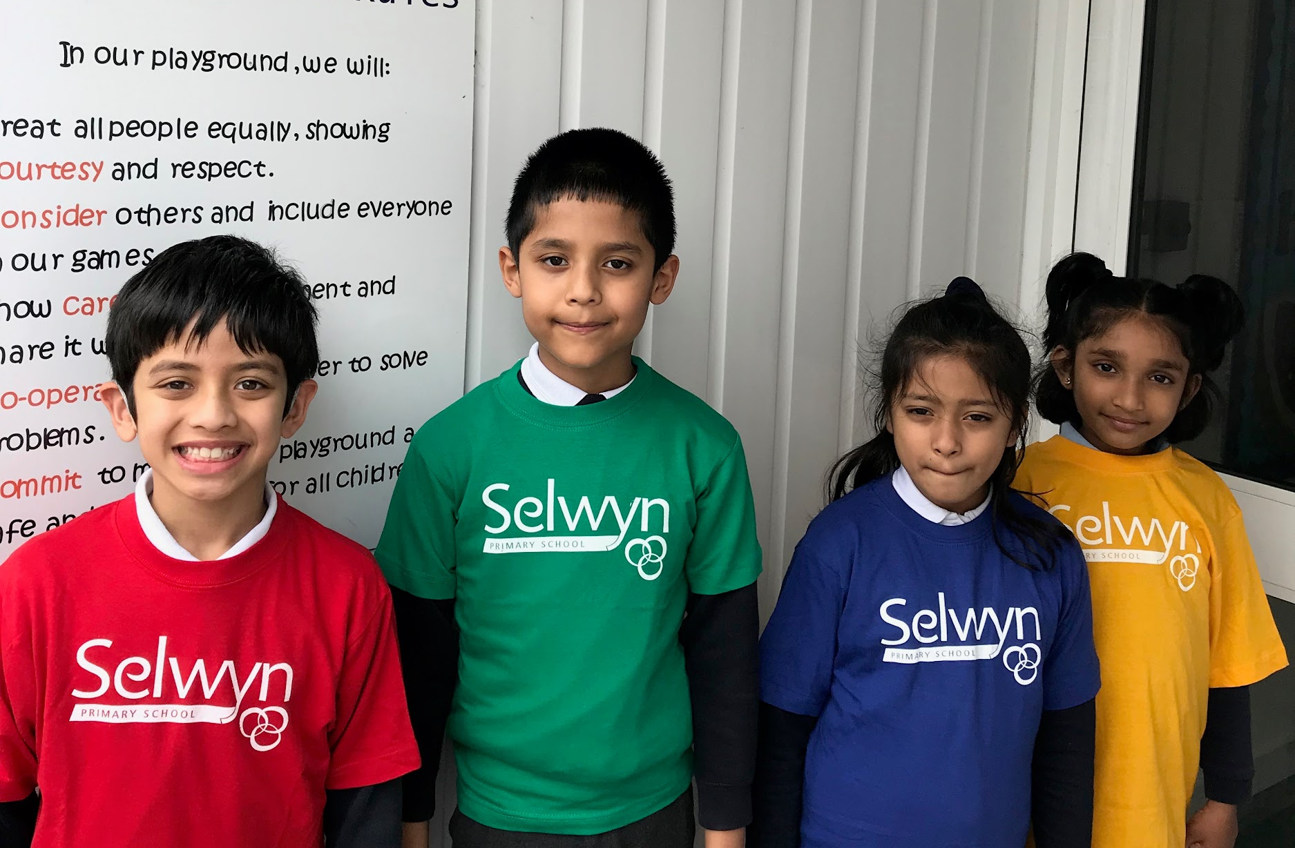
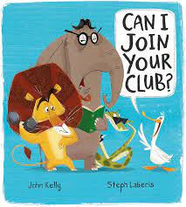




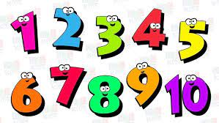
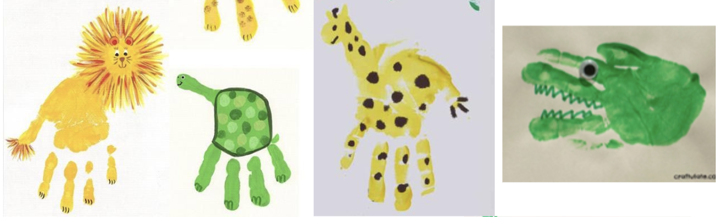
Reception’s
PSED
Literacy, communication and language
Personal, Social & Emotional Development
Our topic is ‘Celebrating Difference’. Our learning objectives are:
I can identify something I am good at and understand that everyone is good at different things.
I understand that being different makes us special.
I know we are all different but the same in some ways.
I can tell you why I think my home is special to me.
I can tell you how to be a kind friend.
I know which words to use to stand up for myself when someone says or does something unkind.
Physical development
Understanding of the world
Our PE lesson is on Thursday, so please wear your PE kit to school.
Through dance we will be physically developing physically the following skills:
Agility through ball chasing
Static balance
Following instructions
We are reading:
To develop our writing skills we will:
Begin to sequence sentences to form a short narrative
Join ideas, with some accuracy, using the conjunction ‘and’
Discuss what has been written with an adult with confidence
Begin to use capital letter to mark the beginning of a sentence
Whilst being exposed to the purpose of writing and writing in different genres, such as adverts and instructions.
Through our planned purposeful play we will be exploring ‘How do we take care of our friends, family and pets?’ and linking it to our quality text each week.
We will be:
Designing maps
Building forts
Roleplaying vets, pet shops, playing with babies and dolls houses to represent our families
Thinking about how our families look after us by talking about things such as going to the doctors, and doing activities like brushing teeth and building healthy meals.
Expressive art and design
For our expressive arts and design activities we will:
We will be moving to the sound of instruments
We will try combining moving, singing and playing instruments!
We will be making our own pet rock to take care of and exploring making animals using different materials.
Mathematics
•Count up to ten objects
•Represent, order and explore numbers to ten
•One more or fewer, one greater or less
•Days of the week, seasons
•Sequence daily events
•Explore addition as counting on and subtraction as taking away

Slide 2




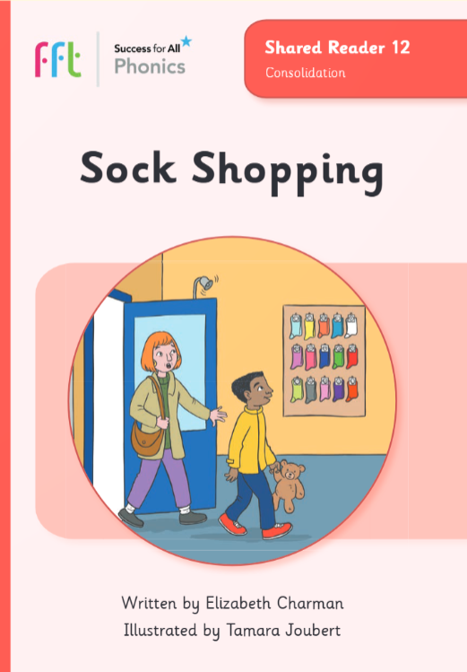
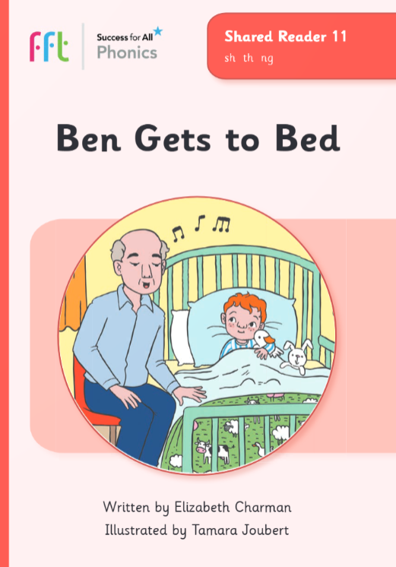



Phonics and reading to practise at home with your child
Phonics GPCs
Red words
Shared Readers
Look out for the weekly email which will contain the GPC(s) we are learning and the associated shared reader.
Reading these at home will help your children to secure their new phonics knowledge.
ai
igh
her
do
my
by
ee
oa
oo
says
they
ask
our
Click here to see how to pronounce these phonemes.
Can your child apply their phonics to decode and read these words?
Click here to go back to the main page

