Slide 1
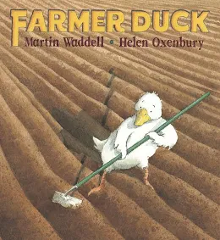


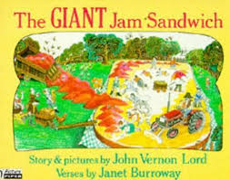

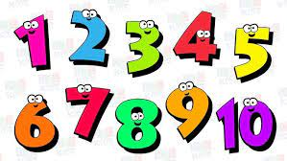

Nursery’s
PSED
Literacy, communication and language
We are reading:
Physical development
Personal, Social & Emotional Development
Through a range of different activities, children will learn to:
Face challenges and finds in which they can help overcome them
How not to give up when task are a little tricky
Help others that are finding task hard
Understand jobs and discuss what jobs involve people who help us i.e. doctors, fire fighters…
Understand how we feel when we help,others
Express emotions related to different of our tasks i.e. how to we feel when we help others or when others help us
Understanding of the world
To develop physically we will:
Continue to develop their movement, balancing, riding (scooters, trikes and bikes) and ball skills.
Try to imitate real jobs i.e. jobs like farmer duck
Skip, hop, jump. Discuss what happens when we move quickly. Feel our heart beats
Develop our cutting skills cut around pictures and shapes.
To develop our communication & language we will:
Enjoy listening to longer stories and can retell much of what happens.
Learn new words and use a wider range of vocabulary
Learn to answer comprehension questions verbally and make predictions of what might happen next in a story.
Discuss parts of stories that we like and relate that to real world and discuss what things we like to do i.e. hobbies
Through our Planned Purposeful Play we will:
Learn about habitats of animals in the stories we read
Discuss and organise animals in specific groups i.e. ones with wings/ without wings, with tails/without tails…
Discussing our own habitat. How are humans different to animals? Can we live and eat like animals? Can animals live like humans?
If not- why?
Finding out about different occupations, Looking at people who help us
Expressive art and design
For our expressive arts and design activities we will:
Collage with different textures to make animals habitats
Explore how tools can be used
Use construction materials for a range of purposes
Paint with a variety of colours
Role play actions of different jobs i.e. digging, washing
Use musical instruments to explore what sounds we can create and how it can stimulate our play.
Mathematics
Reinforcing our understanding of numbers and its values with actions
recognise small quantities without having to count them all
Identifying smaller numbers within a number
Splitting a number and recombining it.
Spot and correct the error in an AB pattern
Click here to go back to the main page

