Slide 1



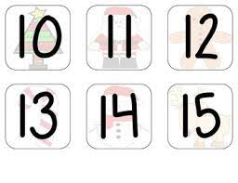
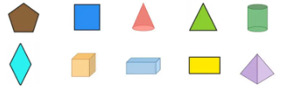
Reception’s
PSED
Literacy, communication and language
Personal, Social & Emotional Development
Caring for our new eggs and hatchlings in the classroom
Learning how to use kind hands when handling the eggs
Understanding how to keep healthy by exploring the concepts of diet, exercise, sleep and hygiene.
Understanding how to keep safe and aware of stranger danger.
Understanding of the world
Physical development
Our PE lesson is on Thursday, so please wear your PE kit to school.
-Progress towards a more fluent style of moving, with developing control and grace.
-Develop overall body-strength, balance, coordination and agility.
-Kicking games
We are reading:
We will be exploring the world around us by:
Visiting new countries/ continents each week and immersing ourselves in their culture.
Make observations of animals what hatch from eggs and explain why some things occur.
Exploring different climates and countries around the world.
Learn about the animals that live in different climates and how they survive.
Take part in chinese new year activities to celebrate the year of the horse!
To develop our writing skills we will:
We are exploring the question, ‘Who lives here?’, reading books from different corners of the world to learn about different continents and climates.
We will continue practising our Phase 3 sounds and introduce Phase 4 consonant clusters (bl, cl, br, cr)
We will use vocabulary and speech that is
influenced by the children’s experiences of books
.
Expressive art and design
Through our art and designs stations we will be:
We have transformed the role play area into an airport for the children to travel around the world.
Playing cooperatively as part of a group to develop and act out a narrative.
Beginning to build a repertoire of songs and dances.
Selecting appropriate resources and adapting work where necessary.
Mathematics
We will learn to:
•Count up to 15 objects
•Order and explore number patterns to 15
•Double and half
•Describe and sort 2-D and 3-D shapes
•Recognise, complete and create patterns

Slide 2
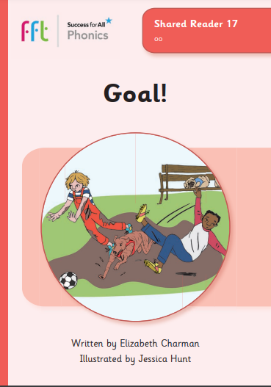
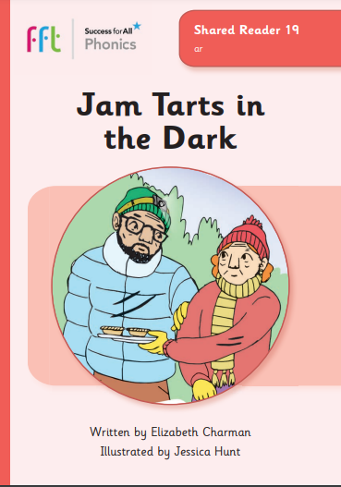
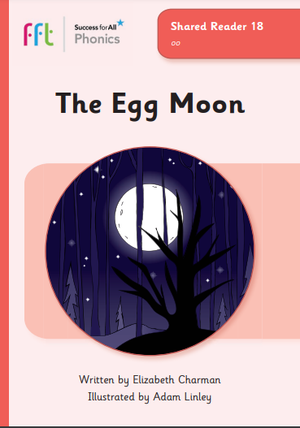
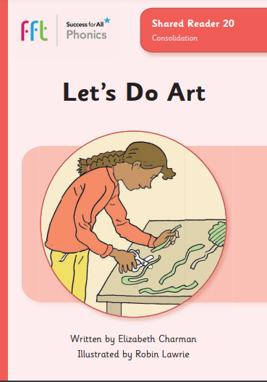
Phonics and reading to practise at home with your Reception child
Spring 2
Phonics GPCs
Red words
Reading books
Goal! Jam Tarts in the Dark
The Egg Moon Let’s Do Art
oo
ar
oo
said
was
Click here and here to see how to pronounce these phonemes
all
put
were
like
there
Can your child apply their phonics to decode and read these words?
zoom moon scoop
wool shook look
arm tarts dark
Watch out for your weekly phonics email with a link to our phonics books.
Click here to go back to the main page

