Slide 1
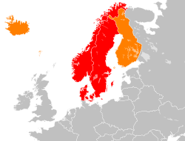
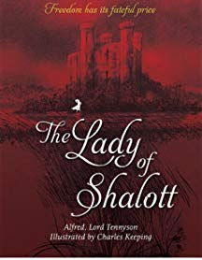

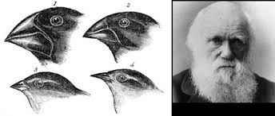
Year 6
English
Science
Geography
Scandinavia
To locate and identify the countries and capital cities of Scandinavia
Identify physical and human features of Scandinavia
Fieldwork - exploring health and wellbeing in Stratford compared to Scandinavian countries
Styles of writing to be covered
Narrative description
Balanced discussion
Narrative: Story retelling
Grammar
Use the subjunctive form correctly
Use embedded clauses effectively
Develop punctuation use (hyphens and semicolons)
Consistent use of tense-past progressing/past perfect
Use similes, metaphors and expanded noun phrases
We are reading:
Evolution and Inheritance
Recognise that living things have changed over time.
Recognise that heredity is what traits offspring inherit from parents
Recognise that living things produce offspring, but normally offspring vary and are not identical to their parents.
Identify how animals and plants are adapted to suit their environment in different ways and that adaptation may lead to evolution.
Computing
Scratch - Variables in games
Understanding how to use variables in Scratch
Using variables in programming
Using variables to improve a game
Designing a game using variables
Designing to code
Internet Safety Day
Decimals and measure
Solve problems relating to mass, money, volume, time, perimeter and area.
Geometry
Finding missing angles and lengths in triangles and quadrilaterals.
Using and applying coordinates, exploring 3D shape
Maths

Slide 2

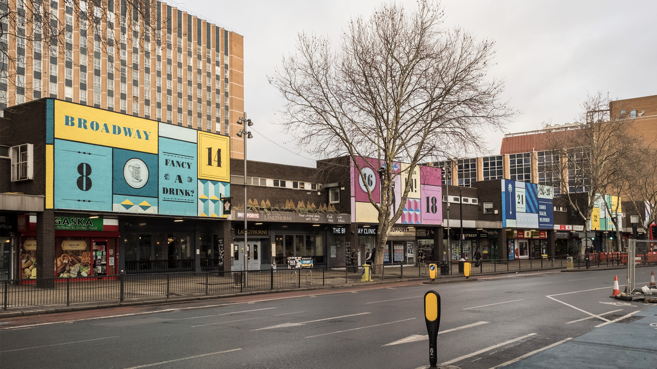

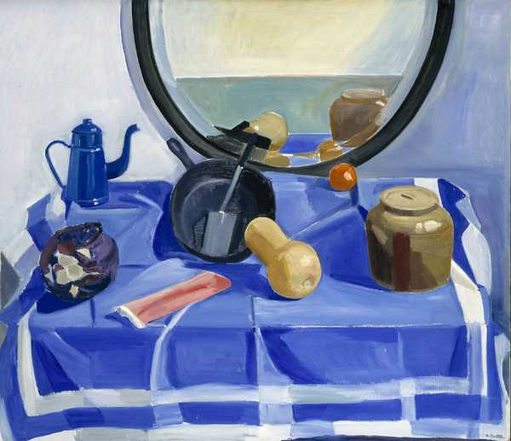
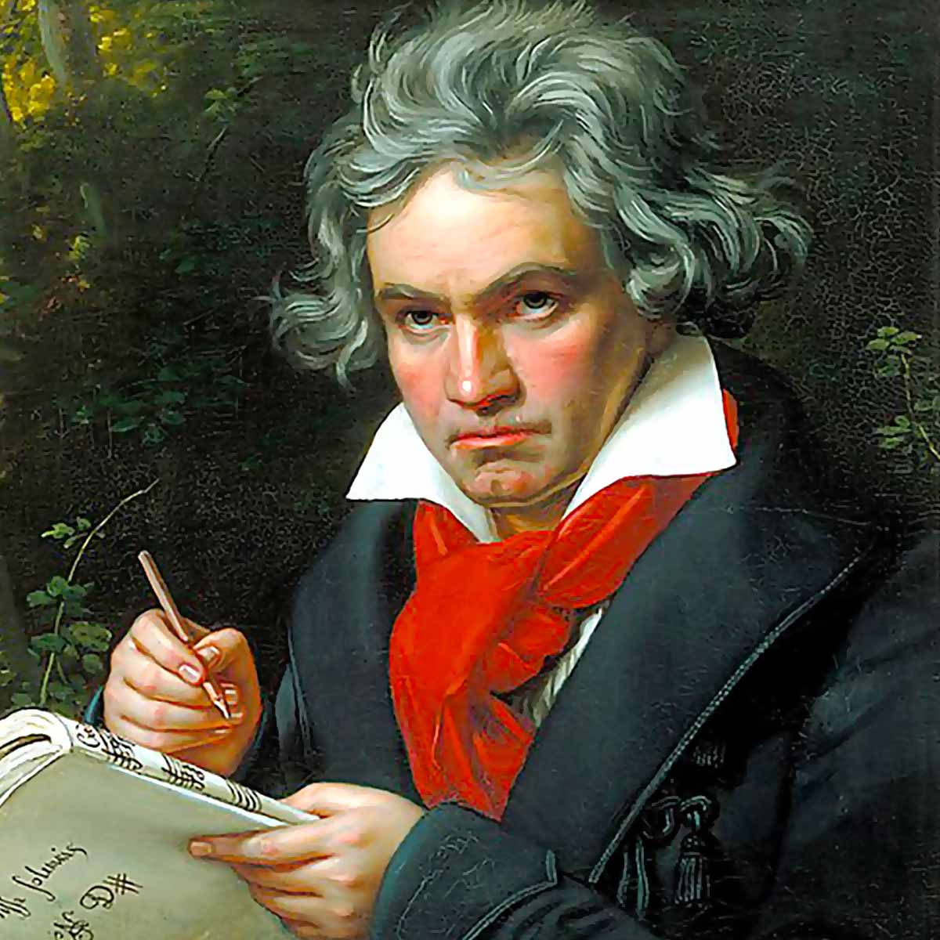
Geography fieldwork
We will be going to Stratford to survey members of the public about their wellbeing and comparing it to given data about Scandinavia.
Physical Education (PE)
This term your PE will be on:
Fundamental Focus
Sport Specific Focus |  | Tag rugby
Whole child focus | PE award for: | Planning personal physical fluency
 | Learning in class about: | Planning how to live a healthy lifestyle
Religious Education
Identify common values and practices shared among various religions and worldviews.
Examine the significance of communal gatherings for religious individuals.
Explore the importance of the Church for Christians and the Mosque for Muslims.
Evaluate the impact of places of worship on the local community.Investigate shared beliefs among different religions and worldviews.
Curriculum Enrichment
To understand there are different perceptions about what normal means
To explain some of the ways in which one person or a group can have power over another.
To know some of the reasons why people use bullying behaviours
Music
PSHE
Art
Year 6 will be composing this half term. They will be creating a piece based on Beethoven’s infamous fifth symphony.
We look forward to hearing
your compositions!
Year 6 will be investigating the Scandinavian Avant-Garde including Louisa Matthiasdottir
They will practise achieving 3D effects using a range of tones in paint before creating their own still life paintings.
Click here to go back to the main page

