Slide 1

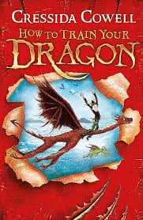

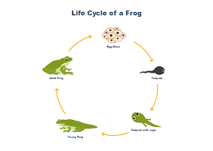
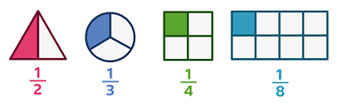
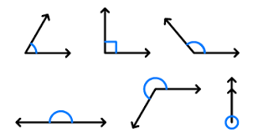
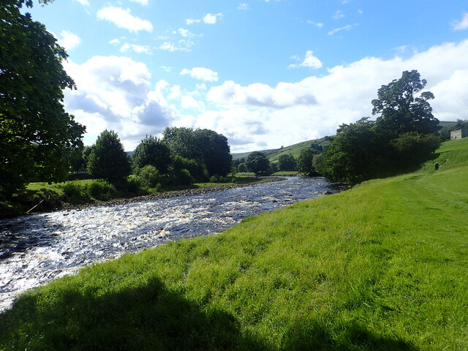
Year 5
Science
Computing
We are reading:
Living things:animals-including humans
Describe the life cycles of insects, amphibians and birds.
Understand how plants reproduce.
Understand why plants produce fruit to help them reproduce.
Compare plant
reproduction
Databases
Understanding a database
Using a database
Creating a database
Using search tools to create a database
Styles of writing to be covered
Non-chronological report
Explanation text
Recount
Grammar
Use brackets, dashes or commas for parenthesis
Use figurative language including metaphors
Use modal verbs to show possibility
Geography
Rivers Deep Mountains High:
How were UK mountains formed overtime?
Where are the Uk’s major rivers and mountain ranges?
What are the physical features of UK rivers?
What are human features of UK rivers?
How are the UK mountains formed over time?
How diverse is the wildlife around the River Lea? (Fieldwork)
How diverse is the wildlife around the River Lea? (Presentation creation)
Maths
Fractions and decimals
Compare and order fractions whose denominators are all multiples of the same number
Recognise and use thousandths and relate them to tenths, hundredths and decimal equivalents
Identify, name and write equivalent fractions of a given fraction, represented visually, including tenths and hundredths
Read and write decimal numbers as fractions
Angles
To identify, compare and order acute, obtuse and reflex angles
To measure angles using a protractor
To use a protractor to draw angles•
To know that angles at a point are equal to 360°T

Slide 2

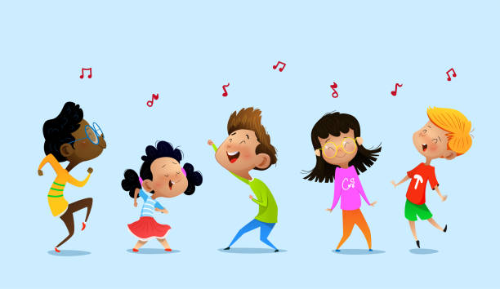

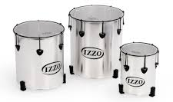
Year 5
Trip to :
Geography fieldwork -
Exploring the River Lea: Kayaking
Physical Education (PE)
This term your PE will be on: Dance
Fundamental Focus
Sport Specific Focus |  | Dance
Whole child focus | PE award for: | Preparing for personal choices
 | Learning in class about: | Identifying how to live a healthy lifestyle
Religious Education
Why is Muhammad and the Quran important to Muslim people?
Lesson 1: Investigate the significance of the night of power for Muslim people
Lesson 2: To evaluate the impact of the Shahada
Lesson 3: To investigate why the Quran is special to Muslim people
Lesson 4: How do Muslim people treat the Qur’an?
Lesson 5: How have Muhammad’s words and actions affected the way Muslims lead their lives?
Lesson 6: How have Muhammad’s words and actions affected the way Muslims lead their lives?.
Curriculum Enrichment
Landscape painting
Focus on complementary colours and analogous colours, stencil making and creating tones, patterns and textures using acrylic paint. Children create landscapes inspired by David Hockney.
Music
PSHE
ART
Samba drums: Percussion
They will learn to:
● play rhythms accurately along with a piece of recorded music
● use their voice to help play rhythms
● follow 10 hand signals
● play a steady rhythm within the group and lead a groove
● play a 5 part groove
Celebrating Differences
To understand that cultural differences sometimes cause conflict
To understand what racism is
To understand how rumour-spreading and name-calling can be bullying behaviour
To explain the difference between direct and indirect types of bullying
To compare my life with people in
the developing world
Click here to go back to the main page

