Slide 1
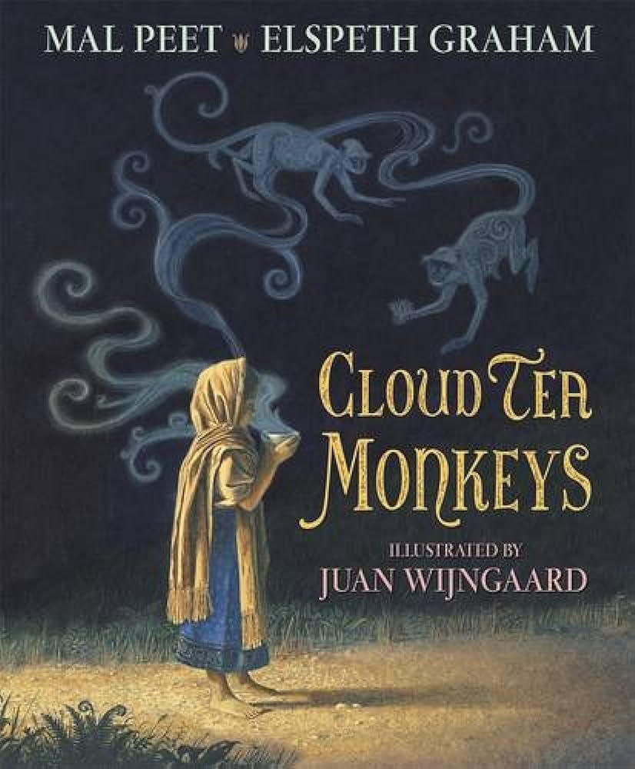
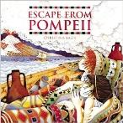
Year 3
English
Computing
Science
News report
What is a green screen?
What do I know about earthquakes and volcanoes?
How do I record a video?
How do I write a script?
We are reading:
Rocks
How we use rocks in everyday life.
Compare and group together different kinds of rocks
How are soils made?
How are fossils formed?
Research and discuss living things found as fossils.
Writing
A letter to persuade the Overseer to be kinder to his workers.
A story inspired by Escape from Pompeii.
Grammar
Use colons to introduce a list or explanation.
Use adverbial phrases for manner.
Geography
Where are Italy’s volcanoes?
Why are Italy’s volcanoes located where they are?
What causes Italy’s earthquakes and volcanoes?
Where in Selwyn school would you be safest from the effects of an earthquake?
Where in Selwyn school would you be safest from the effects of an earthquake?
Communicate findings to an audience
Maths
Multiplication and Division
Count from 0 in multiples of 4, 8, 50 and 100
Recall and use multiplication and division facts for the 3, 4 and 8 multiplication tables
Multiply and divide two-digit numbers by one-digit numbers, using mental and progressing to formal written methods
Solve problems, including missing number problems, involving multiplication and division

Slide 2
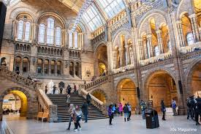


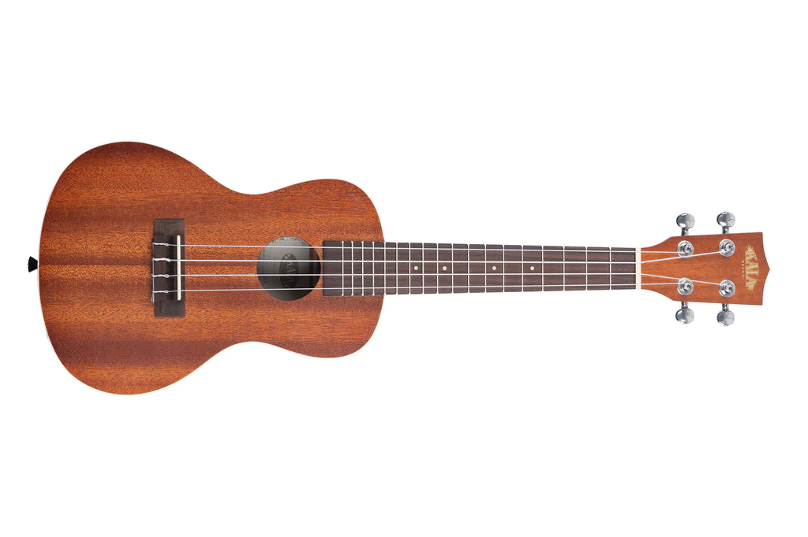
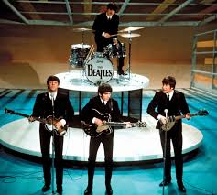
Trip to the National History Museum
Physical Education (PE)
This term your PE will be on: Wednesdays
Fundamental Focus
Sport Specific Focus |  | Outdoor Adventurous activity
Whole child focus | PE award for: | Explain why we should look after our bodies
 | Learning in class about: | Benefits of a healthy lifestyle
Religious Education
Significance of Light
Explore how light is used as a symbol and in everyday life across different cultures.
Learn why lamps and light are important in Hindu and Sikh celebrations like Diwali.
Find out how light is part of Christmas traditions and what it represents for Christians.
Discover the story behind Hanukkah and why Jewish people celebrate it.
Learn about the Hanukkah menorah and what its lights mean in Jewish tradition.
Curriculum Enrichment
ART
Music
PSHE
Painting the weather inspired by JMW Turner
Analyse an artwork
Explore colour
Represent movement
Experiment with texture
Paint a seascape
Children will have an introduction to the ukulele; how to hold and pluck the 4 strings
We will continue songs
as it is at the heart of a
our music curriculum.
We will also be listening to music by The Beatles and learning just why they were so popular!
Celebrating Differences
Recognise that every family is unique and special.
Understand that conflicts can happen in families.
Learn what it means to witness bullying and how actions can help or harm.
Identify hurtful language and its impact.
Reflect on how your words can affect others and their consequences.
Click here to go back to the main page

