Slide 1




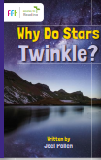
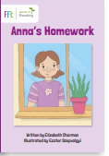
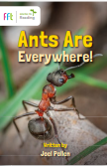
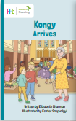
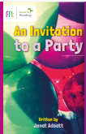
Year 2
Year 2
English
Writing texts
Computing
Science
This term, Year 2 will be entering data to make pictograms using the programme Jit 5.
The children will read a range of fiction and non-fiction quality texts including
The day the crayons quit, The day the crayons came home and If I were Prime Minister.
In writing the children will be writing a persuasive letter and a non-narrative explanation text.
We have a new reading scheme which links with our grammar, phonics and spelling.
You can enjoy these books with your child at home Please see links to these books on next slide
Year 2 will be focusing on living things and their habitats.
Comparing things that are living, non-living and have never been alive (e.g. animals and objects)
Understand what habitats are and what they provide.
Identify animals that live in microhabitats.
Identify animals and their food.
Construct a food chain and explain what it means.
We are reading
Geography
This term in Geography, Year 2 will be learning about some of the iconic landmarks in the city of London. To do this they will doing the following:
Locating london on a map .
Identifying London landmarks
Comparing similarities and differences
Children learn about the Physical geography of London as well as how it has been impacted by humans
Design a London Landmark
This term, Year 2 will be focussing on telling and writing the time, including quarter past and quarter to. The children will be able to compare and sequence intervals of time. They will identify the number of hours in a day and the minutes in an hour.
Children will identify and compare fractions, including halves, quarters and thirds of shapes, moving onto learning about numerators and denominators.
Maths

Slide 2

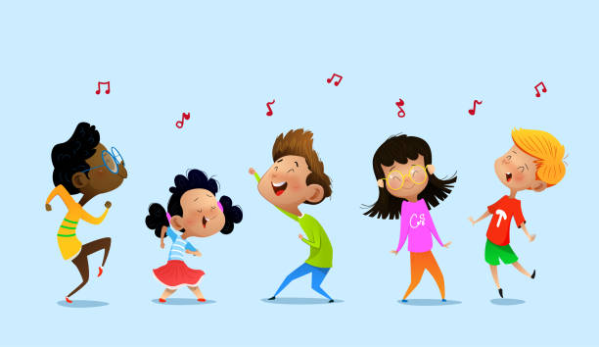



This term we will be participating in an educational visit to see London landmarks and the National Art Gallery.. We will also engage in a Great Fire of London workshop with the London Fire Service.
Physical Education (PE)
This term your PE will be on: Mondays
Fundamental Focus
Sport Specific Focus |  | Dance
Whole child focus | PE award for: | Describe how we look after our bodies
 | Learning in class about: | Describing how the body works.
Art
Religious Education
What can stories teach us about forgiveness?
-Define the meaning of apologising and saying sorry.
-Explore reasons why some individuals may resist or choose not to apologise.
-Extract lessons from the story to gain insights or guidance.
-Investigate diverse perspectives on forgiveness and the act of apologising from others.
-Determine methods for expressing personal values and the importance of effectively communicating them.
Use ‘wrong hand’ and ‘continuous line’ techniques. Practise drawing leaves using methods from previous lessons. Experiment with different mediums and pencil types.
Curriculum Enrichment
PSHE
Celebrating Difference:
-How important friendships are in making us feel happy and secure, and how people choose and make friends
-The importance of respecting others, even when they are very different from them (for example, physically, in character, personality or backgrounds), or make different choices or have different preferences or beliefs
-About the concept of privacy and the implications of it for both children and adults; including that it is not always right to keep secrets if they relate to being safe
Music
https://parents.fft.org.uk/YR2_The_Dreams_of_Moxie_Mouse_and_Cat_Capone
Links to FFT reading texts
Year 2 will:
-continue learning songs to widen their vocal range
-practise creating rhythms on tuned and untuned percussion
-listen to the music of James Brown.
https://parents.fft.org.uk/YR2_Kongy_Arrives
https://parents.fft.org.uk/YR2_Why_Do_Stars_Twinkle
Click here to go back to the main page

