Slide 1




English
Science
Computing
Digital painting:
How can we paint using computers
Using shapes and lines
Using shapes to create art
Creating a painting in the style of an artist
We are reading:
Year 1 will be expanding their knowledge about animals, including humans. Children will be focusing on:
Identifying and naming parts of the human body + animals
Identifying and naming different animals
Grouping animals
Identifying similarities and differences between animals
Grammar:
Conjunctions
Capital letters
Exclamation and question marks
Styles of writing covered:
Instructions
Two recounts
Two character descriptions
Geography
We are learning about the UK landscape and answering the enquiry question: ‘How are UK urban and rural landscapes different?
We will investigate:
Where is England?
What is the difference between the UK’s urban and rural areas?
How is London different from its surrounding countryside?
What natural and man-made features can we find?
Geography Challenges Day
Exploring calculation strategies within 20
Model, explain and choose addition and subtraction strategies
Numbers to 50
2-digit numbers - represent, sequence, explore, compare
Cont in 2s, 5s and 10s
Describe and complete number patterns
Addition and subtraction within 20 (comparison)
Comparing and finding difference
Applying ‘Make ten’ to find difference
Writing equations to compare numbers
Problem solving
Maths

Slide 2



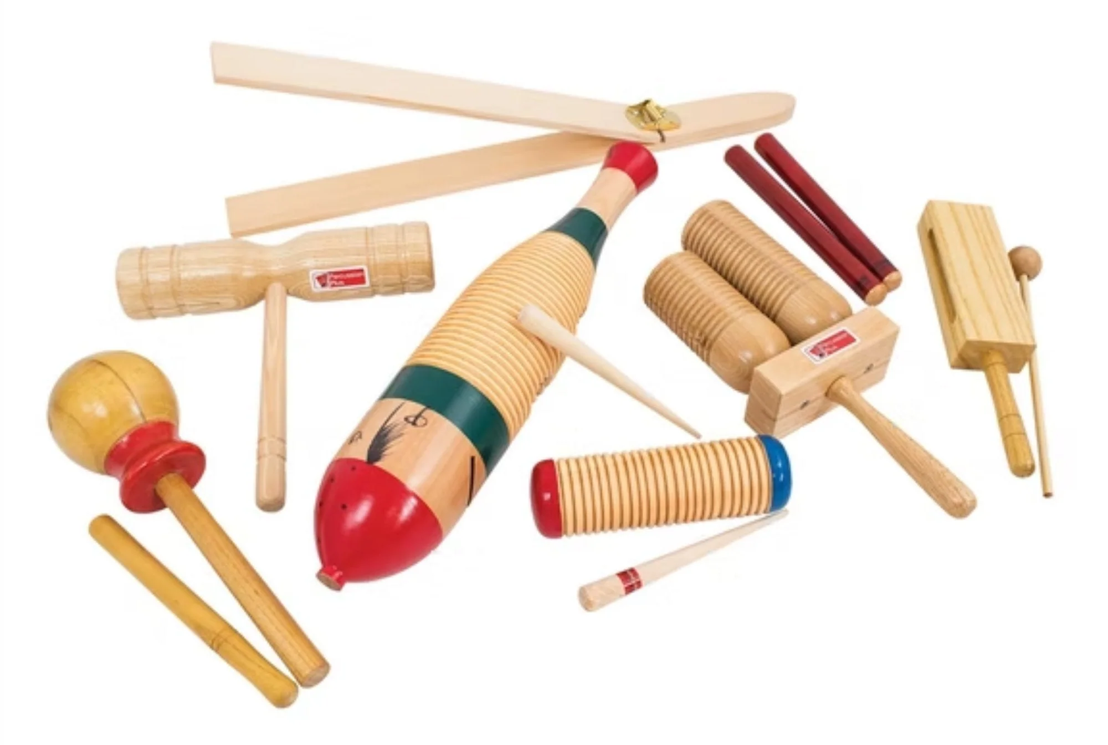
- Celebrate Safer Internet Day
- Geography fieldwork and challenges Day
Physical Education (PE)
This term your PE will be on: Tuesdays
Fundamental Focus
Sport Specific Focus |  | Dance
Whole child focus | PE award for: | Identify how are bodies work
 | Learning in class about: | How are bodies work
Religious Education
What does it mean to belong to Sikhism?
Examine how individuals within religious communities demonstrate a sense of belonging.
Define Sikhism and explore its key practices.
Investigate ways in which children express their faith with Sikhism.
Understand the significance of the story of Guru Nanak bathing in the river in Sikh tradition.
Curriculum Enrichment
PSHE
Art
Music
Rhythm:
- Practise playing to the beat of the music
- To try and copy and repeat a rhythm on an instrument
-To play an untuned instrument along to a piece of music
Celebrating difference:
To identify similarities between people in my class
To celebrate differences between people in my class
To tell you what bullying is
To know some people who I could talk to if I was feeling unhappy or being bullied
To know how to make new friends
To tell you some ways I am different from my friends
Painting British Flora
Analyse an art work
Explore colour
Experiment with texture
Use decoupage
Paint a leaf

Slide 3










Phonics and reading to practise at home with your child
Phonics GPCs
Red words
Reading books
Look out for the weekly email which will contain the GPC(s) we are learning and the associated shared reader.
Reading these at home will help your children to secure their new phonics knowledge.
plant
floor
every
grass
whole
only
Click here to see how to pronounce these split digraphs.
move
father
eye
Can your child apply their phonics to decode and read these words?
Click here to go back to the main page

