Slide 1
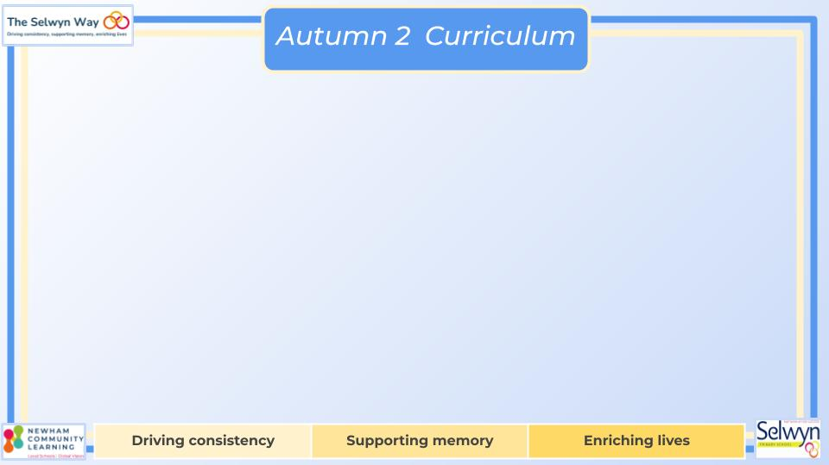
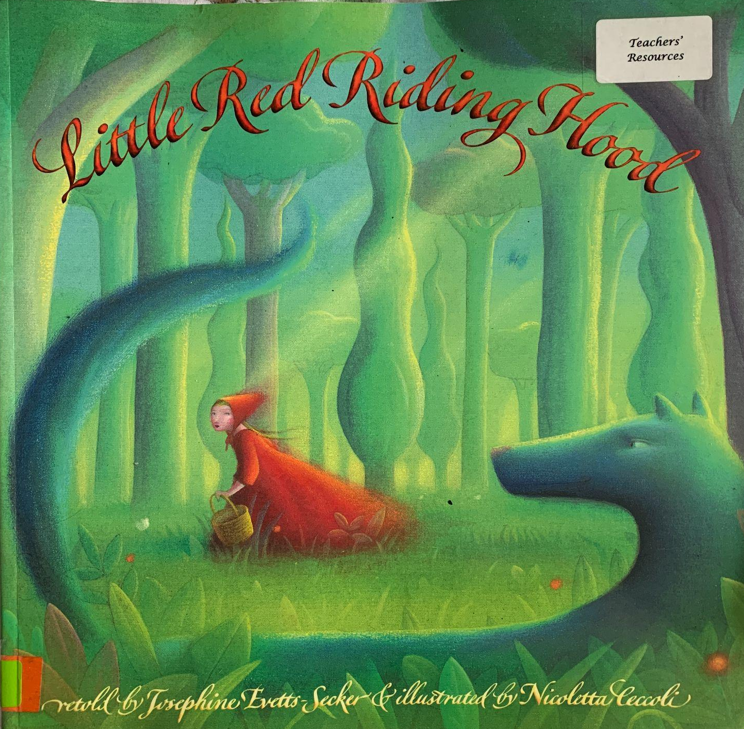




Year
English
Computing
Science
Understand what personal information is.
Learning how to log on to the chromebooks.
Practising our mouse and keyboard skills.
Learning how to save work
We are reading:
Distinguish between an object and the material
Identifying and naming materials
Grouping objects based on their materials
Comparing the properties of different materials
Conducting scientific enquiries centred around the following questions:
How waterproof?
How absorbent?
Grammar and punctuation focus:
Capital letters and full stops
Question marks
Use a capital letter for the personal pronoun ‘I’
Writing outcomes:
Two character descriptions
Two fact files
Short story
Recount
History
The Gunpowder Plot: Why did the Gunpowder Plot happen?
Why was the gunpowder plot developed?
- What happened during the Gunpowder Plot?
- What can we learn from primary sources?
- What was the chronology of the Gunpowder Plot?
- A fact file - Why do we remember the 5th November?
Maths
Numbers to 20
•Identify, represent, compare and order numbers to 20 •Doubling and halving
•One more and one less
Addition and subtraction within 20
•Represent and explain addition and subtraction strategies including ‘Make Ten’
•Use known facts to add and subtract

Slide 2
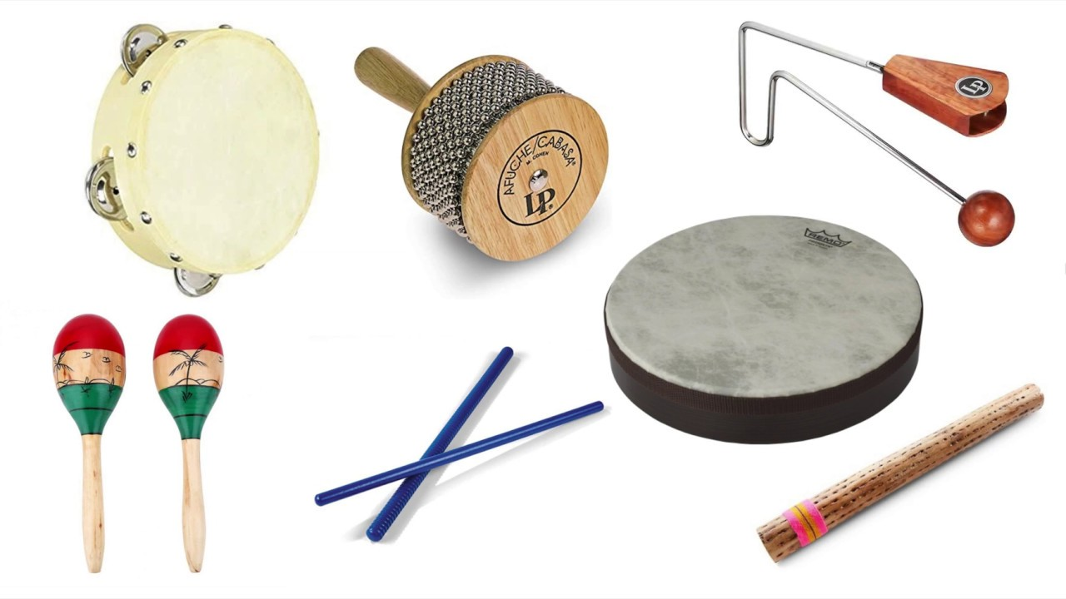

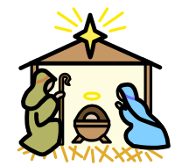
Year
History engagement afternoon - Why do we remember the 5th November?
Wow Day:A themed day where children can dress up, inspired by the Gunpowder Plot and will do a range of Gunpowder Plot-inspired activities.
Physical Education (PE)
This term your PE will be on:
Fundamental Focus |  | Static Balance - seated Dynamic balance to agility
Sport Specific Focus |  | Gymnastics
Whole child focus | PE award for: | Relating to emotions
 | Learning in class about: | Describing types of emotions
Religious Education
How do Christians celebrate Christmas?
Identify the characteristics that make a gift special.
Understand the reasons behind giving gifts.
Recognise the date and timing of Christmas.
Describe the common customs and traditions of Christmas.
Analyse the role of a church in teaching the Christmas story, including the use of nativity scenes and religious services.
Curriculum Enrichment
Music
PSHE
DT
Dreams and Goals
To set simple goals
To set a goal and work out how to achieve it
To understand how to work well with a partner
To understand challenges will help my learning
To tell you how I felt when I succeeded in a new challenge
Snack Bars
Analyse snack bars
Explore ingredients
Design snack bars
Create snack bars
Test and evaluate recipes
The children will be preparing for their Winter Nativity performance.
They will be using their voices expressively and creatively, singing songs and speaking chants and rhymes in the performance.

Slide 3

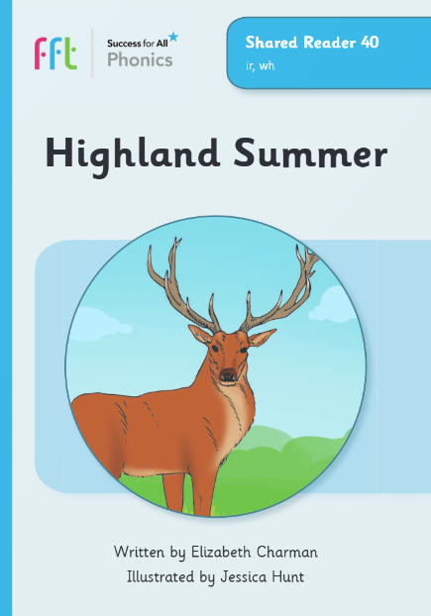
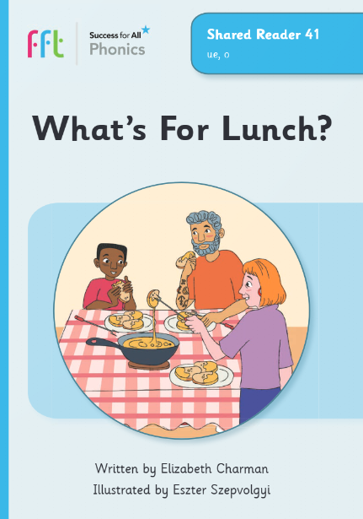
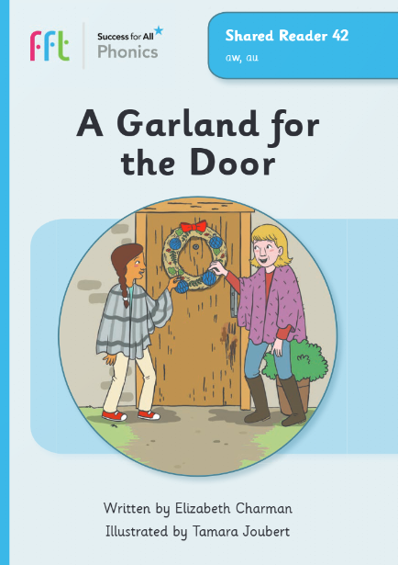

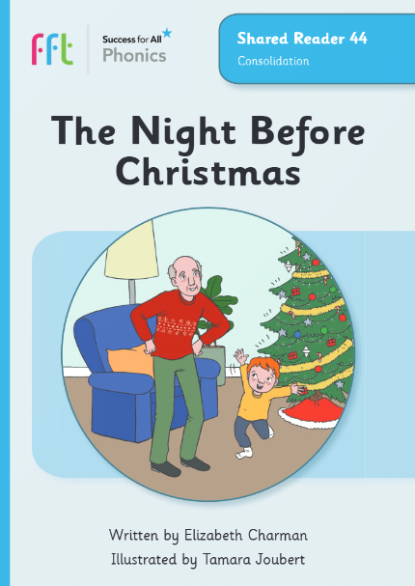








Phonics and reading to practise at home with your child
Click here to go back to the main page
Phonics GPCs Set 5
Red words
Shared Readers
ir
(girl)
ue
(blue/cue)
could
any
who
because
would
aw
(jaw)
ew
(blew/new)
E-Reader
E-Reader
E-Reader
water
past
you
through
two
hour
Click here to see how to pronounce these phonemes.
door
floor
many
E-Reader
E-Reader
Christmas
different
Or, click on the book name to a video of the Shared Readers.
Highland Summer
Can your child apply their phonics to decode and read these words?
What's For Lunch?
A Garland for the Door
Just The One Moon
The Night Before Christmas

