Slide 1
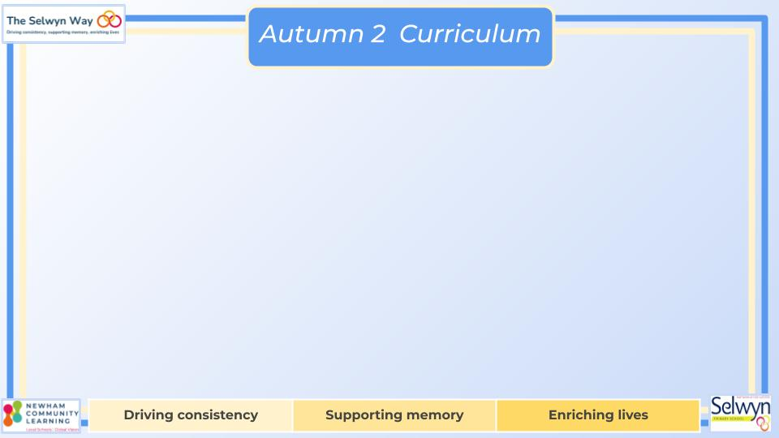
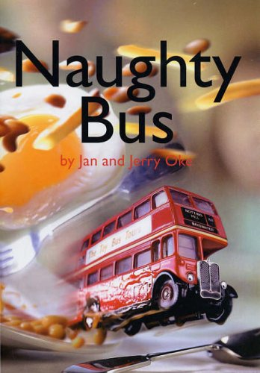


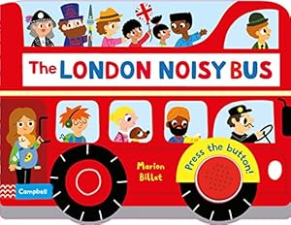


Nursery’s
PSED
Literacy, communication and language
We are reading:
Understanding of the world
We are reading:
This term through a range of different activities, children will learn to:
Face challenges and finds in which they can help overcome them
How not to give up when task are a little tricky
Discuss what we can further work on, setting goals
Help others that are finding task hard
Understand jobs and discuss what we would like be when we get older
Understand how we feel when we can do a task.
Express emotions related to different of our tasks i.e. how to we feel when something is hard and how we feel when can can achieve something. Relating this to the colour monsters
Physical development
Through our Planned Purposeful Play we will:
Talk about our holidays
Describe special times and events such as birthdays and celebration with family
Show interest in different occupations.
Discuss occupations parents are in
Looking at how we travel. Whether we can always use same mode of transportation to get to different places
Explore and talk about different forces we can feel.
We will look at maps, why we use them and make our draw our own maps
To develop physically we will:
Continue to develop their movement, balancing, riding (scooters, trikes and bikes) and ball skills.
Go up steps and stairs, or climb up apparatus, using alternate feet.
Skip, hop, stand on one leg and hold a pose for a game like musical statues.
To develop our communication & language we will:
Enjoy listening to longer stories and can remember much of what happens.
Learn new words and use a wider range of vocabulary
Learn and sing large repertoire of songs.
Engage in conversation with peers and adults
Discuss different modes of transportation and what they travel on i.e. planes travel in the air..
Expressive art and design
For our expressive arts and design activities we will:
Collage with different textures
Sing songs about seasons and celebrations
Explore how tools can be used
Use construction materials for a range of purposes
Paint with a variety of colours
Create junk model vehicles using wooden nails and hammers
Role play being drivers of bus, train…
Mathematics
Recite numbers past 5.
Say one number for each item in order: 1,2,3,4,5.
Show ‘finger numbers’ up to 5.
Compare quantities using language: ‘more than’, ‘fewer than’.
Talk about and explore 2D (for example, circles, rectangles, triangles) using informal and mathematical language. Manipulate 2D shapes to create patterns and pictures
Click here to go back to the main page

