Slide 1
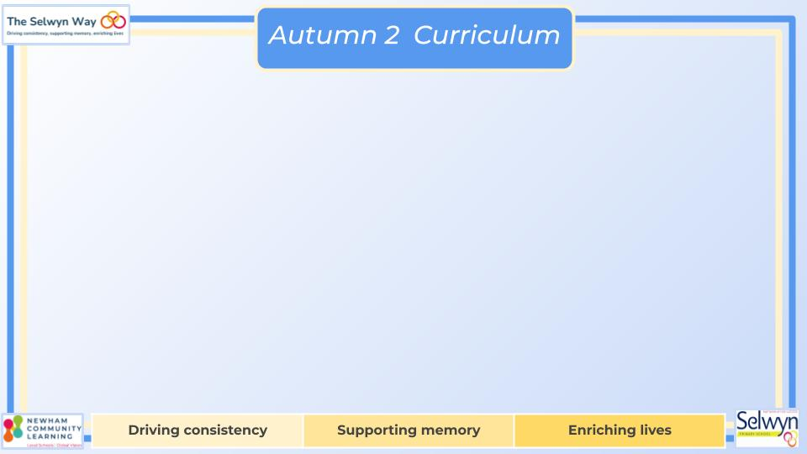
Butterfly, Bumblebee & Ladybird
Maths
Reading and Writing
We are reading:
Butterfly
Butterfly
Bumblebee
Bumblebee
Ladybird
Ladybird

Slide 2
Butterfly, Bumblebee & Ladybird
PSED
Communication
Physical development
Building relationships
Managing self
Self-regulation
Understanding of the world
Listening, attention and understanding:
Speaking:
Geography
Science
Gross Motor
Fine Motor
Expressive art and design
Music

