Slide 1
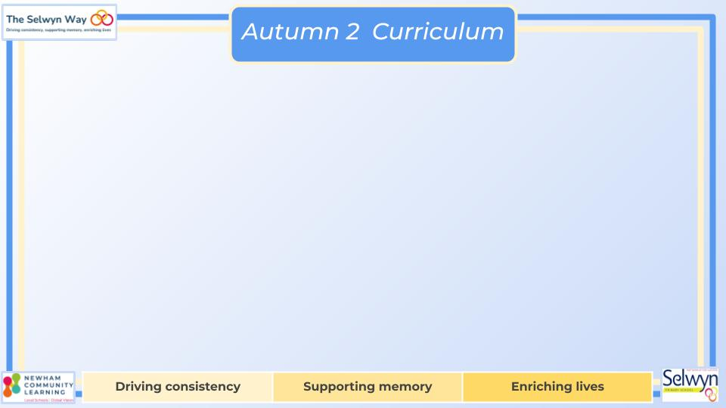
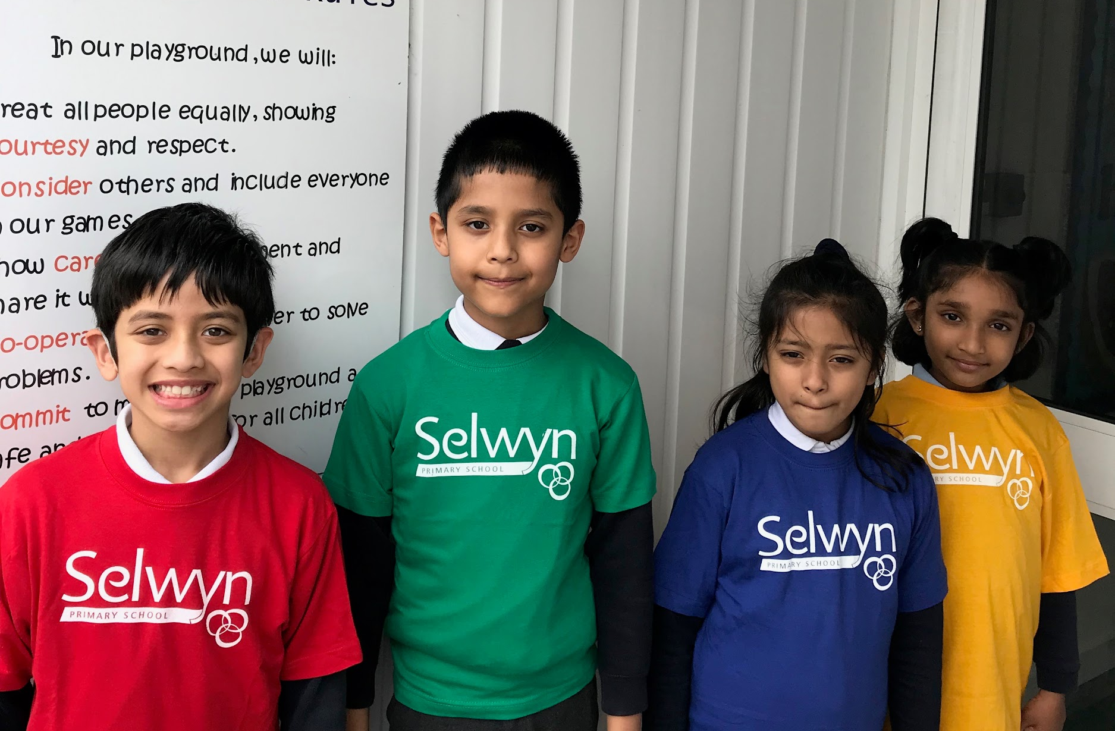



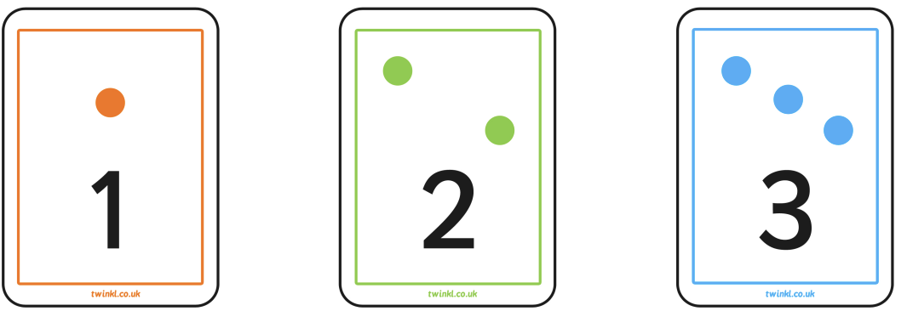
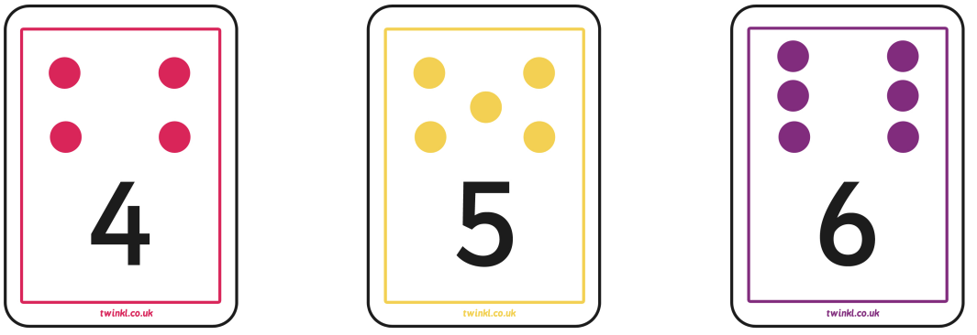

Reception’s
PSED
Literacy, communication and language
Personal, Social & Emotional Development
Our topic is ‘Dreams and Goals’.
Our objectives are:
- I understand that if I persevere I can tackle challenges.
- I can tell you about a time I didn’t give up until I achieved my goal.
- I can set a goal and work towards it.
- I can use kind words to encourage people.
- I understand the link between what I learn now and the jobs I might like to do when I am older.
- I can say how I feel when I achieve a goal and know what it
means to feel proud.
Physical development
Understanding of the world
Our PE is on Monday morning.
Please wear your PE kit to school.
To develop physically we will:
-Balance
-Gymnastics
-How to play with others
-Different types of food
-Labeling our emotions
We are reading:
To develop our communication & language we will:
Begin to use more complex sentences to link thoughts (e.g. using and, because).
Retell a simple past event in correct order (e.g. went down slide, hurt finger).
Use talk to connect ideas, explain what is happening and anticipate what might happen next
Recall and relive past experiences
Show understanding of prepositions such as ‘under’, ‘on top’, ‘behind’ by carrying out an action or selecting correct picture.
-
Through our planned purposeful play we will:
Learn about different types of transport.
Recall and role play times the different modes of transport I’ve been on.
Learn about different animals from farms and other environments.
Talk about what makes the animals different to one another.
Talk about different types of houses and where I live.
Expressive art and design
For our expressive arts and design activities we will:
Learning and reciting songs by heart for our Christmas assembly
Listening to a wide range of music and responding
We will be creating different types of transport using different materials to match our topic and crafts relating to current events, e.g. Bonfire Night.
Mathematics
We will be covering:
-Numbers within 6
-Addition and subtraction within 6
-Measure
-Shape and sorting
Click here to go back to the main page

