Slide 1
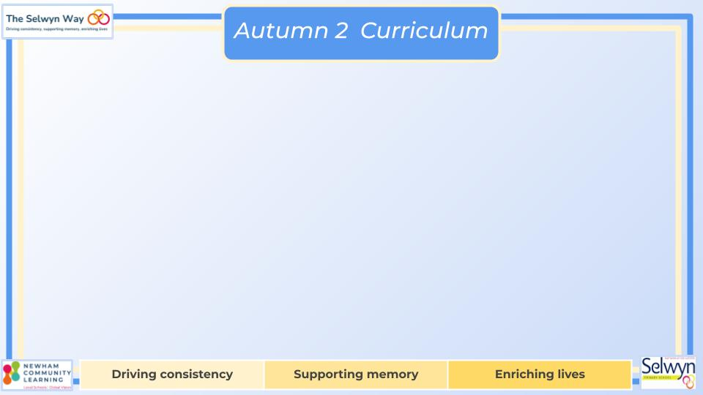
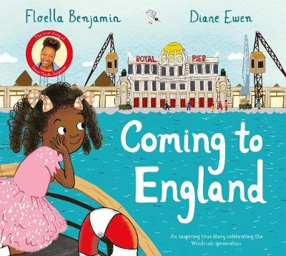

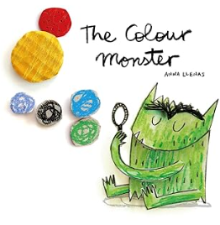
Year 2
We are reading:
Coming to England
If I were a Prime Minister
The colour Monster
Computing
English
Science
Computer Systems and Networks
Children will learn how to use the main features of a computer. Key skills:
Online Safety
Robot Algorithms: Planning an Escape Route
Create a series of instructions that can be run as a program
Create and run a program on a device
Debug a program
Year Two will be learning all about different materials. Here are the objectives they will cover:
Identifying everyday materials
Describing the properties of different materials
Comparing different materials
Evaluating the suitability of different materials
Writing focus:
Balanced discussion
Non-narrative: explanation
Explanation text
Grammar focus:
Apostrophes for contractions
Third person pronouns
Coordinating conjunctions
Subordinating conjunctions
Past and present tense
Suffixes
Synonyms
Fronted Adverbials
History
In history, the children will be looking at the impact that the 2012 London Olympics had on the local area of Stratford.
Investigating the key events leading up to the Olympics
Exploring how the Olympic Park has changed.
Identifying the impact on the area
Learning about the significance of a local figure
Using a range of historical sources
The children will also be learning about Black History Month and its importance.
Maths
Measure- Length
-Compare and order lengths and record the results using >, < and =
Graphs
-Interpret and construct simple pictograms, tally charts, block diagrams and simple tables
Multiplication and Division
-Recall and use multiplication and division facts for the 2, 5 and 10 multiplication tables, including recognising odd and even numbers
-Calculate mathematical statements for multiplication and division within the multiplication tables and write them using the multiplication (×), division (÷) and equals (=) signs

Slide 2
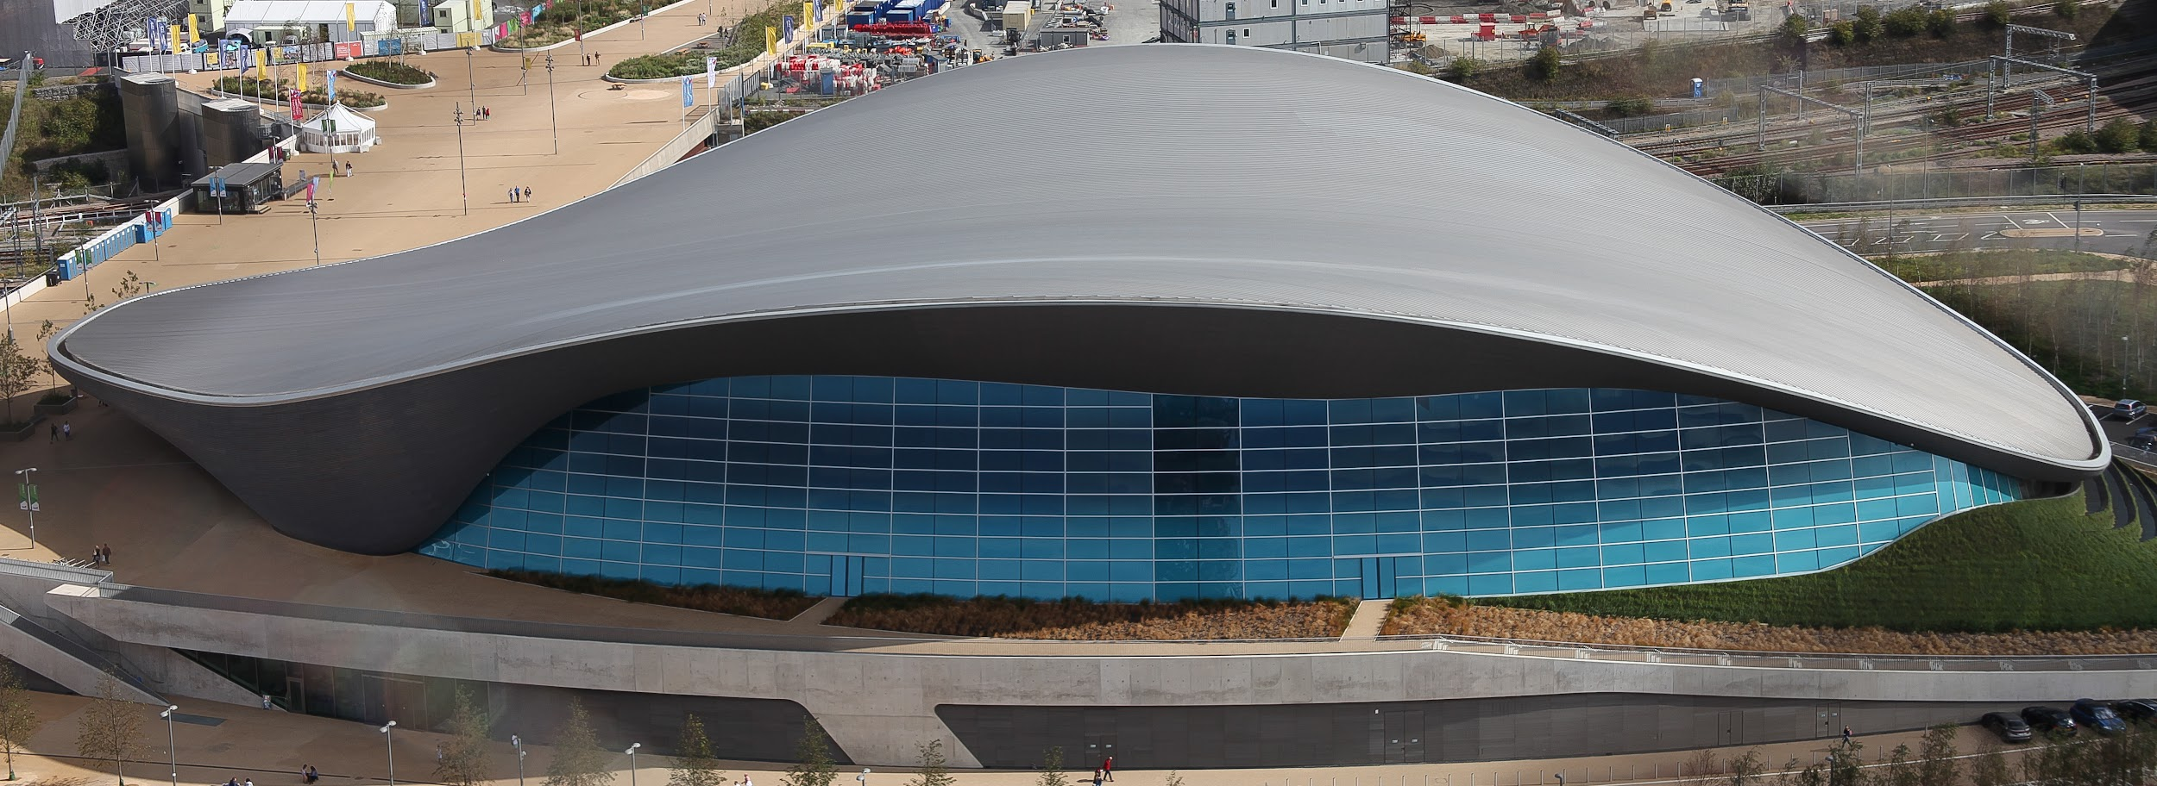
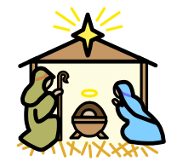

Year 2
We will be planning a trip to the Olympic park to see the Olympic stadium to link with ouu history topic.
Physical Education (PE)
This term your PE will be on: Thursday
Fundamental Focus |  | Static Balance - Seated Dynamic Balance to agility- Jumping and landing
Sport Specific Focus |  | Gymnastics
Whole child focus | Learning to: | Regulate Emotions
 | Learning about: | Regulation Strategies
Religious Education
Why are different books special for different people?
-Explore the factors that make certain books more significant than others.
-Identify special holy books and explain why they are important.
-Explore why the Bible is considered special, and for whom it is significant.
-Learn about the Torah and understand why it's important in Judaism.
-Discover why the Qur'an is a special book in Islam and what makes it unique.
Curriculum Enrichment
Music
PSHE
Singing and performing
The children will be preparing for
their Winter Nativity performance.
They will be using their voices expressively and creatively, singing songs and speaking chants and
rhymes in the performance.
Dreams and Goals:
-To choose a realistic goal and think about how to achieve it
-To persevere even when I find tasks difficult
-To recognise who it is easy for me to work with and who it is more difficult for me to work with
-To work cooperatively in a group to create an end product
-To know how to share success with other
People
Zones of Regulation - emotional support
Design and Technology
Olympic Stadium Design
-Experimenting with a range of materials to build structural models. Children will develop an original stadium design using CAD and technical drawing methods inspired by contemporary architects.
Click here to go back to the main page

