Slide 1
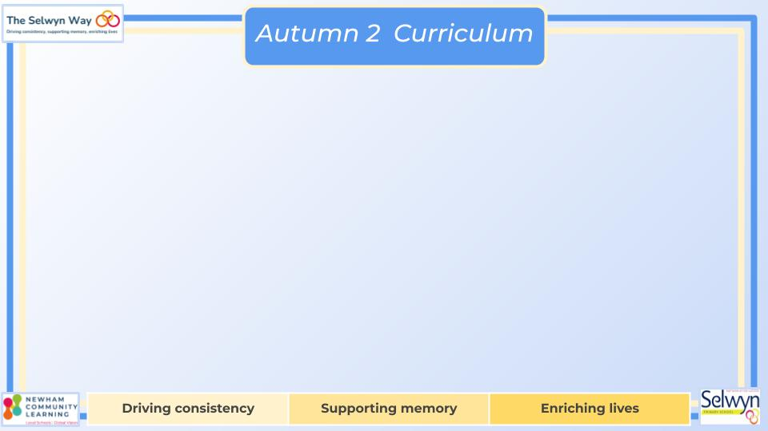

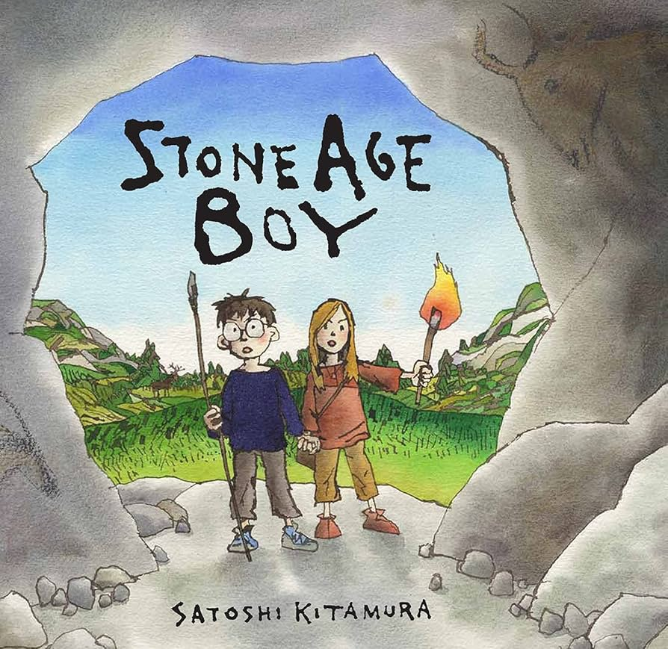
Year
English
Computing
Science
Use sequence, selection, and repetition in programs; work with variables and various forms of input and output
Use logical reasoning to explain how some simple algorithms work and to detect and correct errors in algorithms and programs
We are reading:
Forces and Magnets
Explore different surfaces to discover which ones create more friction, helping them understand why some surfaces provide better grip.
Use force meters to measure the amount of force needed to move objects, learning how friction is measured in Newtons.
How magnets can push or pull objects without touching them, exploring the concept of magnetic fields and how magnets interact.
Investigate which everyday materials are attracted to magnets.
Look at how magnets are used in everyday objects like fridge doors and whiteboard erasers.
Writing outcomes
Character description of Mr Fox
Description of a setting from the story.
Narrative Short Story
Diary entry from the perspective of Stone Age boy
Grammar
Coordinating conjunctions
Adverbial phrases
Apostrophes for possession
Begin to use prepositions ‘before, after, du
Geography
Why was Stonehenge Created?
What was Britain like during the Paleolithic and Mesolithic periods?
How did Britain change during the Neolithic period?
What do different historians say about Stonehenge?
Debate contested interpretations - Why was Stonehenge created?
A report - Why was Stonehenge created?
Maths
Addition and Subtraction
• Estimate the answer to a calculation and use inverse operations to check answers
• Add and subtract mentally including adding 1s, 10s and 100s to a three-digit number
• Add and subtract numbers with up to 3 digits, using formal written methods of columnar addition and subtraction
• Solve problems, including missing number problems, using number facts, place value, and more complex addition and subtraction

Slide 2
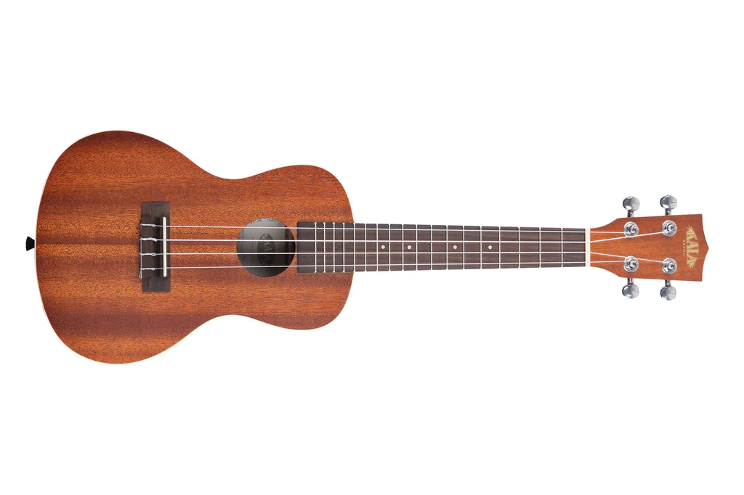

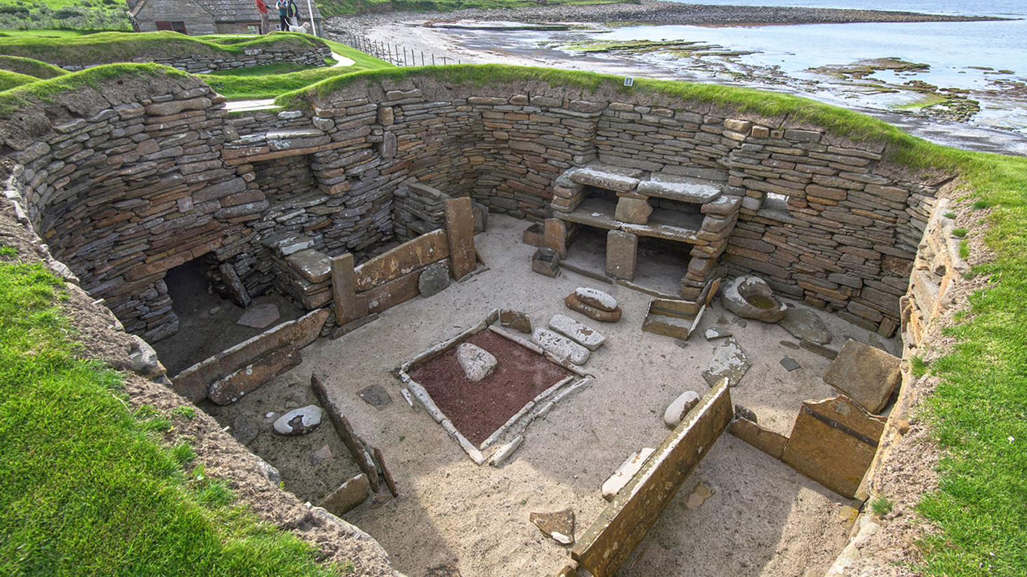
Year
Trip to the Cinema
Pantomime Experience
Physical Education (PE)
This term your PE will be on:
Fundamental Focus |  | Jumping and Landing Seated Balance
Sport Specific Focus |  | Dance
Whole child focus | PE award for: | Labelling Others Emotions
 | Learning in class about: | Developing Emotional Vocabulary
Religious Education
Significance of Light
Explore how light is used as a symbol and in everyday life across different cultures.
Learn why lamps and light are important in Hindu and Sikh celebrations like Diwali.
Find out how light is part of Christmas traditions and what it represents for Christians.
Discover the story behind Hanukkah and why Jewish people celebrate it.
Learn about the Hanukkah menorah and what its lights mean in Jewish tradition.
Curriculum Enrichment
DT
Music
PSHE
Houses
Children will research how houses evolved from the Stone Age to the Bronze Age, focusing on key elements still used today. Inspired by modern designs, they will experiment with materials, build models, create visualisations, and evaluate their work before developing a final house design.
Children will have an introduction to the ukulele; how to hold, strum and pluck the strings
We will be preparing songs for our winter assembly
We will be listening to
the music of composer
A. R. Rahman.
Dreams and Goals
Children will discuss different challenges and how perseverance leads to success.
Explore dreams and goals, with children sharing their own ambitions.
The class will design a garden to help people facing challenges, working in teams.
Children will use problem-solving techniques to overcome obstacles in their projects.
Reflecting on Successes.
Click here to go back to the main page

