Slide 1
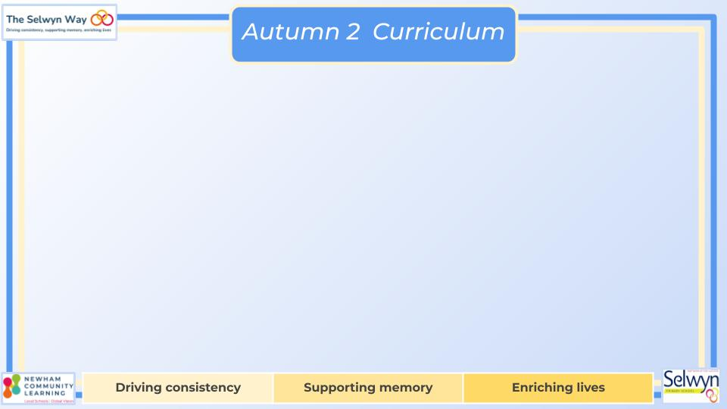
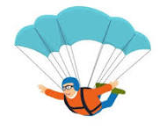

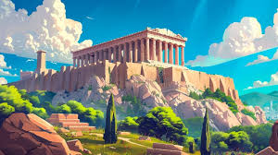
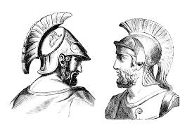
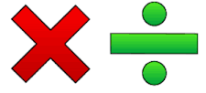

Year 5
English
Computing
Science
Graphic Design
Create drawings and designs using different shapes
Learn how to resize, rotate and change the colours of shapes in a drawings.
To group shapes together
Forces
Understand how gravity affects objects
Understand air resistance as a force
Testing falling rates due to air resistance
Understand water resistance as a force
Understand how levers are used to move objects
Style of writing to be covered:
-Recount
-Balanced discussion
-Short story
Grammar and punctuation:
-Using commas after subordinating clauses.
-Similes and metaphors.
-power adjectives and power of three.
We are reading:
History
Ancient Greece
What were the similarities and differences between Athens and Sparta?
Research using primary and secondary sources p.1 and 2
Explore historical concepts
Discuss historical contrasts
Write a report - What were the similarities and differences between Athens and Sparta?
Develop creative responses
Maths
Multiplication & Division
Find multiples and factors of numbers
Multiply and divide by 10,100 and 1000
Use a formal written method for multiplying and dividing
Develop f formal written method for short division
Perimeter & Area
Calculating perimeter
Calculating perimeter of rectilinear shapes
Calculating the area of rectilinear shapes

Slide 2
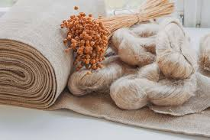

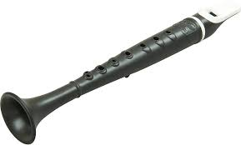
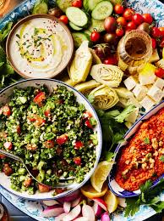
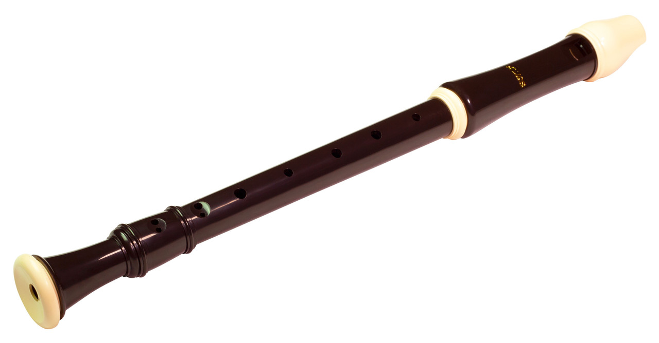
Year 5
Physical Education (PE)
This term your PE will be on:
Fundamental Focus |  | Dynamic balance and Static Balance
Sport Specific Focus |  | OAA
Whole child focus | PE award for: | Managing conflict
 | Learning in class about: | Conflict management strategies
Religious Education
How is Christmas celebrated around the world?
What differences are there in accounts given by Luke and Matthew?
Which stories have developed from the ‘real’ Christmas story?
What happens during Advent?
How do Christmas traditions vary around the world?
How is Epiphany celebrated around the world?
Gardening sessions
Curriculum Enrichment
DT
Music
PSHE
Topic: Designing a Mezze dish
Design a balanced dish in the Greek Mezze style.
Design for a target audience.
Make and evaluate their dish.
After much success in Year 4, Year 5 will continue learning to play the flutephone and recorder thereafter.. They’ll learn low D as well as high C and D and gradually learn to read music.
They will also prepare
a song for the winter
assembly.
Topic: Dreams and Goals
Understand that I will need money to achieve some of my goals.
Learn about a range of jobs by people I know.
Identify a job I would like to do, and discover how I can get there.
Understand that communicating with someone from a different culture is valuable.
Click here to go back to the main page

