Slide 1
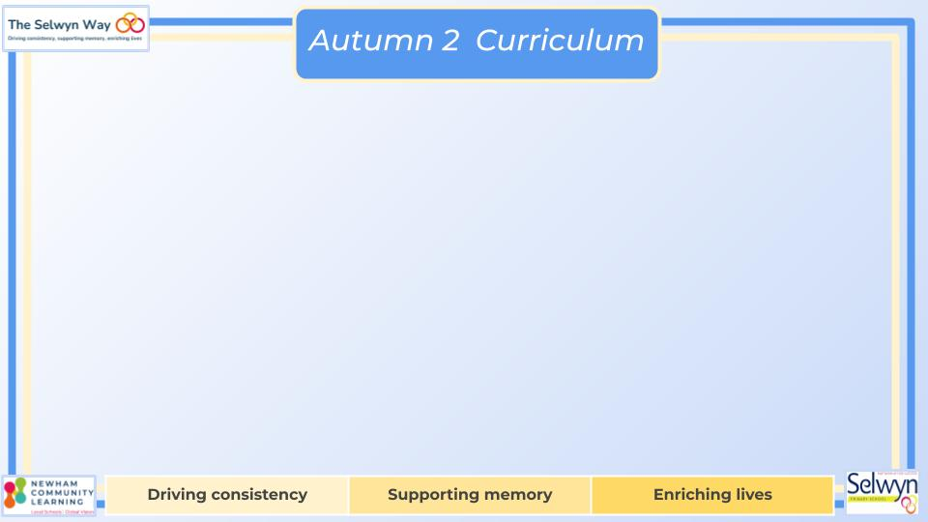
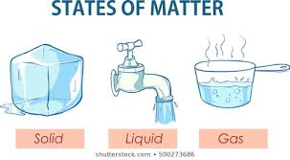


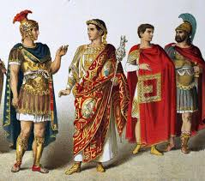

Year 4
English
Computing
Science
Web page creation
Researching information
Sourcing relevant information
Creating pages on a website
Creating links within a website
We are reading:
States of matter
Compare and group solids, liquids or gases
Observe that some materials change state when they are heated or cooled
Identify the part played by evaporation and condensation in the water cycle and associate the rate of evaporation with temperature
Experiment with insulators and how they keep liquids hot or cold
Grammar and punctuation
Use commas after fronted adverbials
Use commas to mark parenthesis with accuracy
Use subordinate clauses to add relevant detail accurately
Writing outcome
Letter of persuasion
Two character descriptions
Non-narrative recount
History
What happened when the Romans
invaded Britain?
What happened when the Romans invaded Britain?
How did life change during the Roman occupation of Britain?
What do historians say about the legacy of Romans in Britain?
A report - How significant was the Roman occupation for Britain?
What happened when the Romans
invaded Britain?
What happened when the Romans invaded Britain?
How did life change during the Roman occupation of Britain?
What can we learn from primary sources?
What do historians say about the legacy of Romans in Britain?
A report - How significant was the Roman occupation for Britain?
Maths
Multiplication and Division
Recall multiplication and division facts for multiplication tables up to 12 × 12
Multiply two-digit and three-digit numbers by a one-digit number using formal written layout
Solve problems involving multiplying and adding, including using the distributive law to multiply two-digit numbers by 1 digit.

Slide 2
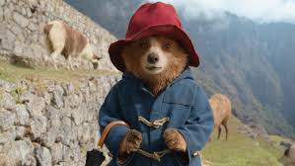
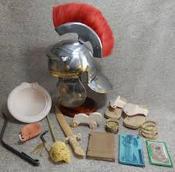
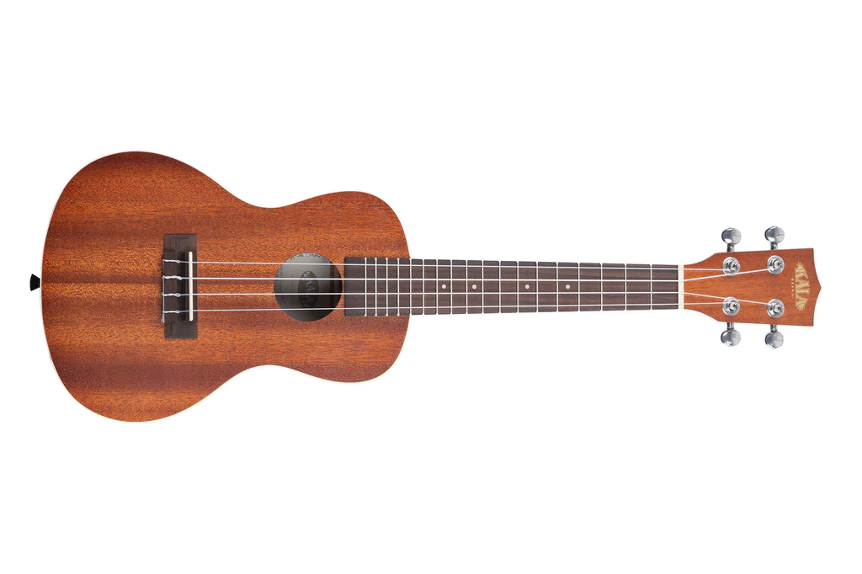

Year 4
Trip to Vue Piccadilly
London Mithraeum Virtual Workshop
Physical Education (PE)
This term your PE will be on:
Fundamental Focus |  | Agility - reaction/response
Sport Specific Focus |  | Static balance - floor work
Whole child focus | PE award for: | Showing Empathy
 | Learning in class about: | Empathising with Others
Religious Education
Why is the Bible a special book?
Why is the bible special?
What is in the bible?
What can we learn from the story of Joseph?
How do Christians use the Bible in the church and in their home?
What inspires and guides me in my life?
Curriculum Enrichment
PSHE
DT
Music
Dreams and Goals
To tell you about some of my hopes and dreams.
To understand that sometimes hopes and dreams do not come true and that this can hurt.
To know how to make a new plan and set new goals even if I have been disappointed.
To know how to work the steps to achieve a goal, and to do this successfully as part of a group.
To identify the contributions made by myself and others to the group’s achievement.
Bridges
Use annotated sketches and prototypes to develop, model and communicate ideas.
Select from and use appropriate tools with some accuracy to cut, shape and join paper and card.
Create designs for a playground bridge inspired by structural engineering used in bridge design.
After much success in Year 3, Year 4 will continue learning to play the ukulele. They will continue to learn chords to accompany songs.
They will also be preparing a song for the winter assembly.
Click here to go back to the main page

