Slide 1
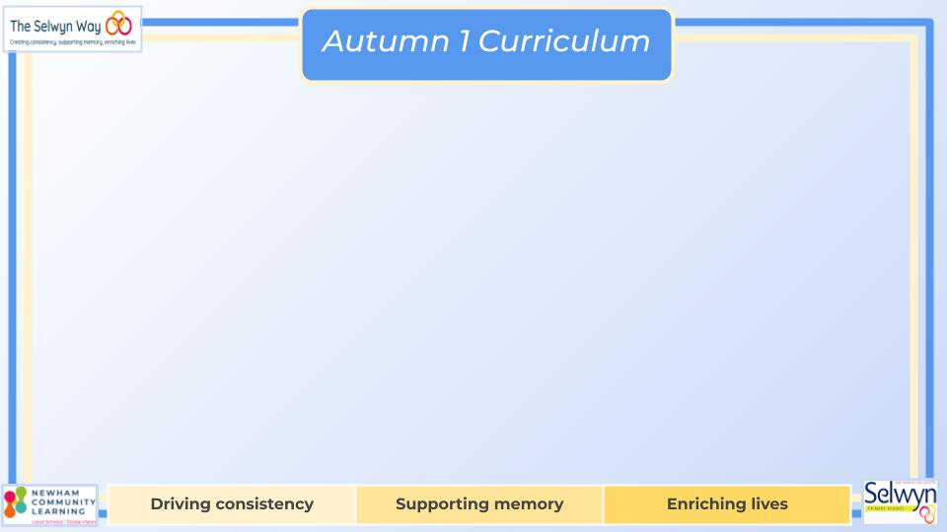
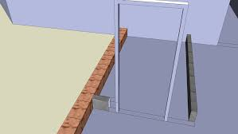


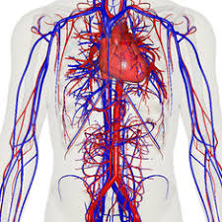
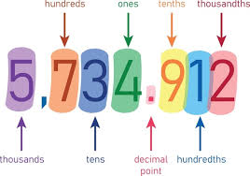

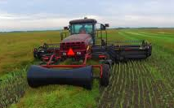
Year 6’s
Computing
English
Science
3D Modelling
- Online Safety: Staying safe on social media
- Understand the difference between working digitally with 2D and 3D shapes
-Make accurate 3D models of physical objects
-Plan, develop and evaluate a 3D model of a photo frame.
Styles of writing to be covered
- Character description
- Balanced discussion
- Narrative description
- Biography/fact file
Grammar
- Experiment with sentence structure to create impact
- Use embedded clauses effectively
- Develop punctuation use for effect
Animals including humans
- Identify the main parts of the circulatory system, and describe their functions.
- Explore how the circulatory system enables the body to function.
- Describe the ways in which nutrients and water are transported.
- Recognise the impact of diet, exercise, drugs and lifestyle on the way their bodies function.
We are reading:
Geography
Local Counties and Industry
- Name and locate the ‘Home Counties’ that border Greater London
- Explore physical and human features of the Home Counties
- Explore how topography affects land use and industries
- Fieldwork investigation into land use along the River Thames in Greenwich
Integers and Decimals
- Represent, read, write, order and compare numbers to 10 million.
- Round numbers, make estimates and use this to solve problems in context
- Solve multi-step problems involving addition and subtraction.
Multiplication and Division
- Identify and use properties of number, focusing on primes.
-Multiply large integers and decimal numbers using a range of strategies.
-Divide integers by 1-digit and 2-digit numbers representing remainders appropriately.
Maths

Slide 2
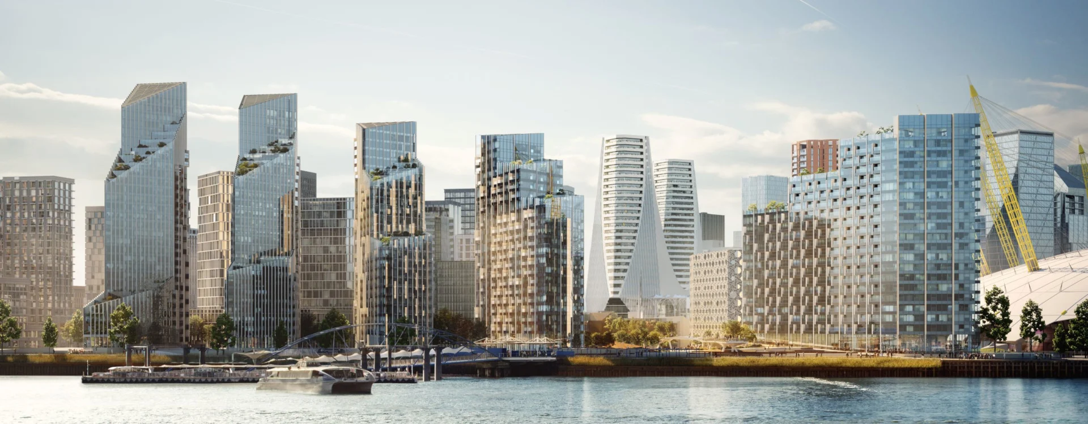
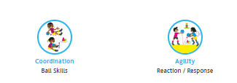

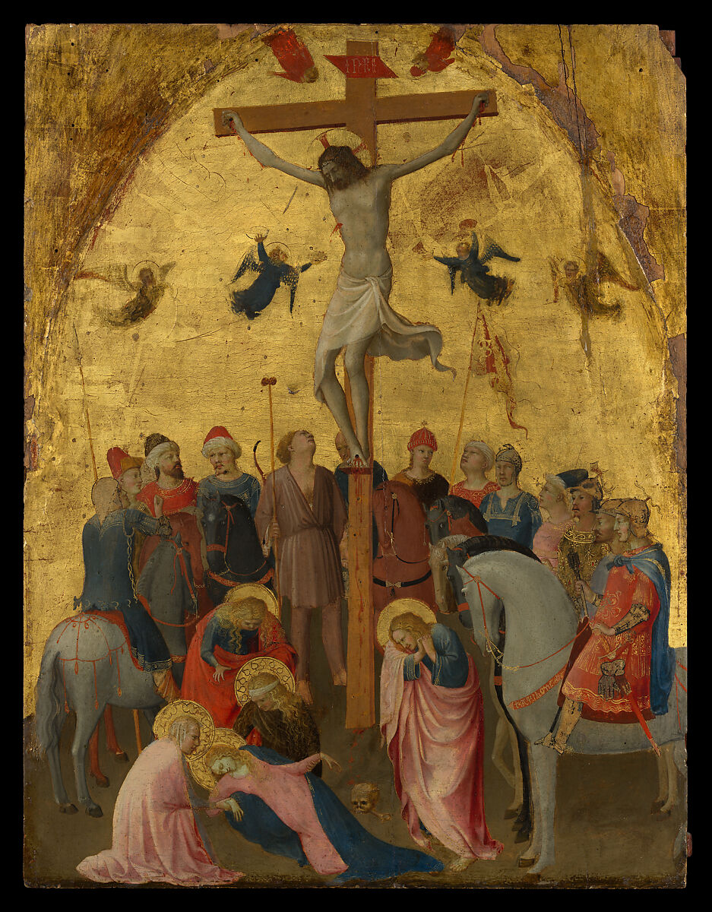
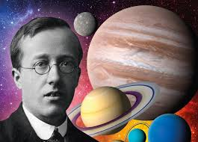
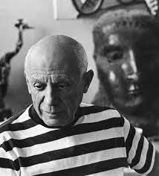
Year 6’s
Children will be taking part in a geography field trip to investigate land use along the River Thames in Greenwich.
Physical Education (PE)
This term your PE will be on: Thursday
Fundamental Focus |  | Reaction/ Response time Coordination - Ball skills
Sport Specific Focus |  | Netball
Whole child focus | PE award for: | Take responsibility for our learning
 | Learning in class about: | Sports Psychology
How do people express their faith through the arts in Christianity?
- Understand various ways people use art to convey and express their faith and beliefs.
- Explore how colours can be employed to communicate religious concepts and emotions within artistic expressions.
- Examine the role of sculpture in religious contexts and discern its significance in conveying spiritual messages.
Religious Education
Curriculum Enrichment
PSHE
Art
Music
Being Me
-Identifying goals and sharing worries about the future.
-Learning about children's rights and why some are not met.
-Understanding how our actions affect others locally and globally.
-Making positive behaviour choices and understanding consequences.
-Exploring how one person’s behaviour can affect a whole group.
-Learning how having a voice and voting helps our school community.
Children will consider how artists, including Picasso, Bacon and Hockney, have manipulated the human image to create distorted and fragmented artworks from multiple viewpoints. Also taking inspiration from artists that have used a map symbolically, children will create a self portrait using different viewpoints and a map of the local area to create a dynamic composition.
We will be focusing on composition this term, using Holst’s ‘The Planet’ as stimulus to write a piece. We have chosen Mars!
Click here to go back to the main page

