Slide 1
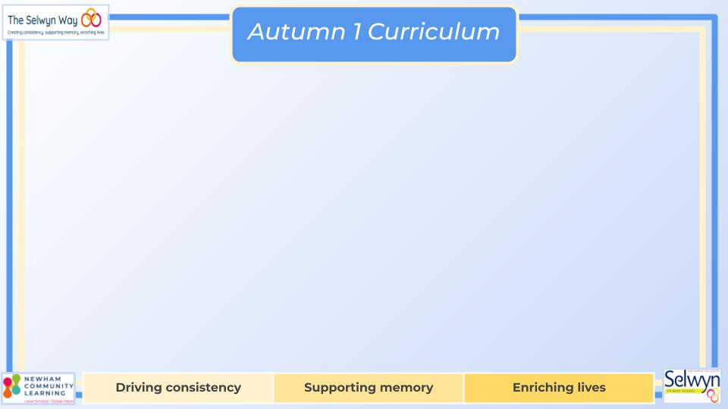


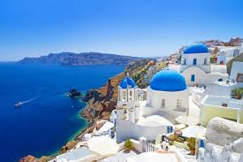
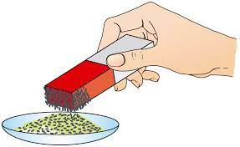
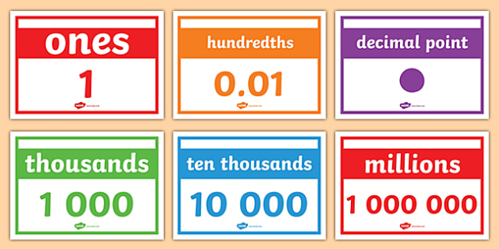
English
Computing
Science
Systems and searching
Lesson 1: Online Safety
Lesson 2: Computer systems and us
Lesson 3: Searching the web
Lesson 4: Selecting search results
Lesson 5: How search results are ranked
Lesson 6: How are searches influenced
Percy Jackson and
the Lightning Thief
Styles of writing to be covered
Description of a minotaur
Recount
Newspaper report
Grammar
Use modal verbs accurately.
Use personal and impersonal language.
Punctuate direct and reported speech correctly.
We are reading:
Materials and their properties
Compare and group together every day materials on the basis of their properties
Give reasons for the particular uses of everyday materials based on evidence
Know that some materials will dissolve and describe how to recover a substance from a solution.
Decide how mixtures might be separated, including through evaporating.
Geography
Greece- How was London 2012 different to Athens 2004?
Lesson 1- Where is Greece?
Lesson 2- What are physical features of Greece?
Lesson 3- What are human features of Greece?
Lesson 4- How was London 20212 different to Athens 2004?
Lesson 5- How was the London Olympics designed to be sustainable? (field visit)
Lesson 6- How was the London Olympics designed to be sustainable? (presentation creation)
Maths
Place Value
Read and write numbers to 1 000 000
Understand the value of the digits
Partitioning numbers
Rounding numbers
Use negative numbers in context
Addition and Subtraction
Mental strategies
Formal written methods
Application of skills through reasoning and problem solving

Slide 2
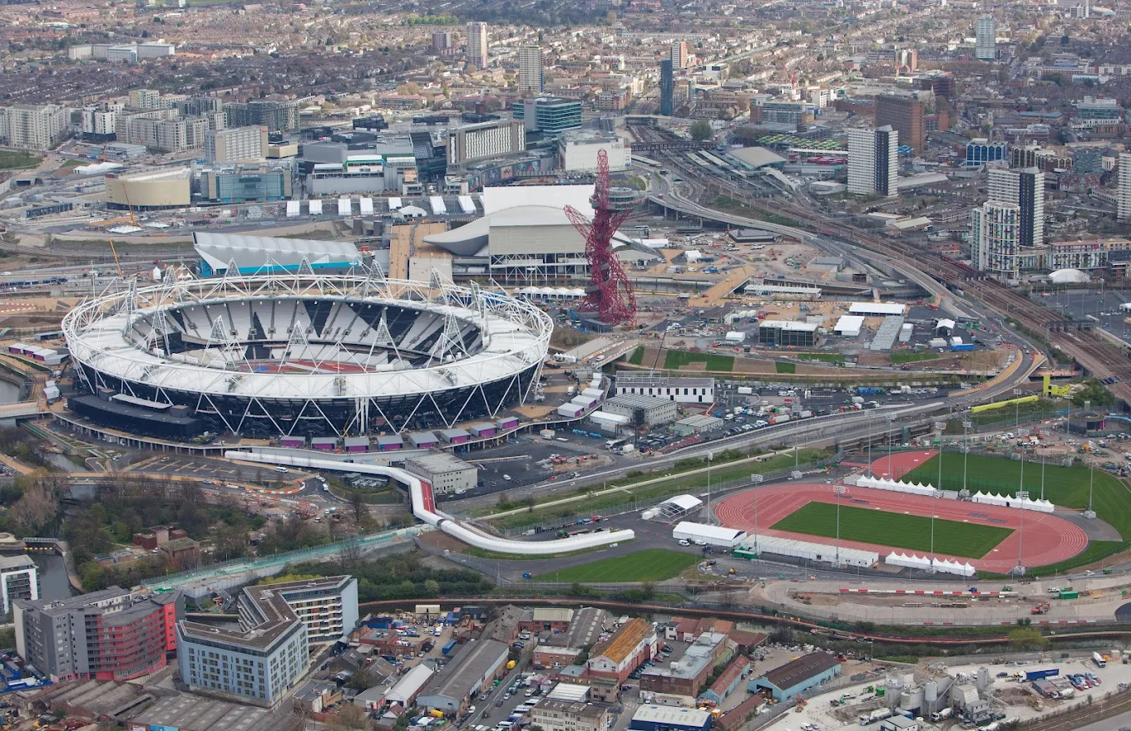




Year 5’s
Geography fieldwork to Olympic park!
Physical Education (PE)
This term your PE will be on: Wednesday
Fundamental Focus |  | Reaction/ Response time Coordination - Ball skills
Sport Specific Focus |  | Basketball
Whole child focus | PE award for: | Embrace challenge
 | Learning in class about: | Challenging yourself
Religious Education
What inner forces affect how we think and behave?
Identify personal triggers and situations that lead to temptation and develop strategies for resisting temptation effectively.
Understand why Adam and Eve didn't listen to God and what we can learn from their story.
Explore why Jonah acted the way he did and what lessons we can take from his actions.
Discover and describe the beliefs we strongly stand by, even when it's tough.
Understand why it can be hard to accept things we know are true and find ways to make it easier.
Curriculum Enrichment
Art
Topic: Drawing monsters of Greek mythology
Product:
Character drawing
Skills:
Tonal drawing
Collage
Ink drawing
Concepts:
Why are Greek myths and monsters so enduring?
Anthropomorphism
Music
PSHE
Year 5 will be writing Protest Songs whilst learning about Ethel Smyth and the Suffragette movement.
They will write and compose their own song before performing it for the whole school!
Our topic for this half term is: Being me
Face new challenges positively and set personal learning goals.
Understand my rights and responsibilities as citizen of the UK.
My rights and responsibilities as a member of our school.
Make choices about my behaviour and understand consequences/rewards.
Understand how democracy and having a voice in a
community can impact me.
Click here to go back to the main page

