Slide 1
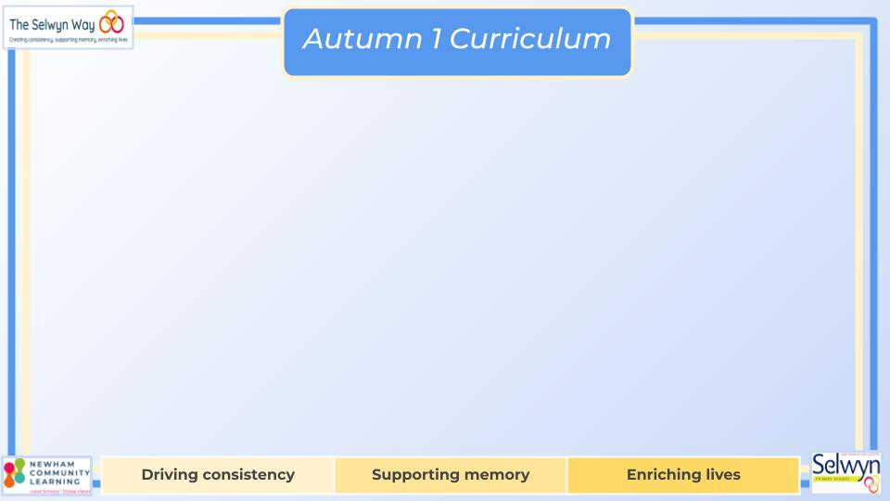

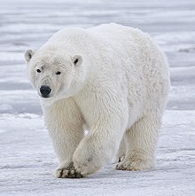



Year 4’s
English
Computing
We are reading:
Science
Web page creation
Researching information
Sourcing relevant information
Using tools e.g image search and spell check
To confidently use a variety of software including internet services
Style of writing to be covered:
Letter writing
Narrative description
Balanced discussion
Explanation
Grammar:
Choose nouns or pronouns appropriately for clarity and cohesion to avoid repetition.
Use brackets, dashes or commas to mark parenthesis with accuracy
Use fronted adverbials to begin a sentence with some accuracy.
Animals and their habitats
Identify how habitats change throughout the year.
Identify how animals are suited to their habitats.
Look at the way humans change the environment and affect animal habitats.
Group animals based upon visible characteristics.
Classify animals using keys.
Geography
Italy
Know the location of Europe on a map and globe.
Know and locate some of Europe's major countries and cities.
Locate Italy using maps and focus on the key physical and human characteristics, countries, and major cities.
Learn about Italian culture and influence of weather, lifestyle and the economy.
Place Value:
4 - Digit place value, Finding 10,100,1000 more or less , Rounding numbers to the nearest 10,100,100
Addition and Subtraction:
Select appropriate strategies to add and subtract using column and regrouping methods
Multiplication and Division:
Times tables, Short multiplication, Multiplying three 1 digit numbers
Maths

Slide 2
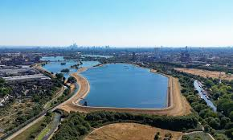

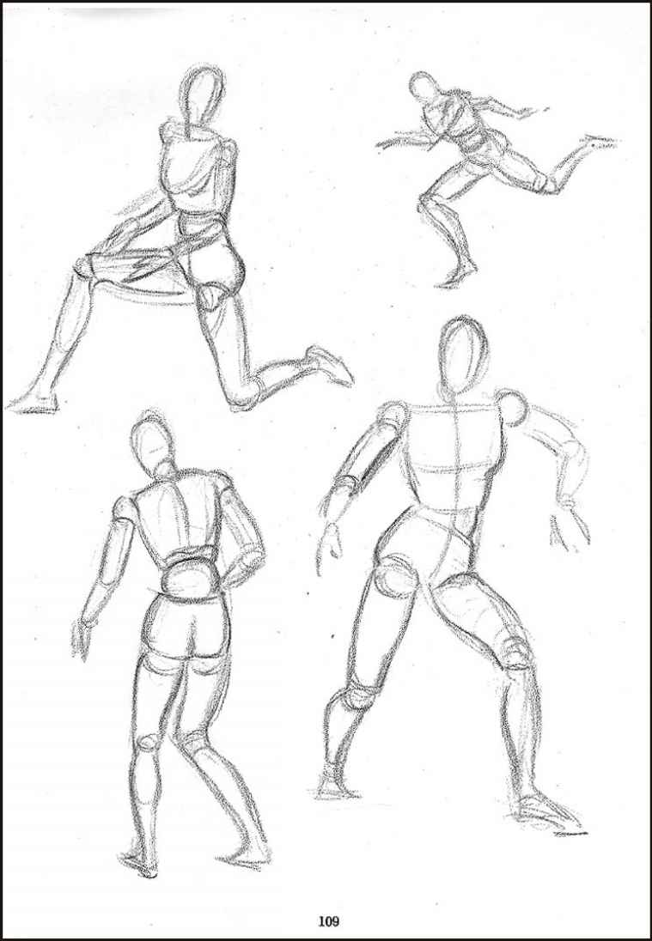
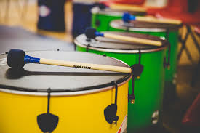
Walthamstow Wetlands - Observe a reservoir and machinery for pumping water
Understand and analyse the diverse perspectives and beliefs about God held by members of the class.
Find out how Hindu people show their beliefs about God, what a shrine is and why it is important. Discover how Hindu people pray and worship in their own houses.
Explore what happens inside a Hindu temple called a Mandir and why it's important.
Understand why prayer is so important in the lives of Hindu people.
Physical Education (PE)
This term your PE will be on: Tuesday
Fundamental Focus |  | Dynamic balance- On a line Coordination - Ball skills
Sport Specific Focus |  | Tag rugby
Whole child focus | PE award for: | Consistently try to improve.
 | Learning in class about: | Attitudes and Actions
Religious Education
Curriculum Enrichment
Music
PSHE
Art
Year 4 will return to Samba drumming this term, learning how to:
● hold drum sticks and make a good sound on my instrument
● follow hand signals from the Samba leader for 5 different sections
● play in time for 1 minute
● play Samba Reggae
● play a groove with 3 different rhythms in
● play different styles of Samba
Being Me
Know my attitudes and actions make a
difference to the class team
To understand who is in my school community, the roles they play and how I fit in
To understand how democracy works through the school council/in this school
To understand that my actions affect myself and others
To understand how groups come
together to make decisions
Drawing
Analyse an artwork
Record movement
Draw a moving figure
Create a dynamic composition
Create an oil pastel drawing
Click here to go back to the main page

