Slide 1
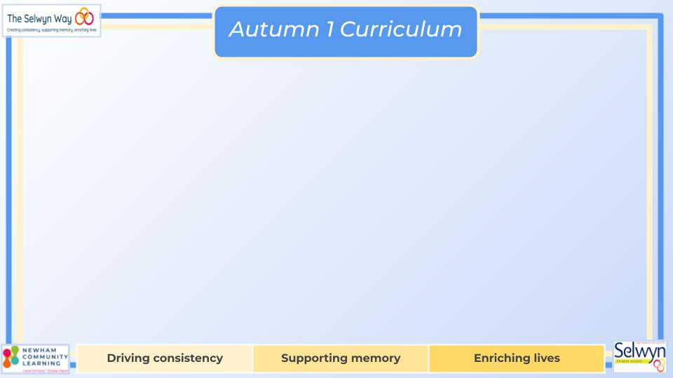


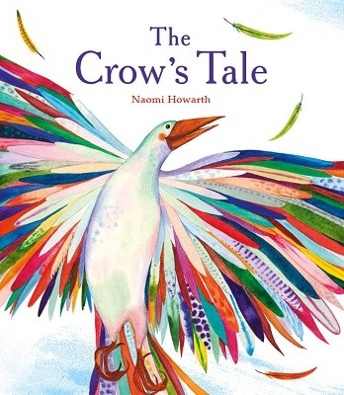


English
Computing
Science
Scratch: Sequence in Music
Create a computerised representation of a piano.
Use motion, sound, and event blocks which they will use to create their own programs.
Create sequences in their program.
Online Safety: learn about how to keep their personal information safe.
Writing Outcomes
Letter to parents to persuade them to let children wear paper bags instead of uniform to school.
A retelling of the ‘The Crow’s Tale’.
A beginner’s guide (explanation / instructions) to making friends.
Grammar
Begin to punctuate sentences using a capital letter and a full stop, question mark or exclamation mark
Adding detail to sentences with an adjective.
We are reading:
Animals (Including humans)
Identify and group animals with and without skeletons and observe and compare their movement.
Explore ideas about what would happen if humans did not have skeletons.
Compare and contrast the diet of different animals (including pets) thinking of ways to group them according to what they eat using the correct terms (herbivore, carnivore, omnivore).
Geography
East of England
To analyse data on a thematic map.
To locate the counties and cities in the East of England.
To read a map using four figure grid references and compass points.
To learn why map symbols are used.
To develop an awareness of how weather conditions affect the East of England.
Maths
Number sense and exploring/Place Value
Addition and subtraction
Word problems
Calculation strategies
Place value
Graphs
Related number facts

Slide 2

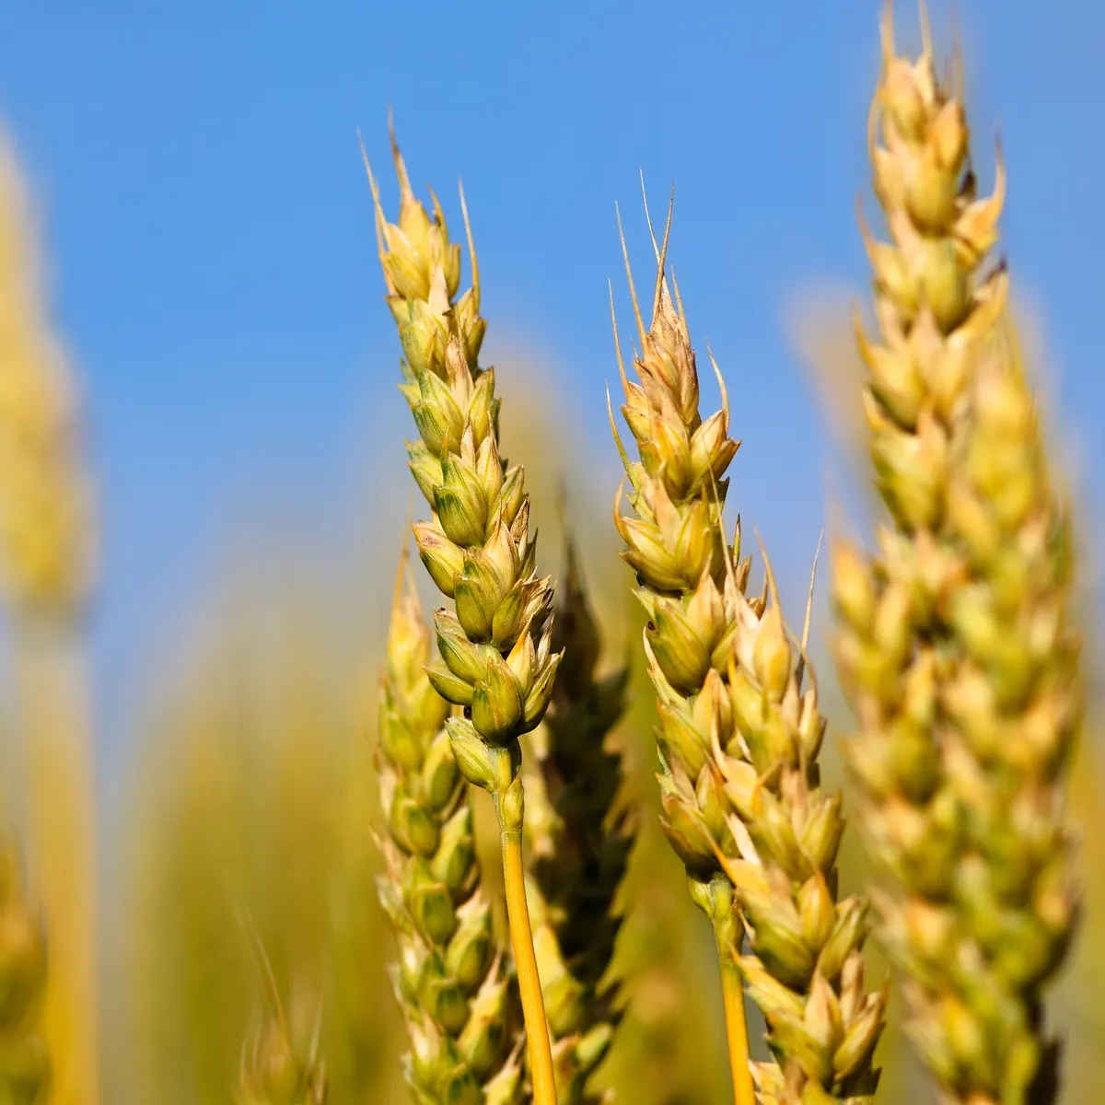
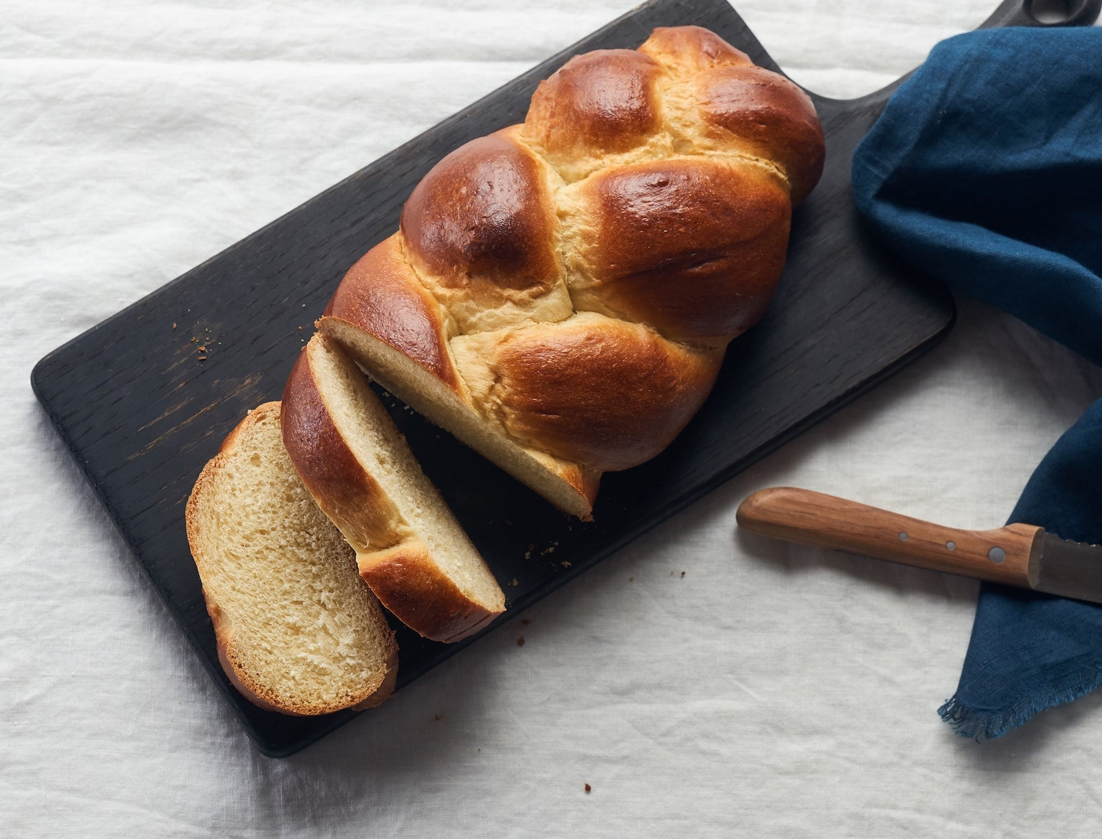

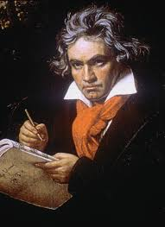
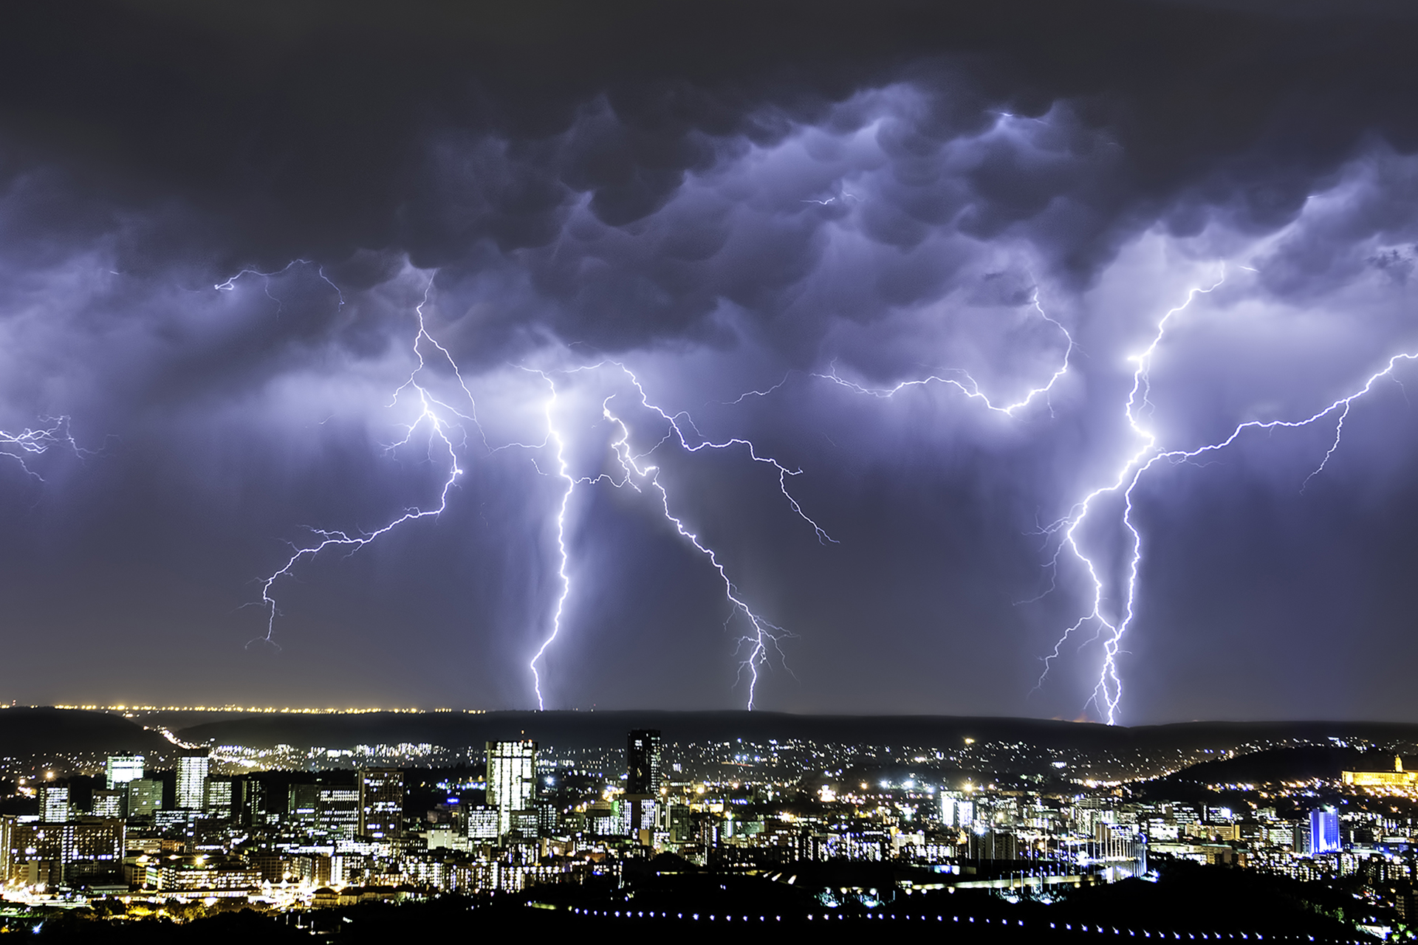
Year 3’s
Geography fieldwork to Rainham Marshes And Bread Making!
Physical Education (PE)
This term your PE will be on: Tuesday
Fundamental Focus
Sport Specific Focus |  | Basketball
Whole child focus | PE award for: | Take Control
 | Learning in class about: | Setting Targets
Religious Education
How did Jesus and Buddha make people stop and think?
Learn about stories, sayings and events that make us think deeply.
Understand the difficulties presented in the story of ‘The Pharisee and the tax collector’.
Explore why some of Jesus' sayings still make people think today.
Think about what Jesus' story of ‘The widow's mite’ means.
Find out who the Buddha was and what stories he told.
Discover how we can use stories, sayings, and events to make others think.
Curriculum Enrichment
Art
Drawing industrial landscapes inspired by Malcolm Teasdale
Analyse an artwork
Represent structure
Represent solid forms
Represent atmosphere
Create a composite drawing
Music
PSHE
Year 3 will be learning about Beethoven this term and will compos music in the style of his 6th Symphony, evoking
a storm…
Being Me
To recognise my worth and identify positive things about myself and my achievements
To face new challenges positively, make responsible choices and ask for help when I need it
To understand why rules are needed and how they relate to rights and responsibilities
To understand that my actions affect myself and others and care about other people’s feelings
To make responsible choices and take action
To understand my actions affect others and
try to see things from their points of view
Click here to go back to the main page

