Slide 1
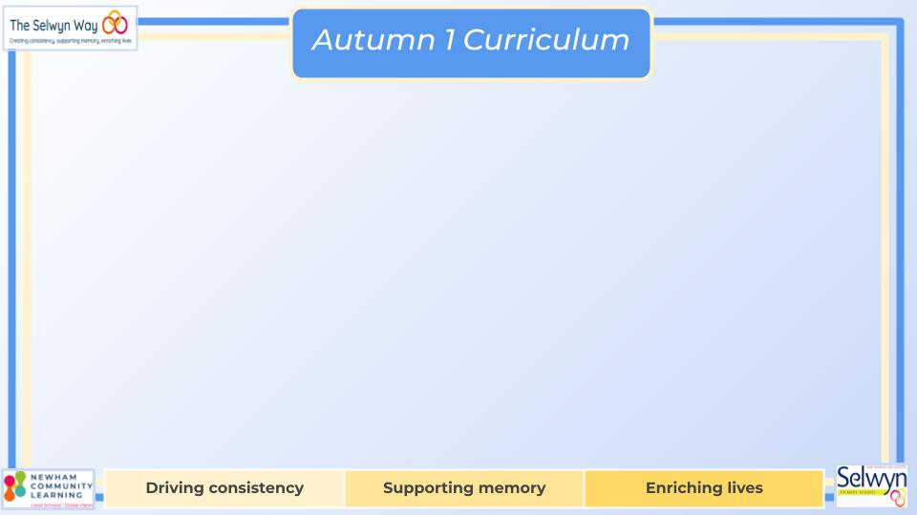



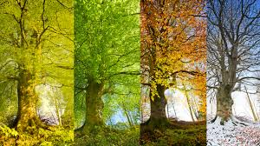
Year 2’s
English
Computing
Science
Digital Photography
Learning about different devices we can use to take photos.
Practise capturing photos on different devices.
Edit an image to improve the photo.
Use the new learning to recognise and explain how they know photos aren’t real.
We are reading:
Animals - Including Humans
• Notice that animals, including humans, have offspring which grow into adults.
• Find out about and describe the basic needs of animals, including humans, for survival (water, food and air).
• Describe the importance of exercise, eating the right amounts of different types of food, and hygiene.
• Describe how animals obtain their food from plants and other animals, using the idea of a simple food chain, and identify and name different sources of food.
The children will be using different texts to support their learning:
The Snail and the whale
Solomon Crocodile
My name is not Refugee
Writing Outcomes
Scene description
Non-chronological report- fact file
Recount-diary entry
Grammar
Identify a statement, question, exclamation or command.
Add detail to sentences using adjectives, verbs, and noun phrases.
Geography
Four Seasons
The children will be exploring the Four Seasons and exploring how weather is different in the UK.
They will also be exploring the UK using maps and identifying countries, seas, oceans and continents.
We will end our Geography topic with an exciting field trip and a weather report.
Maths
Place Value
Count in steps of 2, 3, and 5 from 0, and in tens from any number, forward and backward
Recognise the place value of each digit in a two-digit number (tens, ones)
Identify, represent and estimate numbers using different representations, including the number line
Compare and order numbers from 0 up to 100; use <, > and = signs
Read and write numbers to at least 100 in numerals and in words
Use place value and number facts to solve problems.
Addition and Subtraction
Recall and use addition and subtraction facts to 20 fluently, and derive and use related facts up to 100
Add and subtract numbers using concrete objects, pictorial representations, and mentally, including:
Show that addition of two numbers can be done in any order (commutative) and subtraction of one number from another cannot

Slide 2
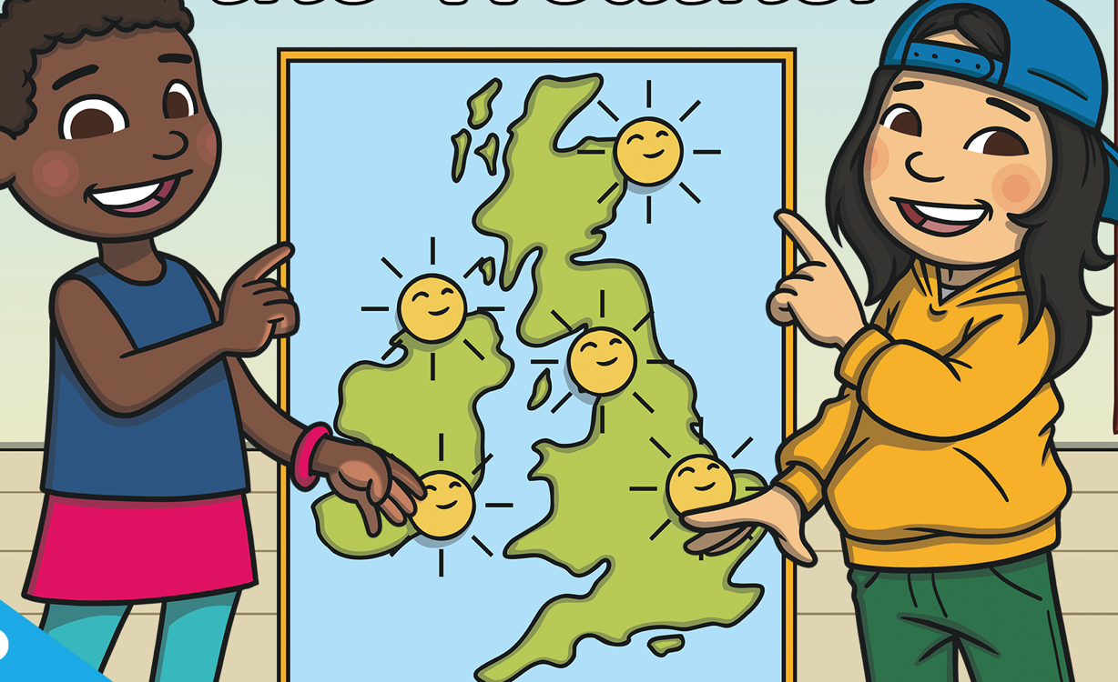


Year 2’s
Children will be taking part in gardening lessons to learn more about how food grows.
Through role play, the children will work in groups to become weather reporters.
Children will also visit West Ham park to observe seasonal changes linking to our Four Season topic
Physical Education (PE)
This term your PE will be on: Tuesday
Fundamental Focus |  | Static Balance - One leg Coordination Footwork
Sport Specific Focus |  | Games - Sending and Receiving
Whole child focus | PE award for: | Keep trying
 | Learning in class about: | Growth mindset
Religious Education
Retell a Christian story and say some things that Christians believe.
Show understanding of what Jesus taught people.
Express how different characters in a parable feel.
Describe what a believer might learn from a religious story or a sacred text and how they would apply this to their life.
Curriculum Enrichment
Drawing UK Landmarks:
In this project children will be asked to consider the work of British artist, Stephen Wiltshire. They will analyse the shapes they can see within the forms of British landmarks. Children will experiment with different drawing media, examining the different effects they can create, and utilise these skills in their final piece.
Art
Music
PSHE
We will be making music using fireworks as a stimulus. We will read the book ‘Olivia Forms a Band’ and create and perform our own firework spectacular in school, culminating in an online concert with players from the London Symphony Orchestra.
Being Me:
Identify some of my hopes and fears for this year
Understand the rights and responsibilities of being a member of my class and school
Listen to other people and contribute my own ideas about rewards and consequences
Understand how following the Learning Charter will help me and others learn
Click here to go back to the main page

