Slide 1
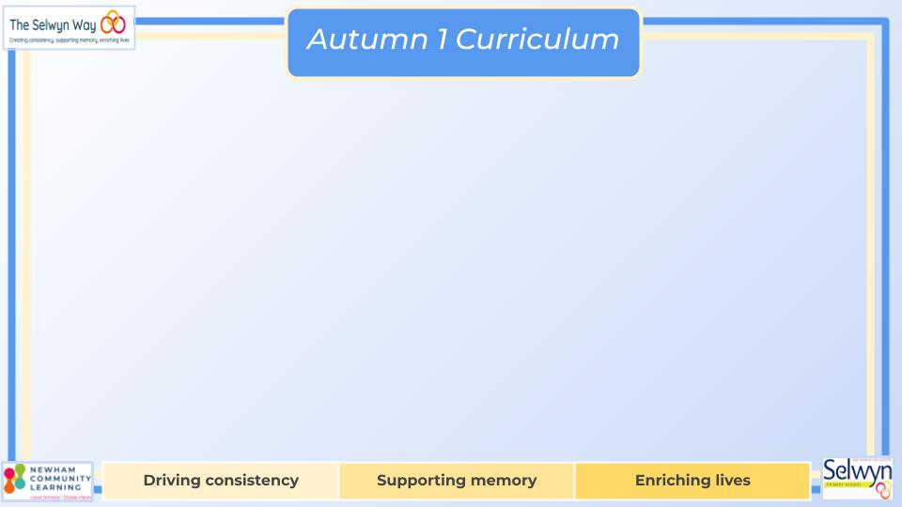

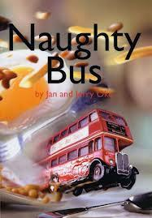



Year 1’s
English
Computing
Science
Understand the importance of only speaking to people we know online
Introduction to coding
Experiment using beebots
Understand the importance of instructions to form algorithms
We are reading:
Identify and name body parts
How do I use body parts to sense the world?
Identify and name parts of an animal
Group animals by observation of their features
Compare and contrast animals by what they eat Identify and name common animals
Grammar and punctuation
Time adverbials
Full Stops and capital letters
Nouns, verbs and adjectives
Writing outcome
A poem
Character description
Two sets of instructions
A story
Geography
We are learning about our local area and will be answering the enquiry question: ‘How are Newham’s parks different to its streets? ’
We will investigate:
Where is Newham?
What are Newham’s features?
How are Newham’s parks different to its streets?
What animal species can we find in a park?
What animal species can we find in a park?
Geography Challenges day
Maths
Place Value
Represent, compare and explore numbers within 10.
One more and one less
Doubling and halving
Addition and Subtraction
Represent and explain addition and subtraction
Commutativity
Addition and subtraction facts
Shape and pattern
Identify, describe, sort and classify 2-D and 3-D shapes
Investigate repeating patterns
Use and follow instructional and positional language

Slide 2
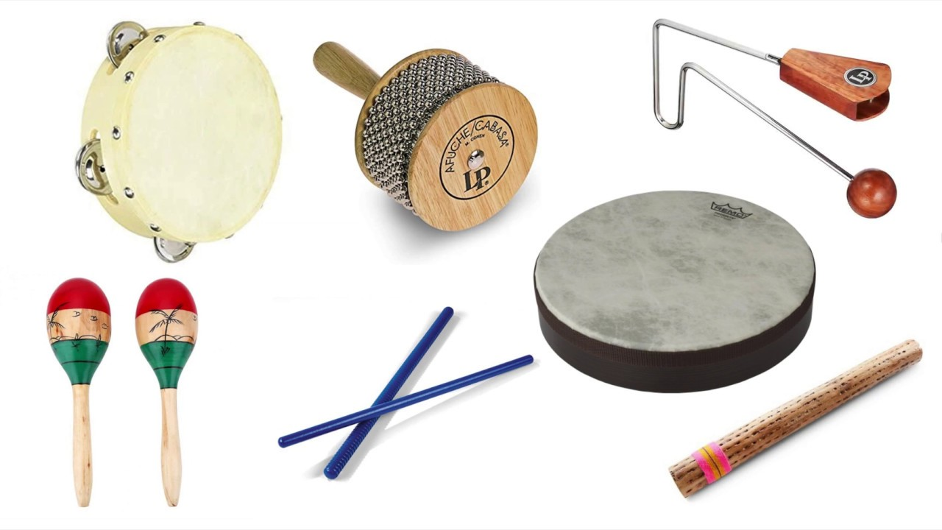
Year 1’s
Children will have the opportunity to work together during the afternoons to explore scientific experiments and understand our world through play.
There will be a visit to West Ham Park to explore different species..
Physical Education (PE)
This term your PE will be on: Wednesday
Fundamental Focus |  | Sending and Receiving Reaction Time
Sport Specific Focus |  | Games - Sending and Receiving
Whole child focus | PE award for: | Stay on task
 | Learning in class about: | Staying safe
Religious Education
How do you live well with family and friends?
Identify personal strengths and unique qualities.
Recognise various special places within homes.
Understand the significance of Friday night in Jewish households.
Explain Hindu customs fostering care between siblings.
Analyse the role of the Bible in facilitating forgiveness within Christian families.
Evaluate the significance of family and friends in one's life
Curriculum Enrichment
Art
Music
PSHE
Drawing our local area
Analyse art work
Experiment with line
Experiment with outline
Draw natural features
Create a skyline
The children will be learning to use their voices expressively in music this term, learning a range of songs and chants.
They will be listening to a variety of music too and finding a steady beat.
They will also have the opportunity to play a range of untuned percussion!
Being me
To understand what it means to feel safe
To understand the rights and responsibilities as a member of my class
To know my views are valued
To understand there are consequences to my
actions
Click here to go back to the main page

