Slide 1
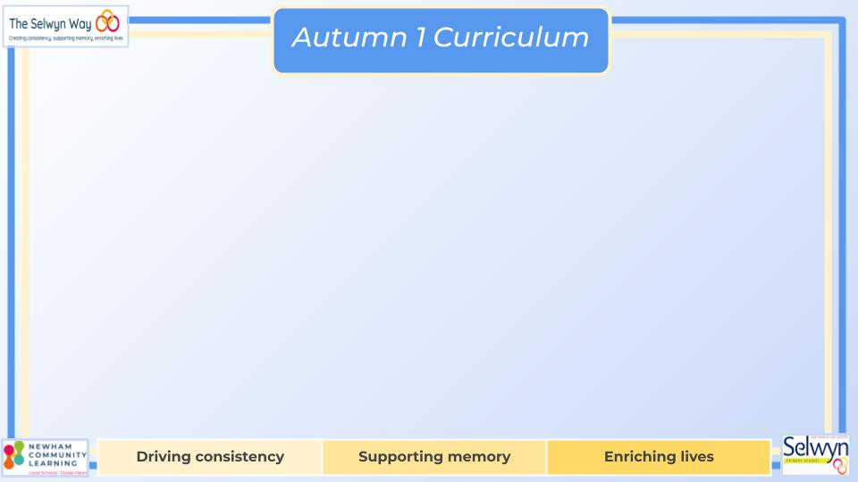
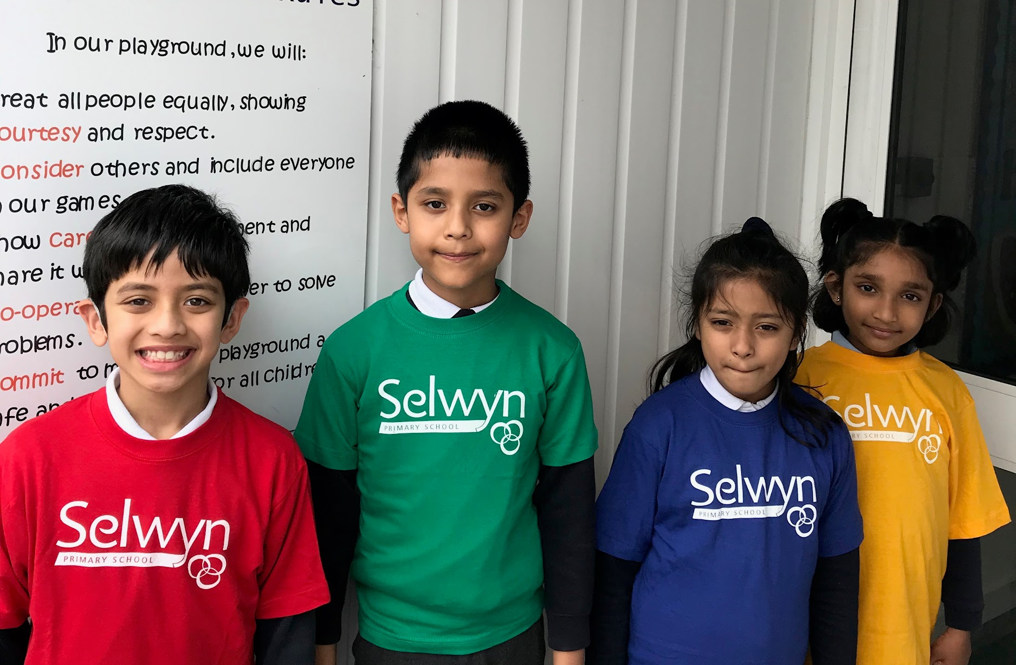

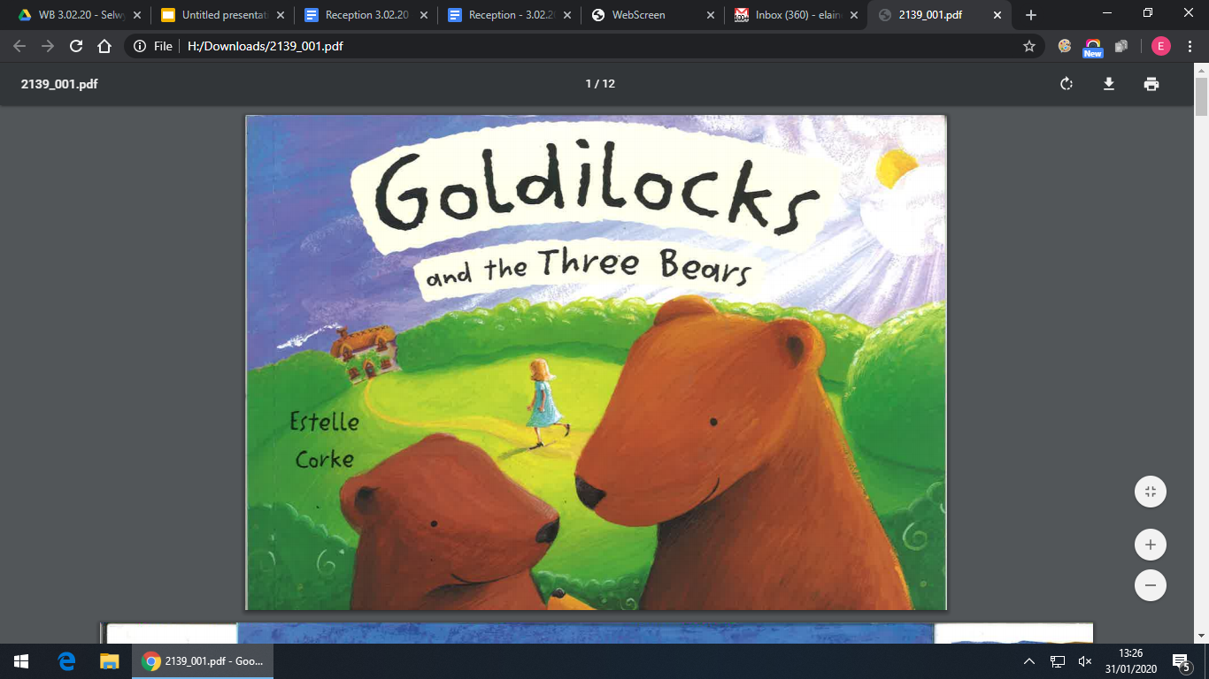
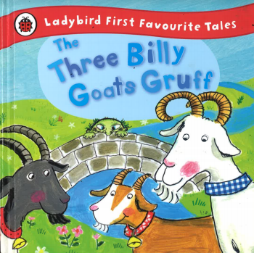
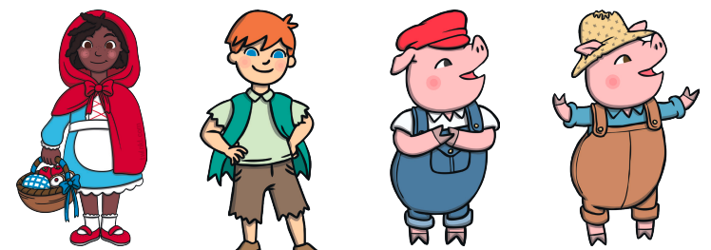
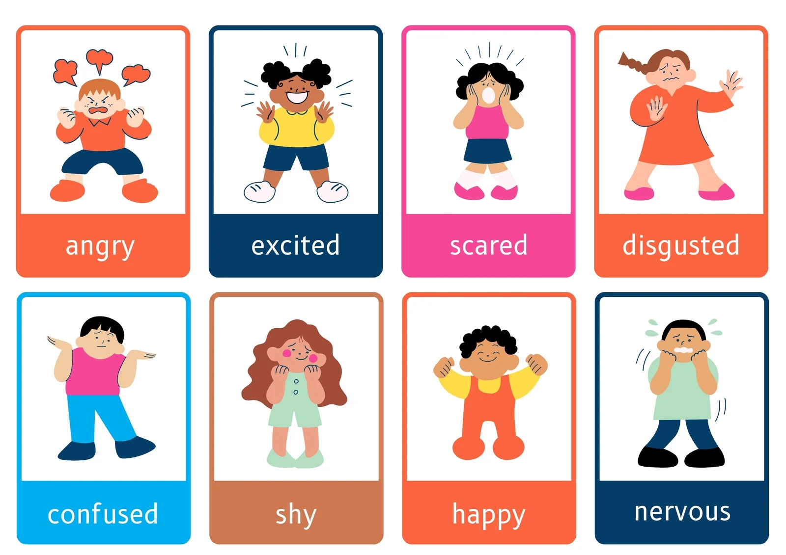
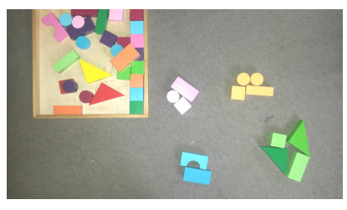
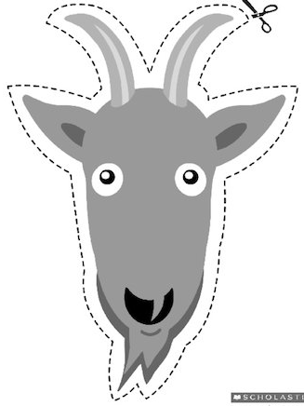
Reception’s
PSED
Literacy, communication and language
Personal, Social & Emotional Development
Our topic is ‘Being Me’.
These are the objectives we will cover:
I understand how it feels to belong and that people can be similar or different.
I can start to recognise and manage my feelings.
I can work together and consider other people’s feelings.
I understand why it is good to be kind and use gentle hands.
Physical development
Understanding of the world
Our PE is on Monday morning.
Please wear your PE kit to school.
To develop physically we will:
revise some of our fundamental movement skills: rolling, crawling, jumping and hopping.
practice our pencil grip
Refine a range of ball skills including: throwing and catching
We are reading:
To develop our communication and language we will:
- Read traditional tales including The Gingerbread Man, Goldilocks and the Three Bears
- Begin to recognise the key language shared in the quality texts.
- Begin to use language specific to the text.
- Begin to spell CVC words using the teacher model and compose phrases that can be read by others.
Our topic this term is ‘Fairytales’.
We will be using discussion, looking at similarities and differences between different characters.
We will draw upon the children's experiences. We will also explain some similarities and differences between life in this country and other parts of the world.
Expressive art and design
For our expressive arts and design activities we will:
engage in imaginative role-play based on own first-hand experiences
explore the different sounds of instruments.
make gingerbread biscuits and The Three Billy Goats Gruff masks along with other creative arts and crafts.
Mathematics
Our first term will be spent giving children exposure to early mathematical experiences with concrete objects, pictures and shapes: :
sorting
matching
comparing
ordering
Click here to go back to the main page

