Slide 1
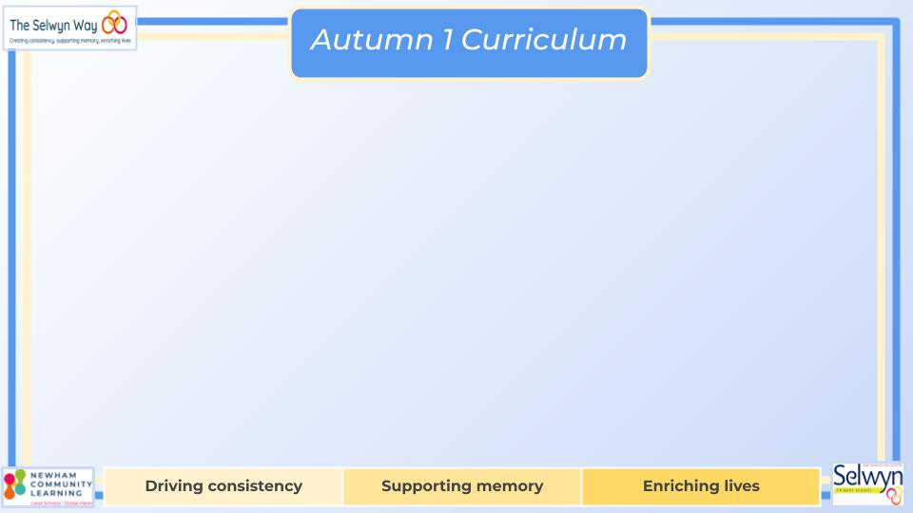
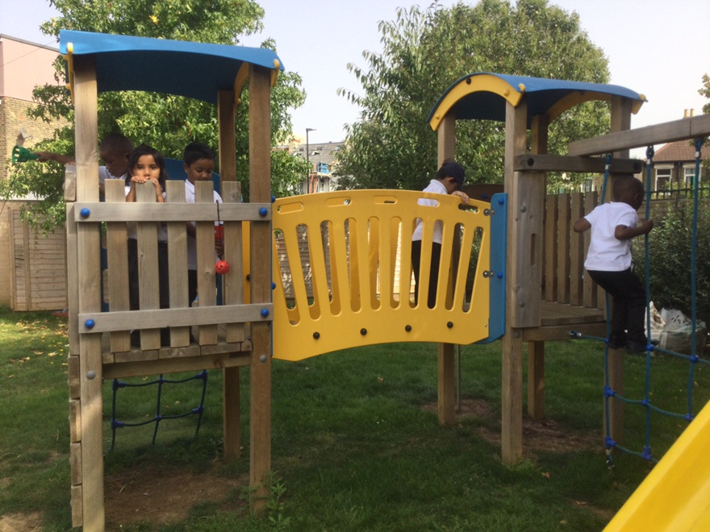


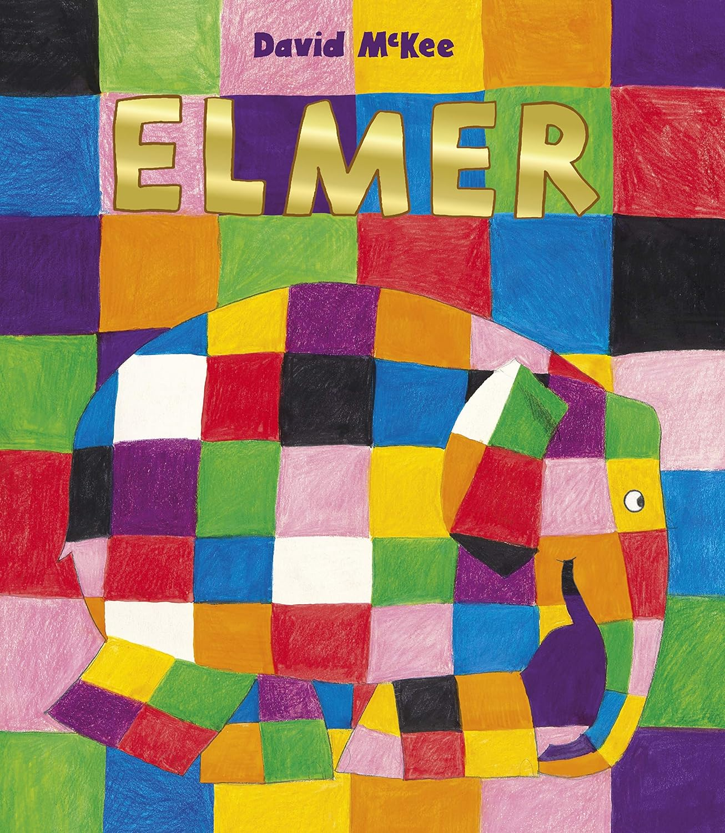
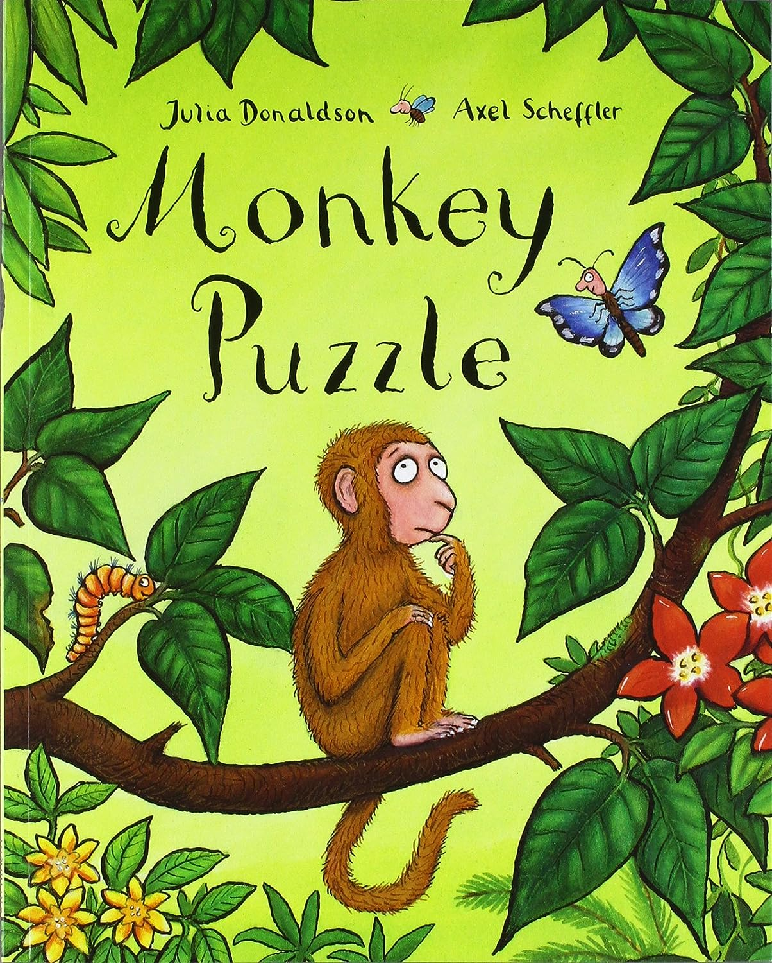
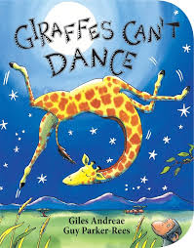

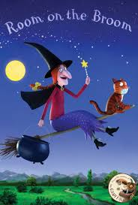
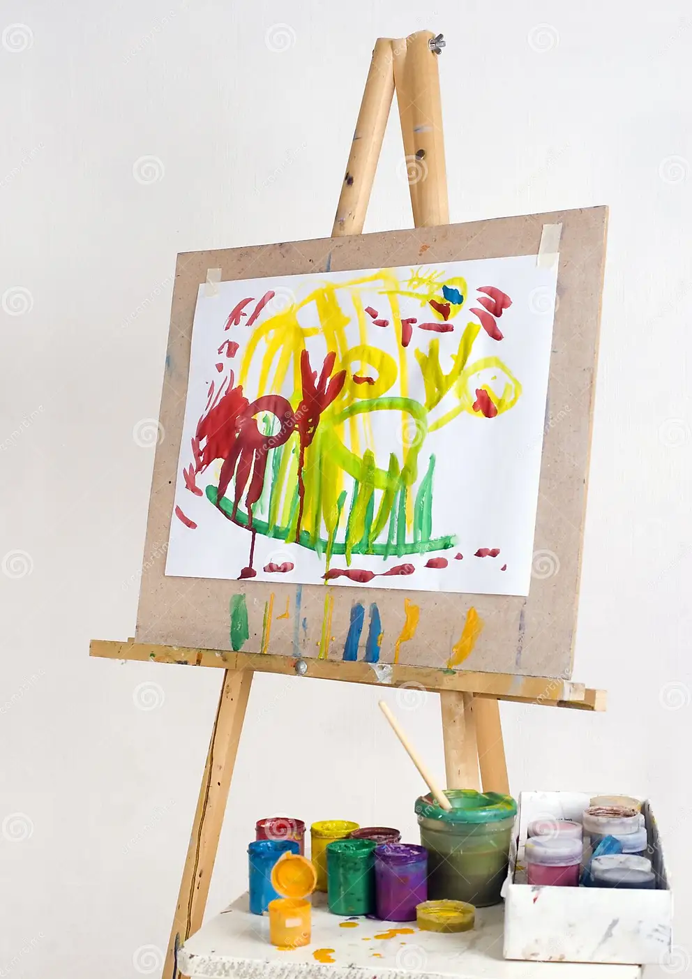
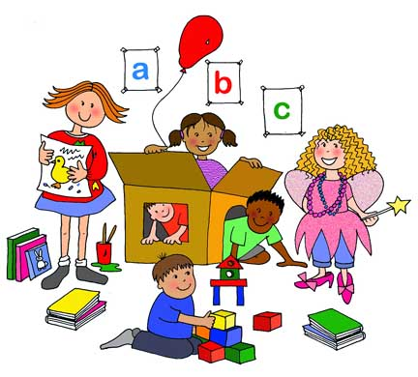
Nursery’s
PSED
Literacy, communication and language
We are reading:
This term through a range of different activities, children will learn to:
Show more confidence in new social situations.
Select and use activities and resources independently
Play in a group and share equipment with peers
Learn to understand our feelings and how to express them.
Learn to use kind hands and how others may feel when we are not kind.
Looking at how we may all be different yet similar.
Understanding of the world
Physical development
We will be using all our senses in exploring the world around us by:
Talking about our own experiences
Describing special times and events such as holidays, celebrations
Looking at habitats of different animals
Understanding the need to respect and care for the natural environment and all living things.
Looking at how animals grow and their cycle e.g. Frogs start off as spawns…
To develop physically we will:
Continue to develop their movement, balancing, riding (scooters, trikes and bikes) and ball skills.
Go up steps and climb up apparatus, using alternate feet.
Skip, hop, stand on one leg and hold a pose for a game like musical statues.
Using a variety of equipment to develop hand coordination such as paint brushes, scissors
We will be extending children’s vocabulary by explaining unfamiliar words and concepts.
Children will encouraged to;
Listen to stories
Retell a past events
Join in with repeated phrases in rhymes and stories
Answer comprehension style questions verbally as they go through the story
Give meaning to marks as they draw, paint and write.
Expressive art and design
We will explore different materials independently including using construction materials for different projects.
We will be expressing ourselves by: dancing and moving like animals and sing songs about book related animals
We will explore colours and how colours can be changed using paint, coloured water and light.
Mathematics
Through games and stories we will be:
Using number names and number language
Reciting numbers in order to five/ten
Counting how many objects there are
Playing with shapes and making arrangements with objects.
Looking at patterns using two colours/ shapes
Click here to go back to the main page

