Slide 1
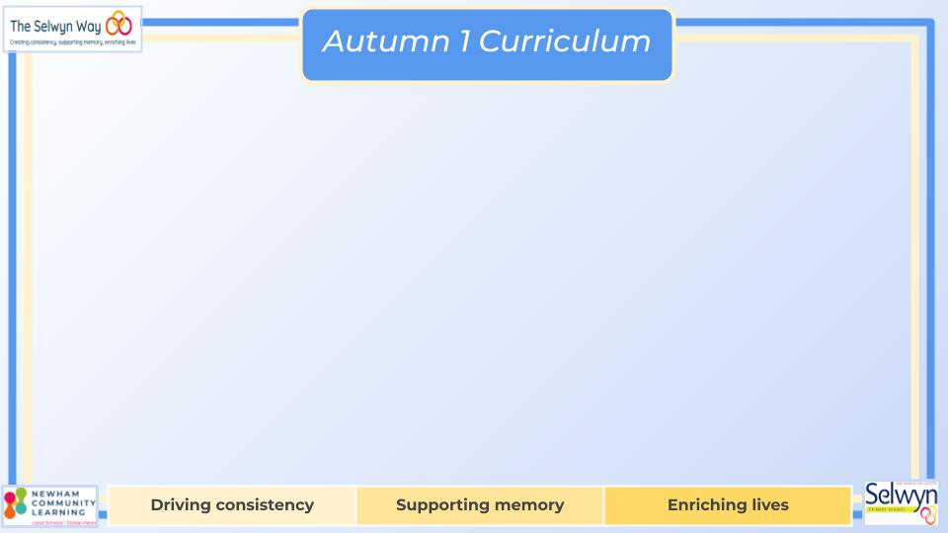
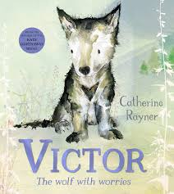
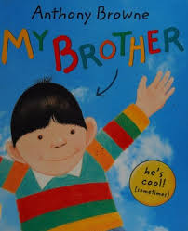

Butterfly, Bumblebee & Ladybird
Maths
Reading and Writing
We are reading:
Butterfly
This term, Butterfly Class will be exploring a variety of writing genres inspired by the books they are reading. They will create a detailed character description using adjectives and similes, following the Colourful Semantics structure to develop sentence-building skills. The children will also learn strategies to manage their emotions and write a supportive poem to help friends who may feel anxious. In addition, they will explore the theme of families and use their creativity to write an imaginative story about their own family. Through these activities, Butterfly Class will develop their descriptive, expressive, and creative writing skills.
Butterfly
This autumn, Butterfly will develop their maths skills by reading and writing numbers to 100, extending to 200, and partitioning 2-digit numbers into tens and ones in different ways. They will find 10 more and 10 less, add and subtract 2-digit numbers with ones and tens without regrouping, and recall number bonds to 10, extending to bonds within 20. Butterfly will count in 2s, 5s, 10s, 50s, and 100s, recall multiplication and division facts for the 2, 5, and 10 times tables, and understand commutativity. They will also interpret pictograms and bar charts, solving related problems using their counting skills.
Bumblebee
This term, Bumblebee Class will be exploring stories through role play and practical activities, helping to bring narratives to life and deepen their understanding. They will be encouraged to enjoy stories independently, fostering a love for reading. In writing, the focus will be on developing sentence structure using the Colourful Semantics approach and beginning to extend sentences with more descriptive language. There will be an emphasis on inspiring the children to ‘fall in love’ with writing, building their confidence and creativity. By the end of the term, Bumblebees will be encouraged to become more independent and expressive writers.
Bumblebee
This autumn, Bumblebee will focus on building strong foundations in number and calculation. They will learn to read and write numerals 0–9, recognise numbers up to 20, and develop one-to-one correspondence when counting. They will say numbers 1–5 in order, match objects to numbers, and understand that the last number counted represents the total. They will subitise small groups, count accurately up to 10, and solve simple addition and subtraction problems within 5 using +, –, and = symbols. They will explore commutativity and inverse relationships, recall number bonds to 10, partition numbers to 20, and begin adding and subtracting 2-digit numbers.
Ladybird
This term, Ladybird Class will be exploring stories through a range of multi-sensory resources, helping to make storytelling engaging and interactive. They will focus on illustrations within books and link them to Colourful Semantics keywords to support understanding. In writing, the Ladybirds will concentrate on developing their fine motor skills and strengthening their pencil grip, with access to a variety of writing tools to encourage early mark-making. They will work on the initial stages of Colourful Semantics, becoming familiar with identifying the ‘who’ in stories. Stories will also be explored through exciting multi-sensory tuff tray activities, incorporating the messy play they love.
Ladybird
This autumn, Ladybird Class will focus on developing early number awareness and counting skills through songs, play, and practical activities. The children will enjoy joining in with familiar number rhymes, supporting adults when counting, and helping to make groups of “one,” “two,” and “lots.” They will learn to recognise and represent the numerals 1 and 2 using fingers, objects, or gestures, as well as begin to recognise numerals up to 10. Ladybirds will practise giving one or two objects when asked, responding to requests for “more,” and stopping or starting with countdowns, helping them build confidence with early mathematical concepts.

Slide 2
PSED
Communication
Physical development
Building relationships
Children will use talk to resolve disagreements, consider others’ views, and show interest in other people’s ideas, developing social understanding and relationships.
Managing self
Children will recognise unacceptable behaviour, express their needs and feelings appropriately, and understand that others may have different thoughts and perspectives.
Self-regulation
Children will enjoy making their own decisions and begin to show self-confidence in expressing their wants and interests to others.
Understanding of the world
Listening, attention and understanding:
This term, children will practise expressing actions and reasons using words, signs, or symbols, verbalise or show different emotions, and follow directions from staff to support communication and understanding.
Speaking:
This term, children will practise asking simple “why” questions, describing objects using multiple properties, and responding to adults when offered a choice of motivating items, supporting curiosity and communication skills.
Geography
In Geography, children will study Europe with a focus on Italy, exploring its food, culture, music, and daily life to gain an understanding of Italian traditions and lifestyle.
Science
In Science, they will learn about habitats for animals and other living things, including woodlands and forests, deserts, polar regions, and oceans, discovering how creatures adapt to their environments.
Gross Motor Children will practise giving others space and using cutlery independently to support coordination and self-care skills.
Fine Motor They will develop control over pressure in their hands and practise snipping with scissors to strengthen dexterity.
Expressive art and design
Children will choose colours to begin their paintings and use coloured paper to create people, developing creativity, fine motor skills, and their ability to express ideas visually.
This term, children will use their imagination in music, dance, and storytelling, improvise simple rhythms, and explore a widening range of musical instruments to develop creativity and musical confidence.
Music
Click here to go back to the main page

