Slide 1
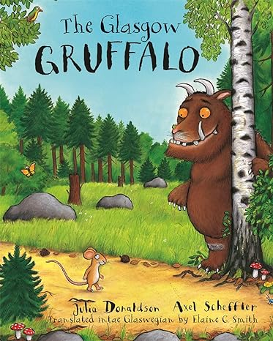
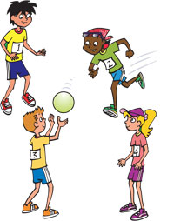
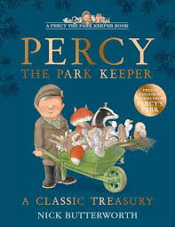
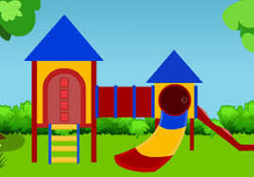
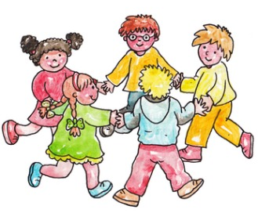
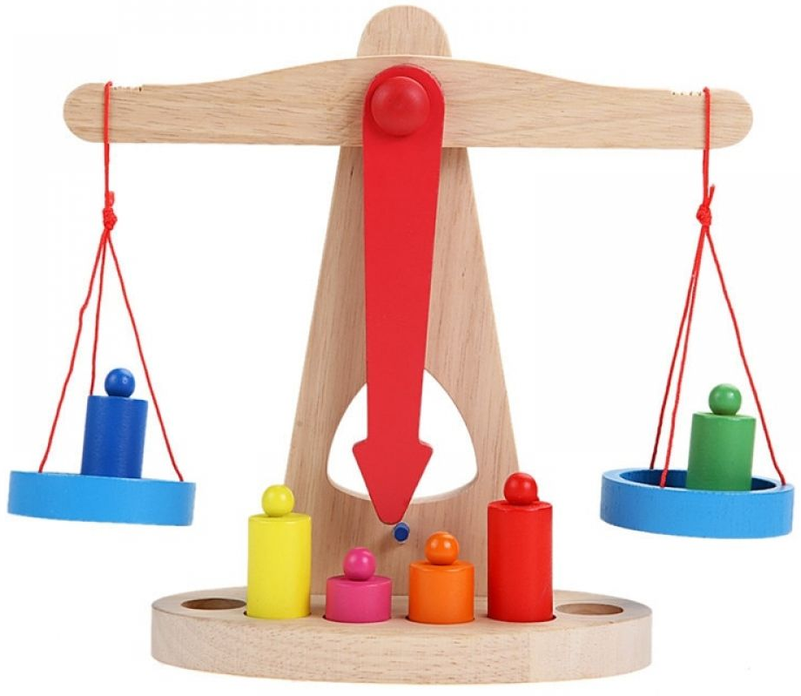
Literacy, communication and language
We are reading:
Physical development
PSED
Understanding of the world
In free play we will:
Use a pencil with increasing control.
Correctly form letters.
Observe the effects of activity on our bodies.
Throw, catch and kick balls of different sizes.
Learn to control our movements and imitate animals from the stories
Reading stories about animals and their habitats, we will learn to:
Listen to and retell stories.
Ask and answer a range of questions about a story.
Write recognisable letters and words.
Engaging in discussions related to what we can learn from each story
We will explore the world around us by:
Comparing different locations.
Showing concern for living things and the environment.
Talking about changes over time.
Look at the life cycle of some of the animals from the stories for example- the life cycle of a butterfly
Through a range of different activities, children will learn to:
Become more confident in new situations.
Extend and elaborate on ideas for playing.
Increasingly follow rules, understanding why they are important.
Learn to understand the feeling of others around us and learn to compromise in our play
Use dialogue to express opinions and resolve issues that may arise during play
Expressive art and design
We will be learning to:
Play ring games.
Join different materials together.
Make our own props for role-play
Create characters from stories using different materials
In Music Lessons, we will
Copy and create rhythms.
Remember and sing entire songs.
Learn songs for our performance
Mathematics
Through games and activities we will:
Using language of time (before, later, soon).
Showing an interest in maths problems.
Comparing quantities.
Matching numerals with quantities.
Adding numbers below 10
Weighing different objects
Creating and completing patterns
Click here to go back to the main page

