Slide 1
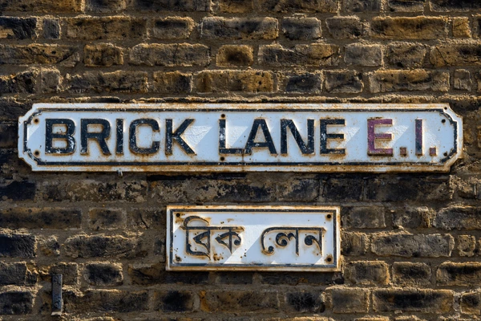
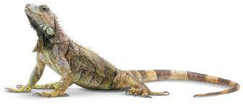
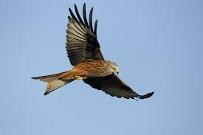
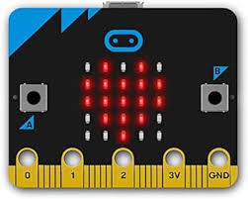
Year 6
English
Changing East End
Investigating how the East End has changed throughout history from Roman times to present day
Investigating post-war migration and how East London became an international ‘melting pot’ of different cultures
Finding out family stories of migration
Science
History
‘Styles of writing to be covered
Newspaper Report
Persuasive letter
Grammar
Use expanded noun phrases to convey complicated information concisely
Use the subjunctive in the most formal writing
Use semicolons to link independent clauses
We are reading:
Living things and their habitats
Learn how to classify invertebrate arthropods.
Understand how predation impacts the adaptation of species.
Explore the classification of reptiles.
Study the adaptations in birds of prey.
Investigate how different environments influence the adaptation of animals.
Computing
Programming movements: Micro:bit
Understand how conditions are used in programs.
Use the ‘if...then...else…’ block
Plan a quiz using a storyboard
Design, write and debug programs that accomplish specific goals, including controlling or simulating physical systems; solve problems by decomposing them into smaller parts.
Use sequence, selection, and repetition in programs; work with variables and various forms of input and output.
Maths
Problem-solving and applied maths focus
Mixed problem solving for example involving number, statistics, probability and algebra
Collecting, interpreting and representing data
Comparing types of average - mean, mode and median
Investigating the mathematics behinds shapes - spirals, hexagons and helixes
Investigating and drawing shapes - patterns, transformations, rotations, reflections

Slide 2
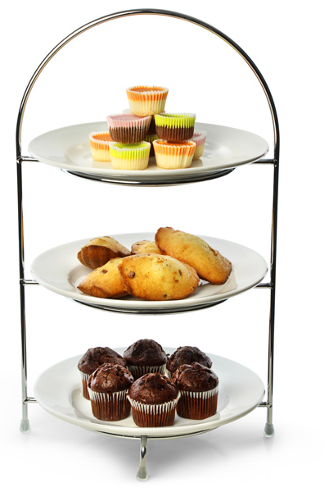
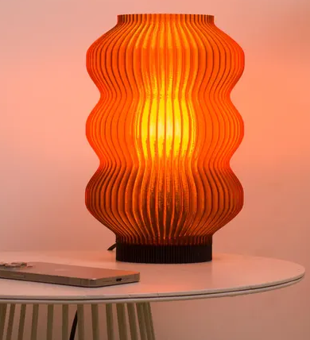
Gardening Sessions
Sports Competitions
Violin Performance
Afternoon Tea Party
Year 6 Production
Celebration trip (TBC)
Physical Education (PE)
This term your PE will be on:
Fundamental Focus |  | One leg balance Jumping and landing
Sport Specific Focus |  | Athletics
Whole child focus | Learning to: | Plan personal fitness
 | Learning about: | Specificity training & Developing training programmes
Religious Education
How could we design a celebration that involved everyone?
Understand the reasons why we have celebrations and their significance.
Learn about what makes celebrations in Islam special.
Explore what makes celebrations in Christianity special.
Compare and contrast a Muslim celebration with a Christian celebration.
Discuss the appropriateness and benefits of participating in the celebrations of other religions.
Learn how to make a celebration inclusive for everyone.
Curriculum Enrichment
Music
In PSHE year 6 will be learning about Growing and Changing:
To become aware of their own self-image and how their body image fits into that.
To recognise the importance of positive self-esteem and learn strategies to develop it.
To understand that there are good choices and bad choices and to realise they are decision-makers.
To identify what they are looking forward to and what worries them about transitioning to secondary school
To learn how a baby is made and grows (conception and pregnancy)
DT
Year 6 will be putting all their efforts into learning the songs and actions From the musical Oliver! Please
ensure you come and see the show
Thursday 10th July (@5.30PM) - Thursday 11th July (@8.50am).
We will also be performing with our violins at the Primary Cluster Day at Lister on Thursday 26th June. Parents and carers are invited to watch the short concert 2:30 - 3pm.
PSHE
Children will look at how lamp design has evolved over time.
Children will experiment with and test materials and structures, create design drawings before developing a final design.
They will test and evaluate their lamps, assessing their luminosity and visual impact.
Click here to go back to the main page

